Slide 1


Notes:
Welcome to ConnectAmericas

Slide 2
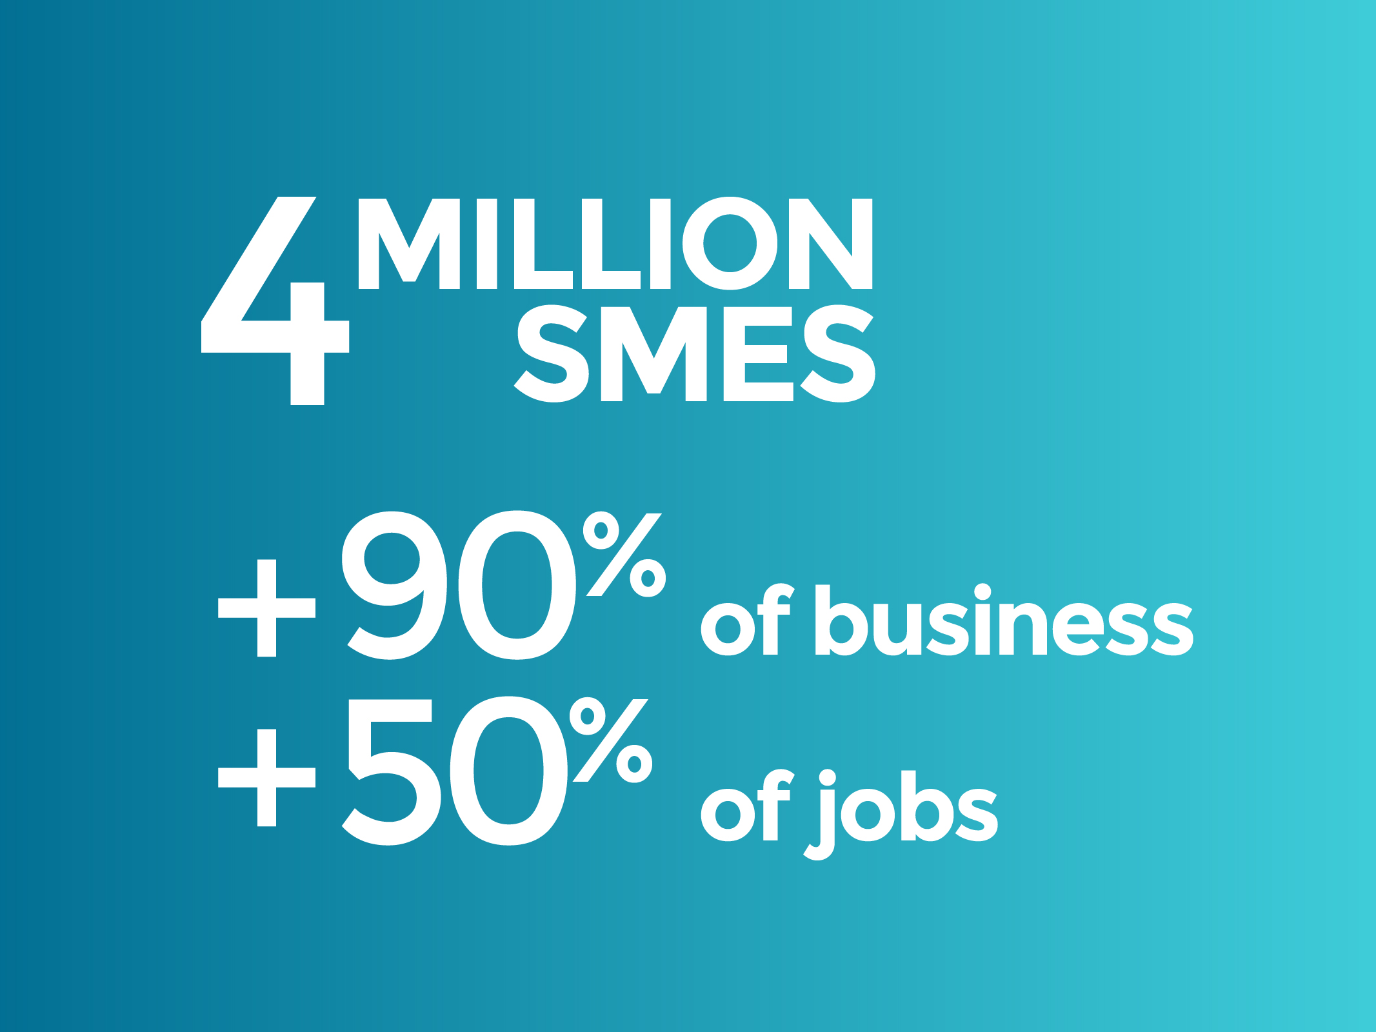
Notes:
In Latin America and the Caribbean there are over 4 million small and medium businesses. They represent, in numbers, more than 90% of companies in the region and are responsible for over 50% of jobs. They are the backbone of our economies.

Slide 3
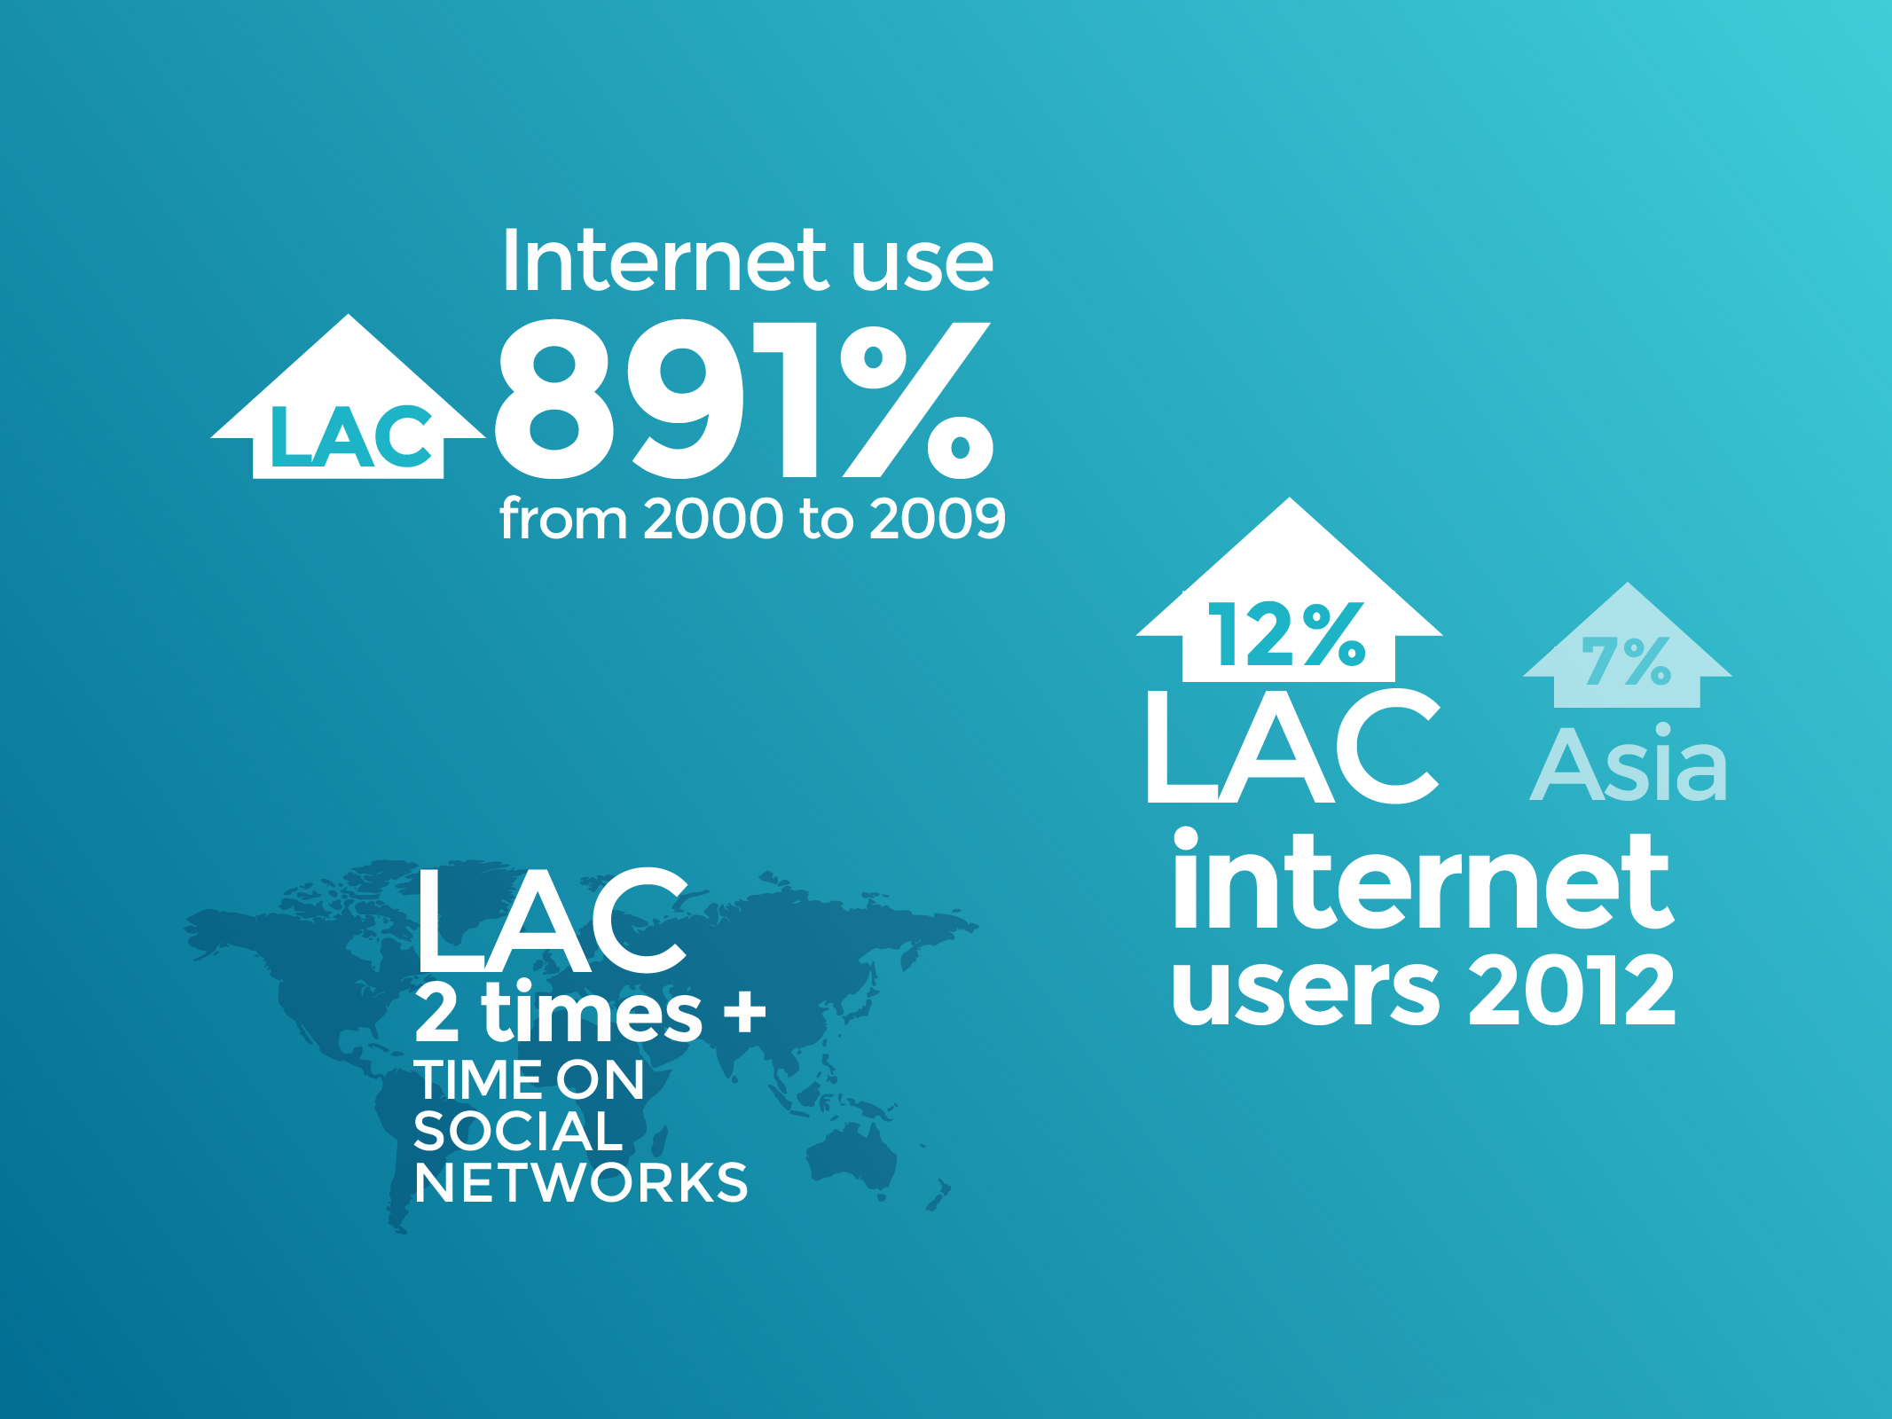
Notes:
In Latin America and the Caribbean, Internet use has grown rapidly over the past 10 years. In our region, people dedicate twice as much time to social media as compared to users in other parts of the world.

Slide 4

Notes:
The world’s large companies have the human resources, financial resources, and know-how to expand internationally.

Slide 5

Notes:
But SMEs don’t have the same resources. It isn’t easy for them to find the clients and suppliers they need in order to do business internationally.

Slide 6
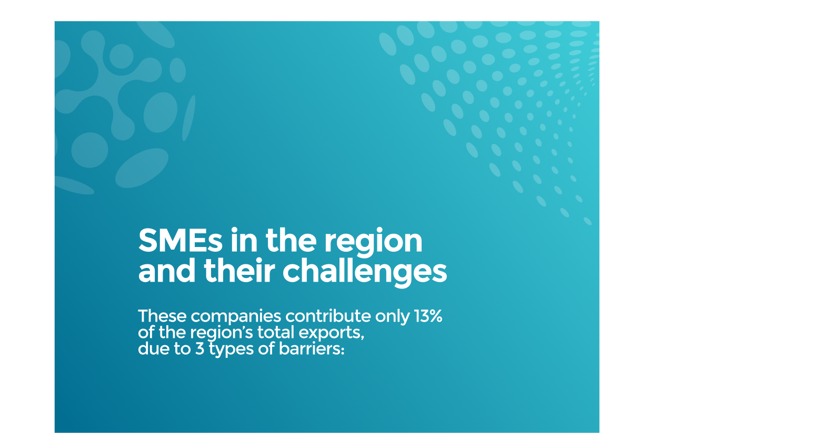

Slide 7

Notes:
It isn’t easy for them to find the clients and suppliers they need in order to do business internationally.

Slide 8

Notes:
It isn’t easy for them to obtain technical information about potential new markets for their products, the size of demand, tariffs, technical requirements, and non-tariff barriers.

Slide 9
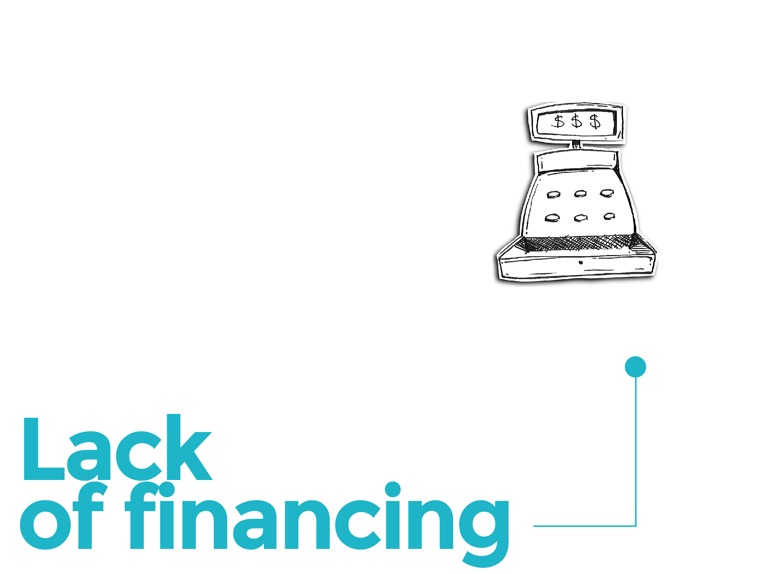
Notes:
It isn’t easy for them to obtain verified information about the financing options available for their businesses. In fact, a McKinsey study estimates that que el déficit de financiamiento de las pequeñas y medianas empresas existente en América Latina y el Caribe asciende a alrededor de 125-155 mil millones de dólares.

Slide 10

Notes:
The platform is called ConnectAmericas. ConnectAmericas is the first social network for businesses in the Americas. ConnectAmericas has been designed to connect companies from Latin America and the Caribbean, especially SMEs, firstly with potential clients, suppliers and investors from all over the world; secondly, with practical information on exporting and investing; and thirdly, with financing options.

Slide 11

Notes:
ConnectAmericas can be summarized in three words, which are the serviceareas we offer to companies:
LEARN, CONNECT, FINANCE.

Slide 12

Notes:
CONNECT. To connect with potential partners or suppliers, each business owner creates a personal profile and one for his or her company.

Slide 13
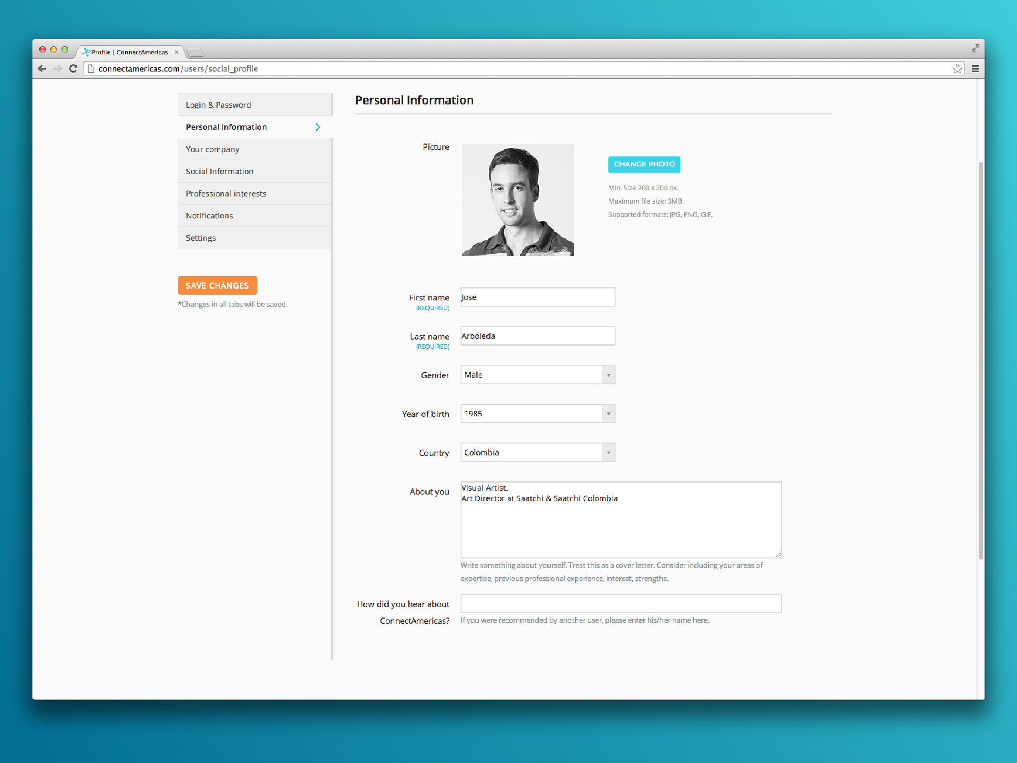
Notes:
Think of a social network like Google Plus or Facebook, or a network of professional contacts like LinkedIn, social network for companies.

Slide 14
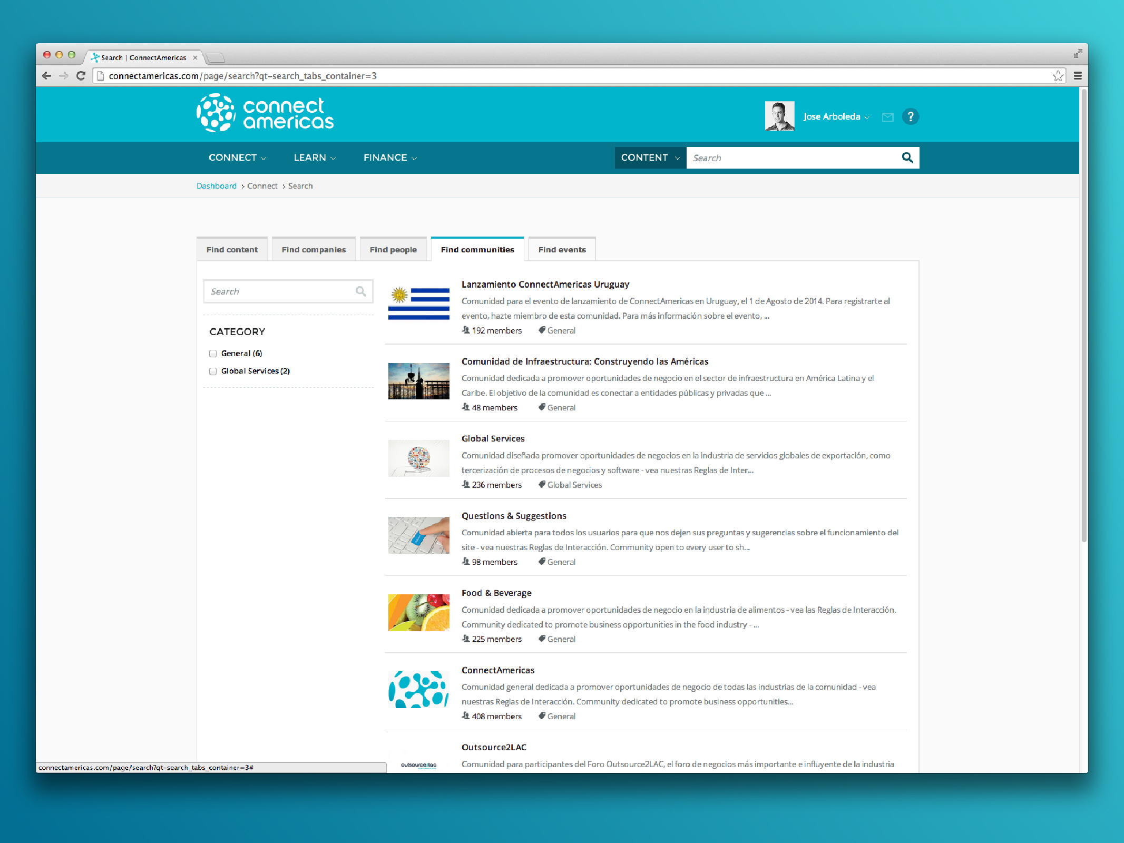
Notes:
Once they create their profile, ConnectAmericas invites users to join industry-specific communities. These are virtual spaces in which users from a given sector can find clients and investors, offer products and services, learn about what’s happening in their industry, and exchange ideas.

Slide 15

Notes:
The second service area is LEARN:

Slide 16
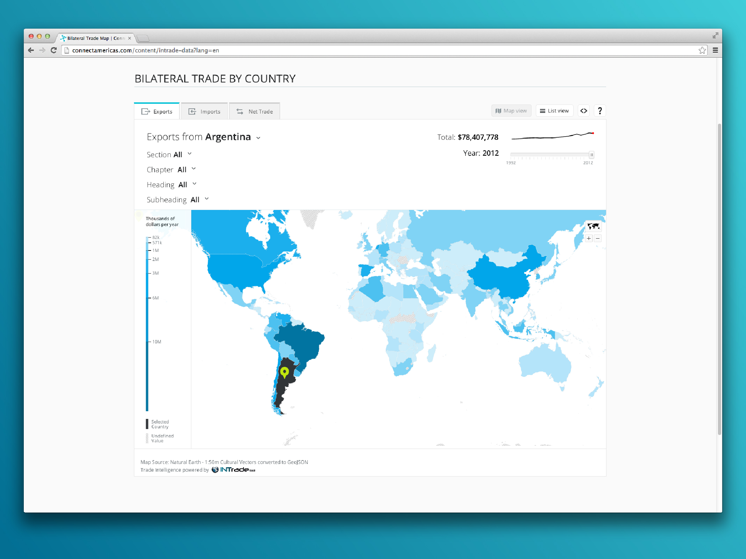
Notes:
ConnectAmericas shows you the practical information you need to identify potential markets and do business internationally. In intuitive, easy to understand maps and charts, we provide you with information on tariffs, non-tariff barriers, sanitary measures, certification requirements, and other information necessary to access foreign markets.

Slide 17

Notes:
Additionally, the site offers free online courses.

Slide 18
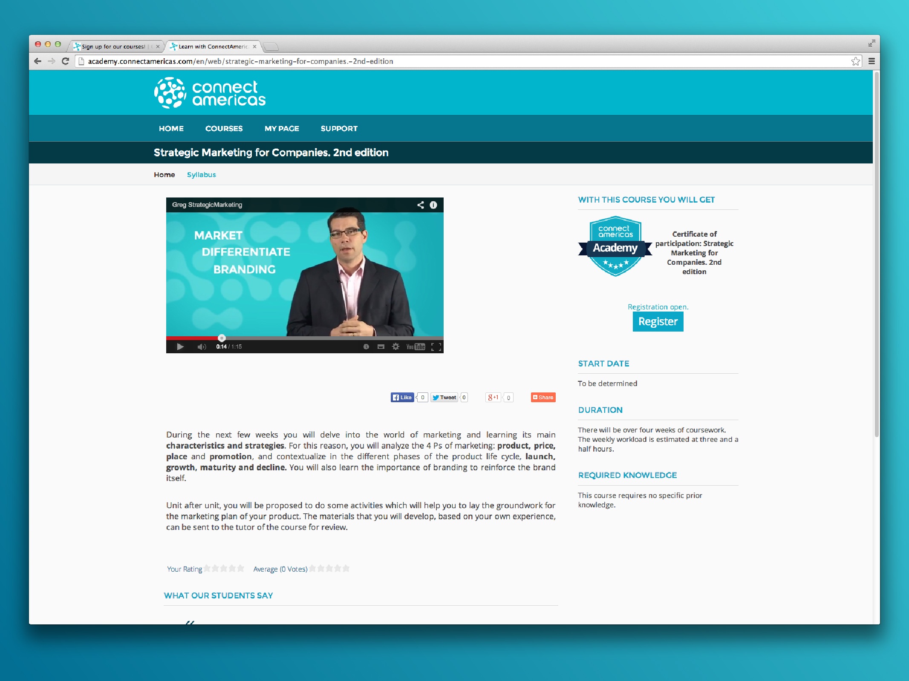
Notes:
These courses can help businesses to import or export better or more efficiently, with topics such as logistics, export management and business strategy, among others.
ConnectAmericas offers a series of knowledge products to improve the competitiveness of SMEs with an emphasis on internationalization. At present, the platform offers a total of 20 courses, 8 courses in Spanish, 6 in English and 6 in Portuguese.

Slide 19
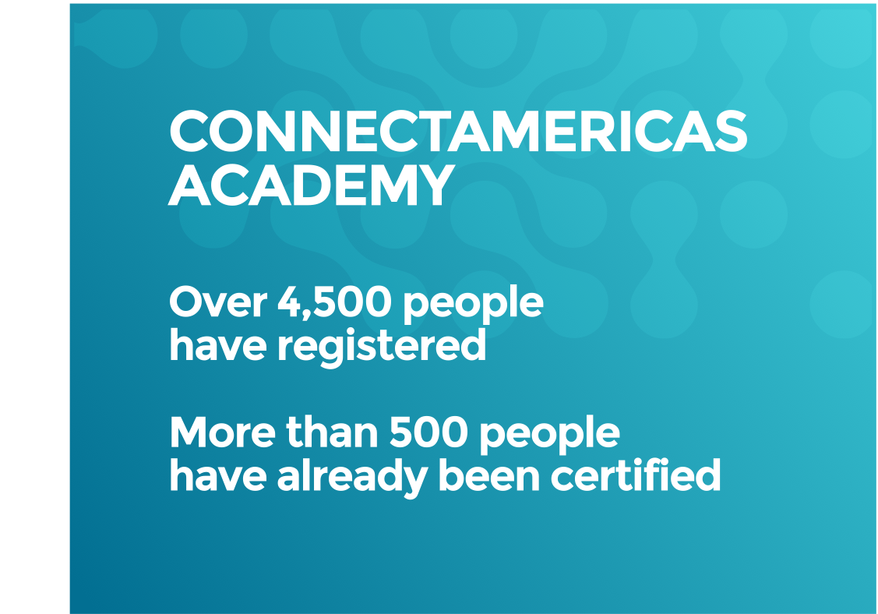
Notes:
As of late September, there were 4,500 people registered of which about 500 have been certified. IIC courses are based on the FINPYME program. The themes are: Business Plan in 7 Steps; Strategic Marketing for Business; Strategic Planning; Internationalization of Business; Food Safety; Courses are available in 3 languages. The average certification in a MOOC course is 5%. Our courses have an average of 14%.

Slide 20



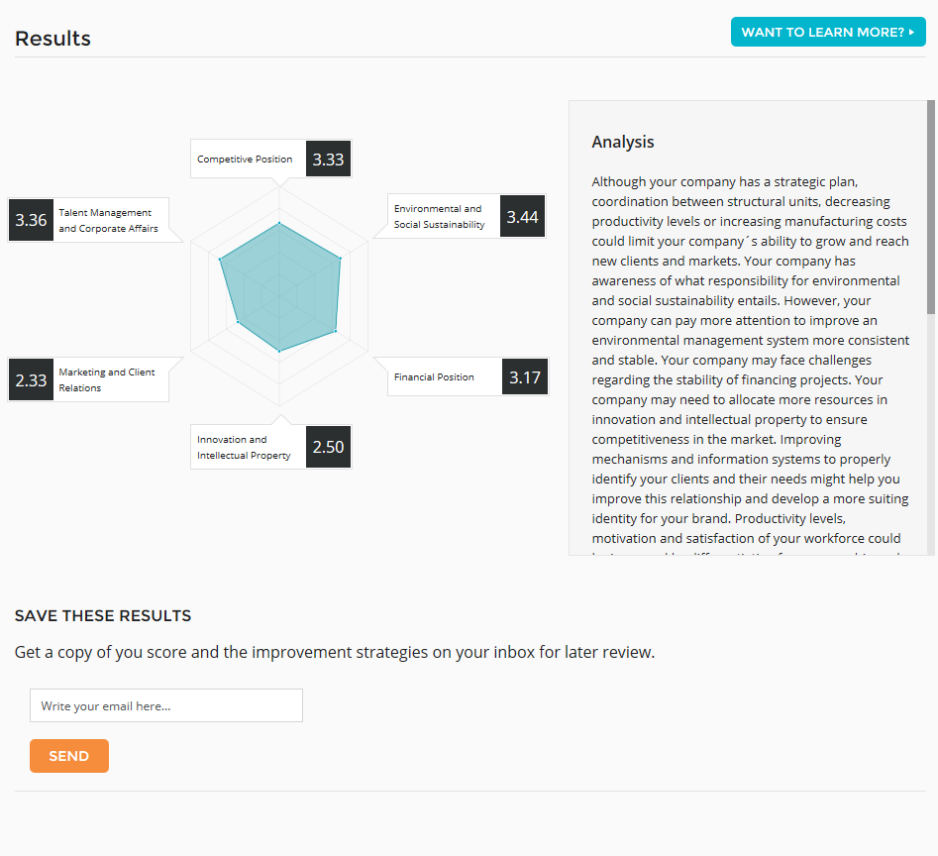
20
Notes:
MIPYME+ is a tool to rate the level of competitiveness of SMEs. So far 257 SMEs have started evaluating and 112 completed their assessments. This tool gives SMEs a number of suggestions based on their scores that help improve different areas of their businesses.

Slide 21
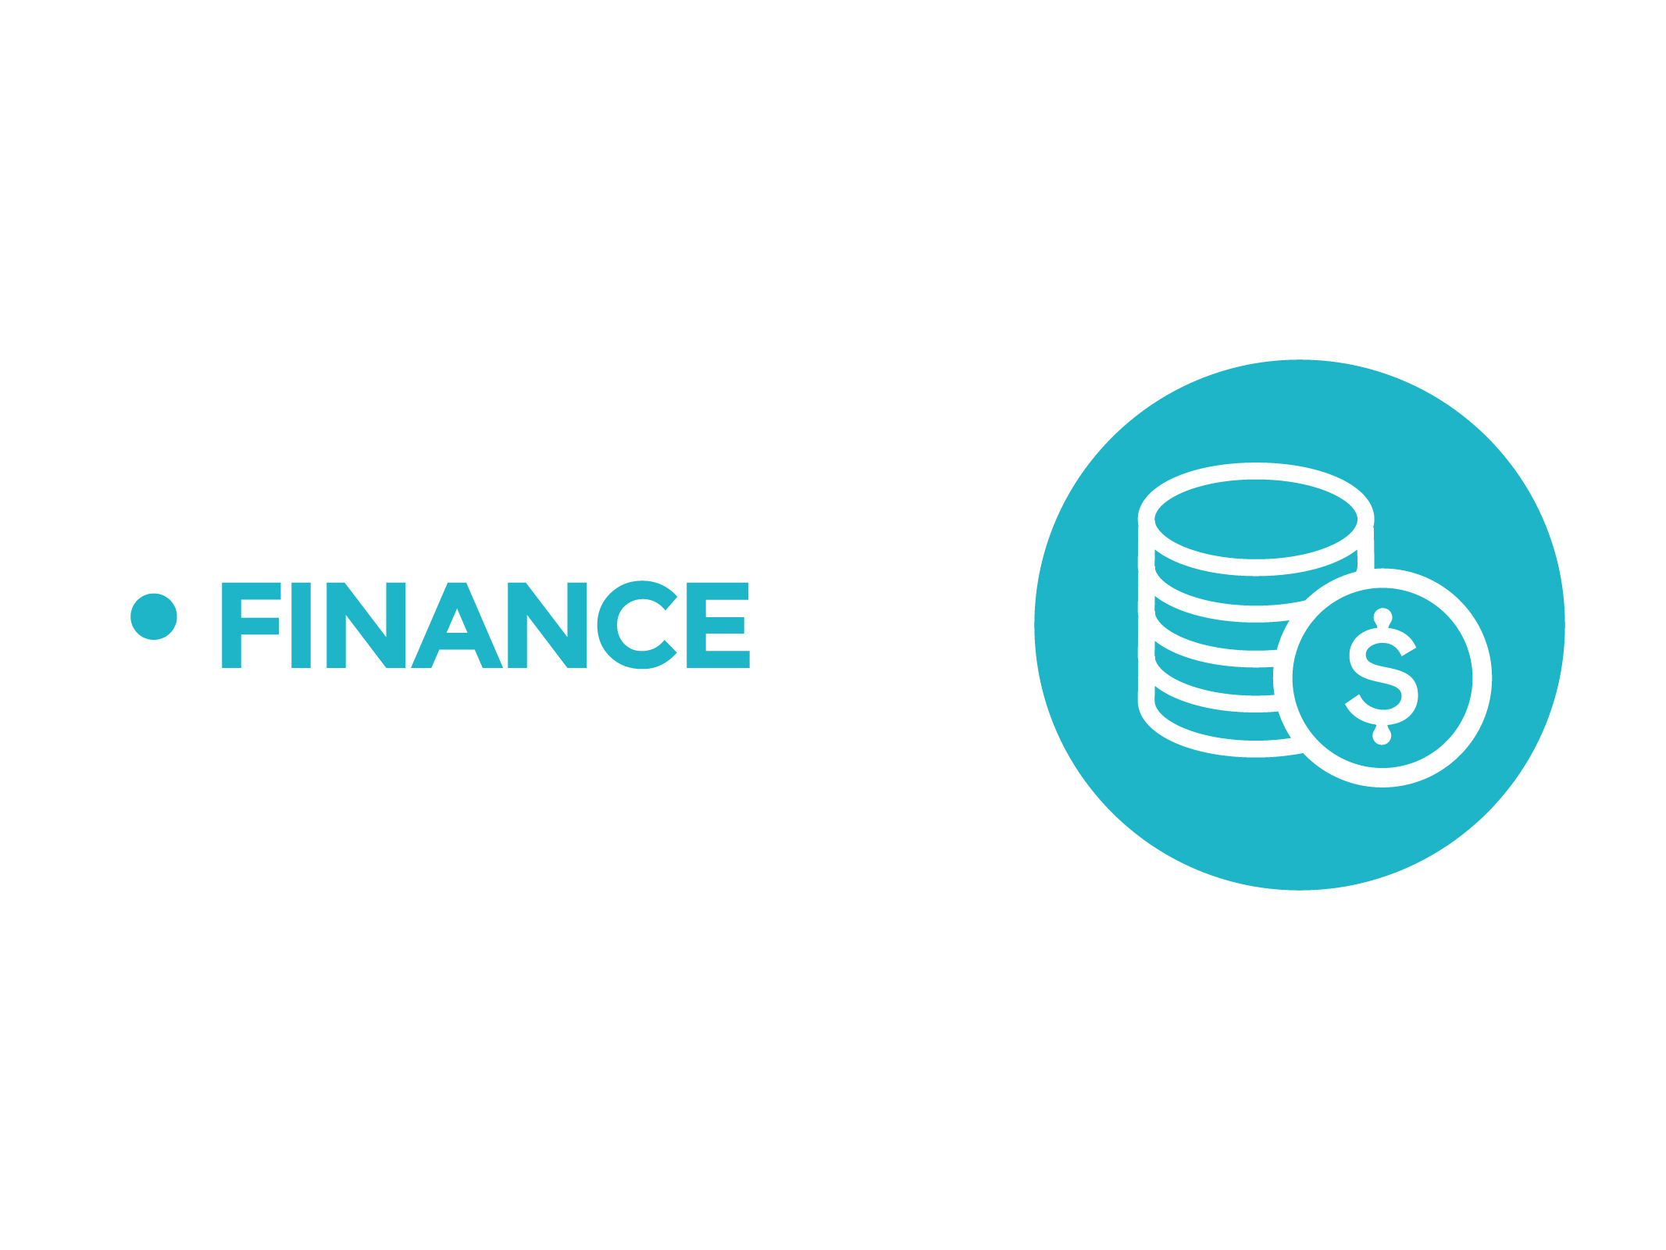
Notes:
The third service area is FINANCE:

Slide 22

Notes:
Connect Americas also offers access to InvestAmericas, an online platform that offers a way for Latin American and Caribbean businesses to meet investors from around the world. It’s not just a website it’s a dynamic community of businesses, investors, service providers, and support organizations dedicated to improving the region’s economy.

Slide 23



23
Notes:
Investors will have access to attractive investment opportunities, third party services, integrated templates to perform due diligence and connection with other investors to explore co-financing opportunities.

Slide 24


24
Notes:
Companies will have the ability to display their business to a wide range of investors and secure funding through debt or equity financing.

Slide 25


25
Notes:
Service providers will have the opportunity to offer their services to the InvestAmericas community and support the due diligence process fir investors

Slide 26


26
Notes:
Business support organizations will have the ability to invite their associates to register on the platform and play a leading role in the process of generating business in their areas of influence.

Slide 27

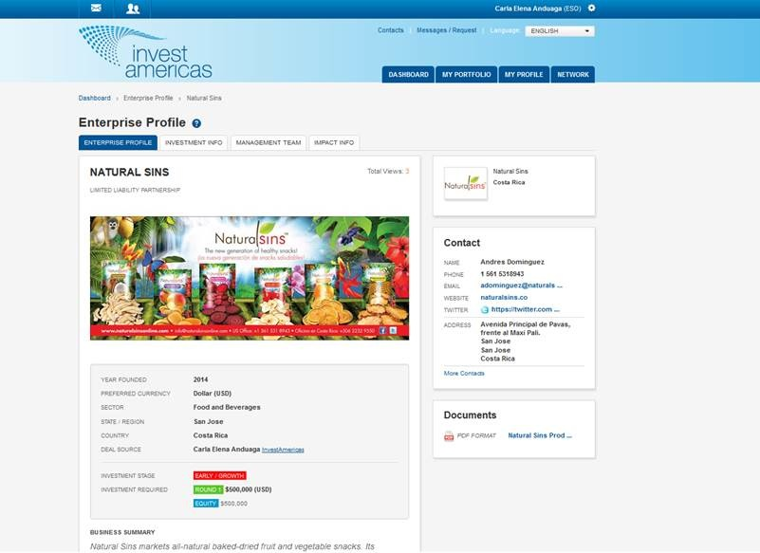
27
Notes:
In InvestAmericas, each user will have the opportunity to create its own profile. Companies can show its financing needs that will be visible to investors.

Slide 28

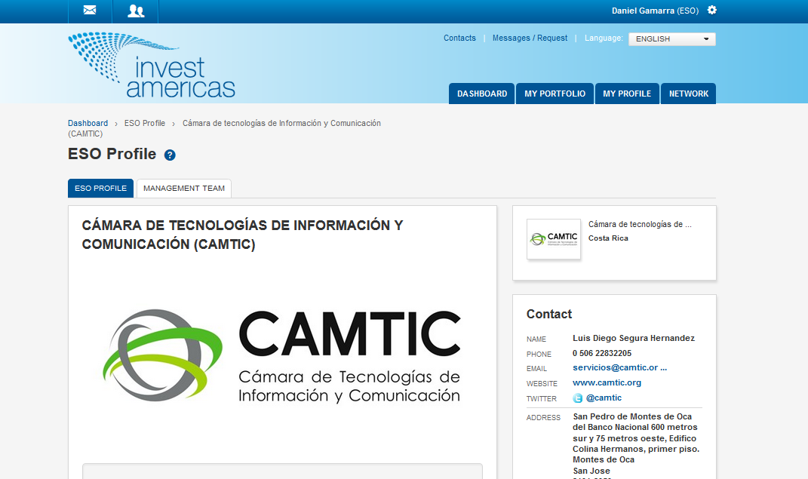
28
Notes:
----

Slide 29

29
Notes:
The more people join the network, the more effective and useful it will be. Join ConnectAmericas.com and Invest Americas
Thank you!

Slide 30
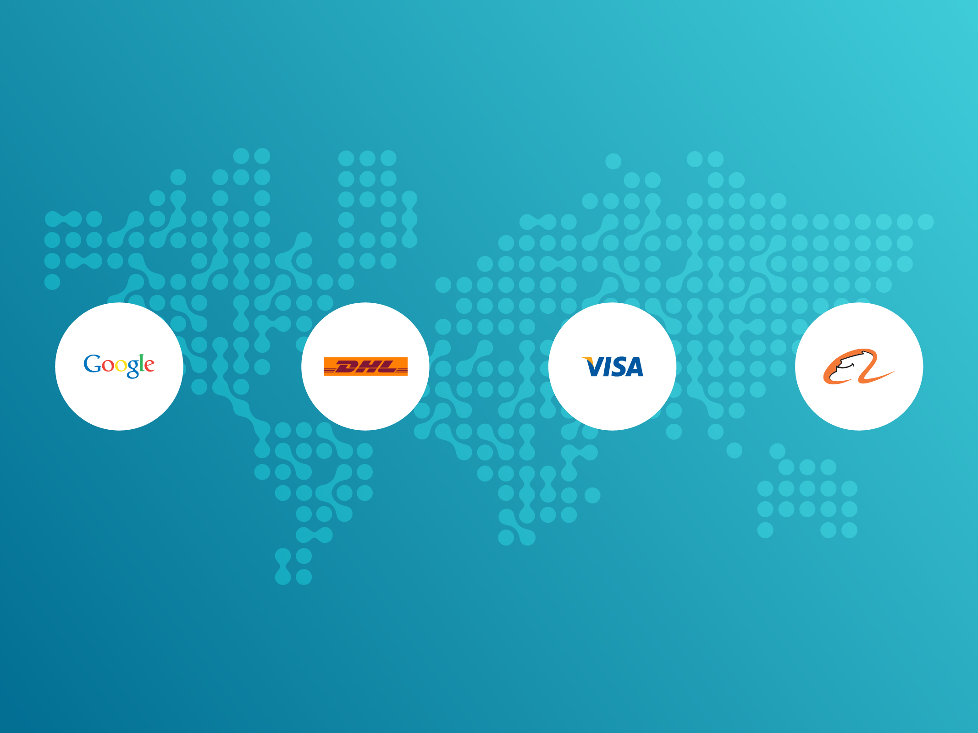
Notes:
Now we will listen to a few words from Eric Schmidt, Chairman of Google, Google, our technological partner in ConnectAmericas. Stephen Fenwick, CEO of DHL Express for Latin America and the
Caribbean, Jose Maria Ayuso CEO of VISA, a strategic financial partner of ConnectAmericas in the SME market.
And Annie Jie XU from Alibaba.com the most important e-commerce company in the world

