Slide 1


large regional firms in the Caribbean:
Drivers of Growth and Opportunities for Expansion into new markets
ELEMENTS FOR DESIGN OF ADVANCED DEVELOPMENT PROGRAMMES
BEING
large regional firms in the Caribbean:
Drivers of Growth and Opportunities for Expansion into new markets
EIL
THINKING
KNOWING
Prof. Miguel Carrillo, Ph D.
DOING

Slide 2
large regional firms in the Caribbean:
Drivers of Growth and Opportunities for Expansion into new markets
ELEMENTS FOR DESIGN OF ADVANCED DEVELOPMENT PROGRAMMES
Objective of the Study: Understand and Document Growth Strategies, Trajectories and Patterns in Large Regional Caribbean Firms.
Large: Typically >> 500 employees
Countries:
  DR
  Guyana
  Jamaica
  Suriname
  Barbados
  Trinidad and Tobago
BEING
EIL
THINKING
KNOWING
DOING

Slide 3
large regional firms in the Caribbean:
Drivers of Growth and Opportunities for Expansion into new markets
ELEMENTS FOR DESIGN OF ADVANCED DEVELOPMENT PROGRAMMES
Project Funded by Compete Caribbean.
Progress:
  37 in depth interviews with CEOs, Chairman and Top Executives of Largest Corporations in the Caribbean
  6 Surveys of Base of the Pyramid Market Profile
  Identification of about 9 Growth Trajectories
  Mapping of LRF
  Cases and Mini Cases
BEING
EIL
THINKING
KNOWING
DOING

Slide 4

Business Mapping of
Large Regional Firms in the Caribbean

Slide 7

Top large Non Financial Firms Employment Size
Company | Head quarters | Employment Size
 |  | Year 2013
Neal and Massey | Trinidad and Tobago | 8988
Ansa McAl | Trinidad and Tobago | 6000
Digicel | Jamaica | 5500
Goddard Limited | Barbados | 5023
Grace Kennedy | Jamaica | 2633
Cerveceria Nacional Dominicana, S.A | Dominican Republic | 2500
Jamaica Producers | Jamaica | 1534
Agostini | Trinidad and Tobago | 1025
TCL Group of Companies | Trinidad and Tobago | 1000
Kersten | Suriname | 999
The Generating Company Haina | Dominican Republic | 600
Bank Holdings (Beverages company) Ltd | Barbados | 589
Light and power holdings | Barbados | 451
Jamaica Broilers Group | Jamaica | 273
Angostura Holdings Limited | Trinidad and Tobago | 250

Slide 8
Top large Financial Firms Employment Size
Company | Head quarters | Employment Size
 |  | Year 2013
Grupo Popular | Dominican Republic | 6500
CIBC First Caribbean International Bank | Barbados | 3424
Republic Bank | Trinidad and Tobago | 4091
Memoria Banco BHD | Dominican Republic | 4000
Guardian Holdings Ltd | Trinidad and Tobago | 2529
Sagicor | Trinidad and Tobago | 1500
First Citizen Bank | Trinidad and Tobago | 900

Slide 9
Revenue Positioning of Top Non Financial and Financial Firms

Slide 10
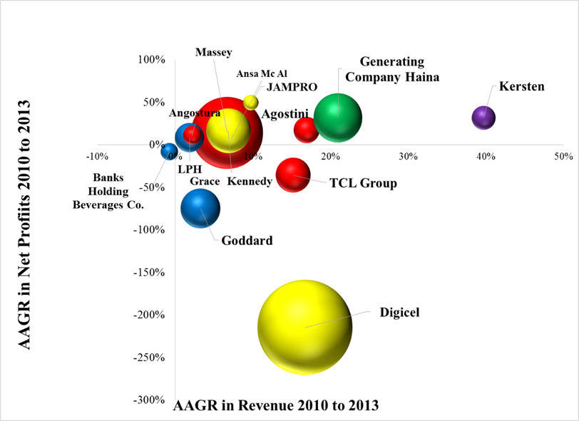
Revenue Positioning of Top Non-Financial Firms in the Caribbean 2010 to 2013

Slide 11
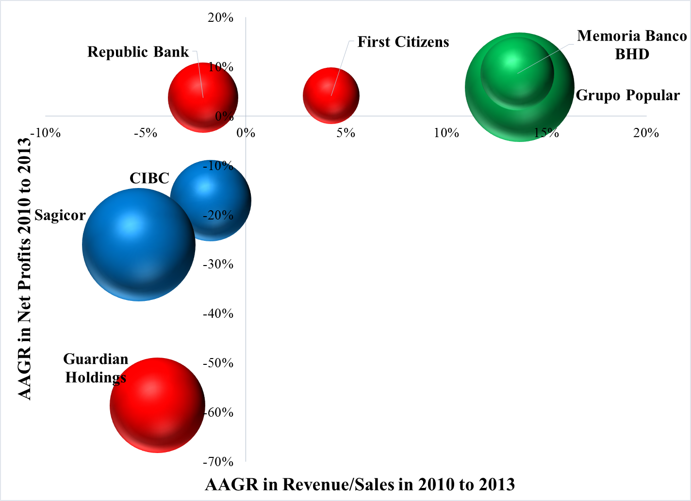
Revenue Positioning of Top Financial Firms in the Caribbean 2010 to 2013

Slide 12
Assets Positioning of Top Non Financial and Financial Firms

Slide 13
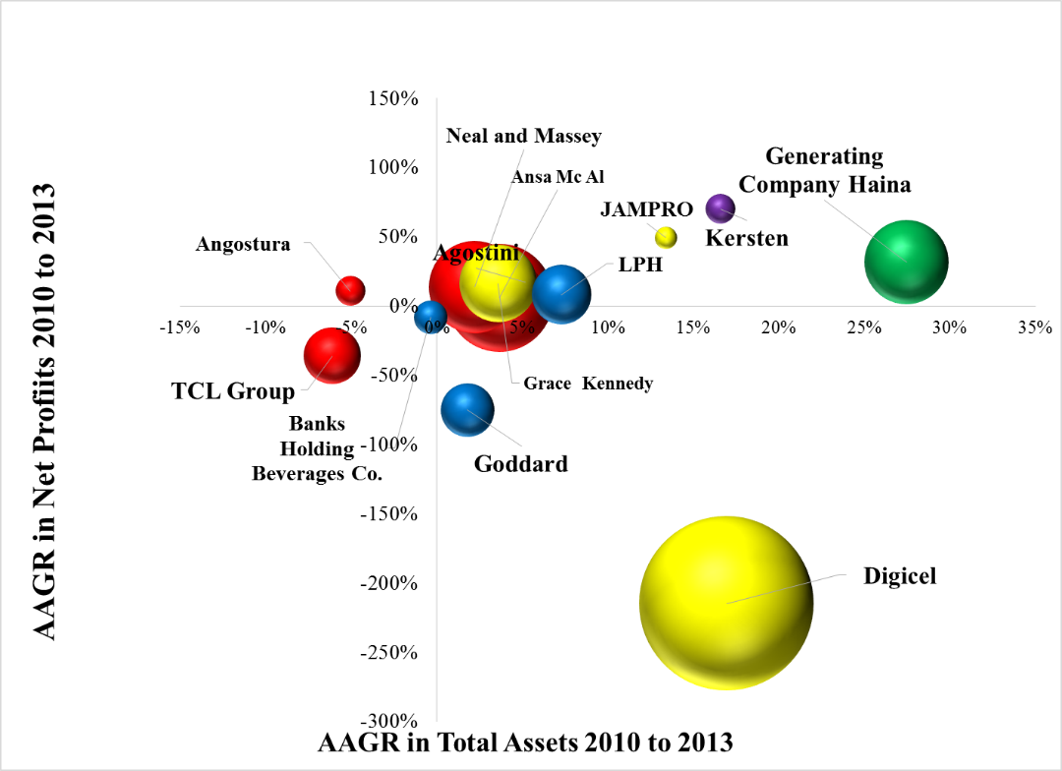
Assets Positioning of Top Non Financial Firms in the Caribbean 2010 to 2013

Slide 14
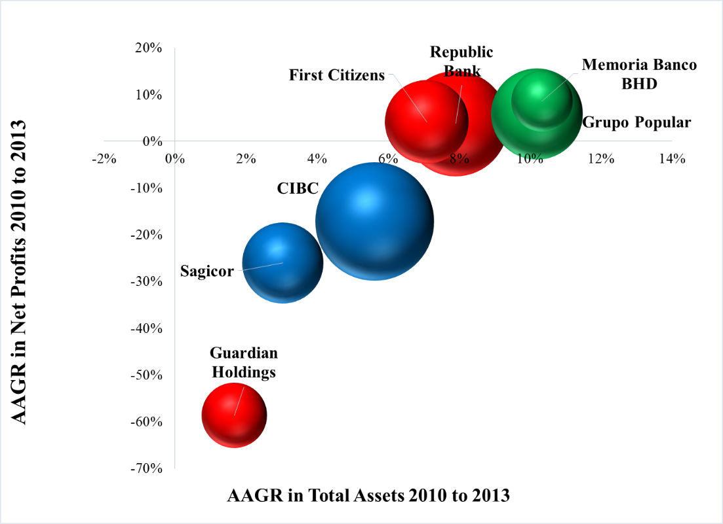
Assets Positioning of Top Financial Firms in the Caribbean 2010 to 2013

Slide 15
Basic Benchmarking some LRF
 | Goddard | Ansa Mcal | Neal & Massy | Grace Kenedy
Market Valuation | 185 Million | 1.829 Billion | 1.02 Billion | 182 Million
P/E | 17.5 | 13.9 | 10.9 | 5.7
# Companies | 53 | 39 | 73 | 36
Sales USD | 487 Million | 1.6 Billion | 1.466 Billion | 850 Million
Territories | 22 | 8 | 11 | 12
Employees | 5,023 | 6,000 | 10,000 | 1,800
Net Profits USD | 21 Million | 174 Million | 131 Million | 20 Million
Asset BasenUSD | 335 Million | 2 Billion | 1.4 Billion | 350 Million
Share Price | 3.08 | 11.75 | 10.8 | 0.50

Slide 16
large regional firms in the Caribbean:
Drivers of Growth and Opportunities for Expansion into new markets
ELEMENTS FOR DESIGN OF ADVANCED DEVELOPMENT PROGRAMMES
Geographic Growth Trajectories:
  Trajectory 1: Country Centric
  Trajectory 2: Caribbean Centric
  Trajectory 3: Caribbean as platform for Global Growth
BEING
EIL
THINKING
KNOWING
DOING

Slide 17
large regional firms in the Caribbean:
Drivers of Growth and Opportunities for Expansion into new markets
ELEMENTS FOR DESIGN OF ADVANCED DEVELOPMENT PROGRAMMES
Location of HQ.
Caribbean HQ serving the Caribbean Region: Ansa Mcal Sagicor, Guardian
Non Caribbean HQ serving the Caribbean Region: PALIG, UNICOMER, Goddard Catering Group
Caribben HQ serving non-Caribbean Regions: SM Jaleel, Grace Keenedy. Goddard.
BEING
EIL
THINKING
KNOWING
DOING

Slide 18

large regional firms in the Caribbean:
Drivers of Growth and Opportunities for Expansion into new markets
ELEMENTS FOR DESIGN OF ADVANCED DEVELOPMENT PROGRAMMES
Growth Patterns relative to Markets:
  Pattern 1: Market Dominance. Have a bigger slide.
  Pattern 2: Market Development. Have a bigger pie
  Pattern 3: Market Dominance as the platform for Market Development. Have a bigger slide of a bigger pie.
BEING
EIL
THINKING
KNOWING
DOING

Slide 19
large regional firms in the Caribbean:
Drivers of Growth and Opportunities for Expansion into new markets
ELEMENTS FOR DESIGN OF ADVANCED DEVELOPMENT PROGRAMMES
Growth Generic Strategies:
  Strategy 1: Integration of new value chain steps
  Strategy 2: Value deployment through new channels
  Strategy 3: Old Growth
BEING
EIL
THINKING
KNOWING
DOING

Slide 20
Growth Playbook of LRF in the Caribbean
Core
Business
Adjacent
Space
Entirely New
Space
Horizon 1
Horizon 2
Horizon 3

Slide 21
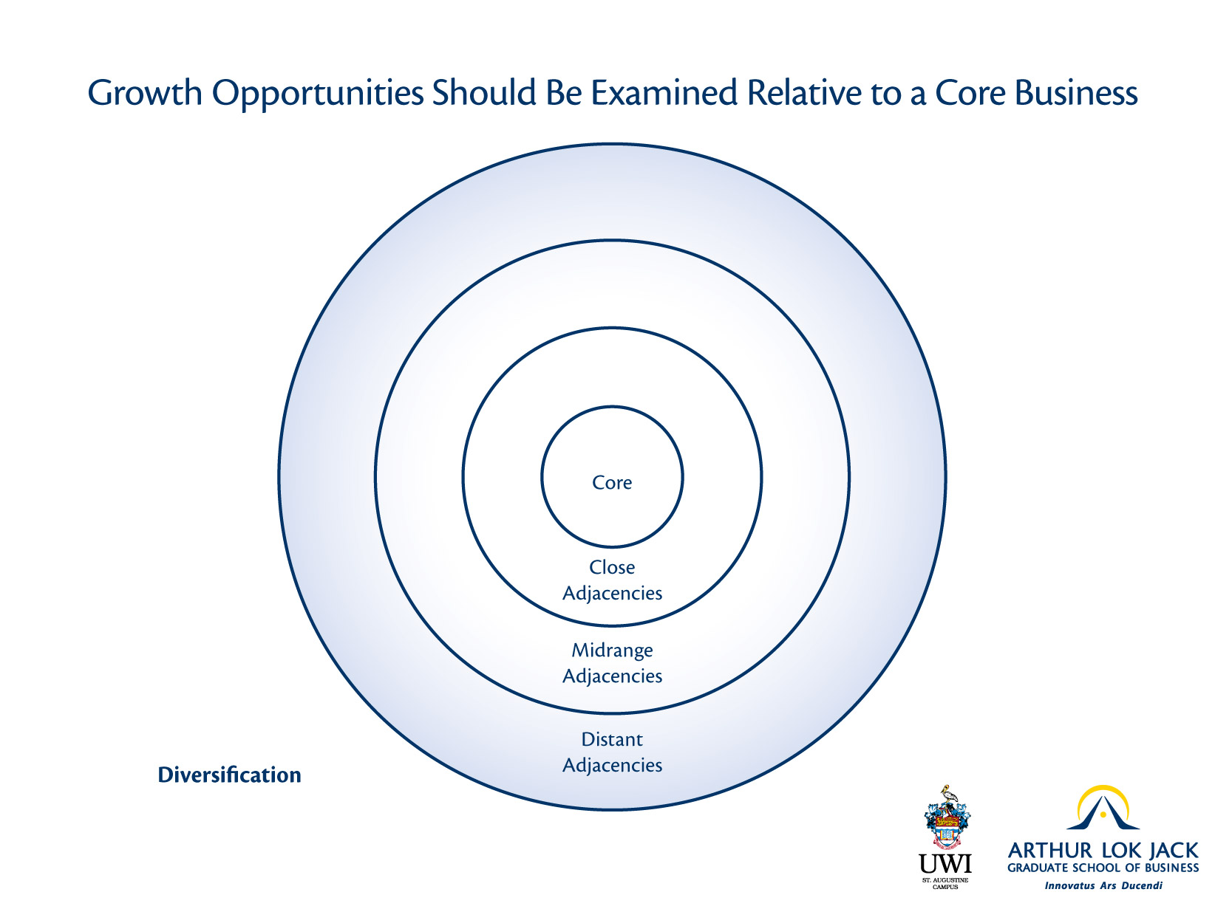

Slide 22
Growth Matrix
Operations in New Locations
Conquering new customer segments
New Products/Services
New business model
M&A/ JV’s in new value chain step
M&A/ JV’s of unrelated new businesses
M&A/JV’s within new channels
New Growth
Market Penetration
Replication
Operational Effectiveness
M&A in same sector/value chain step
M&A in related Markets
JV with traditional players
Old Growth
Organic Growth
Inorganic Growth

Slide 23
NEW
15%
5%
OLD
65%
15%
ORGANIC
INORGANIC
How will your company grow in the next 3 years?
N=11 LDF

Slide 24
NEW
30%
10%
OLD
40%
20%
ORGANIC
INORGANIC
How will your company grow in the next 5 years?
N=11 LDF

Slide 25
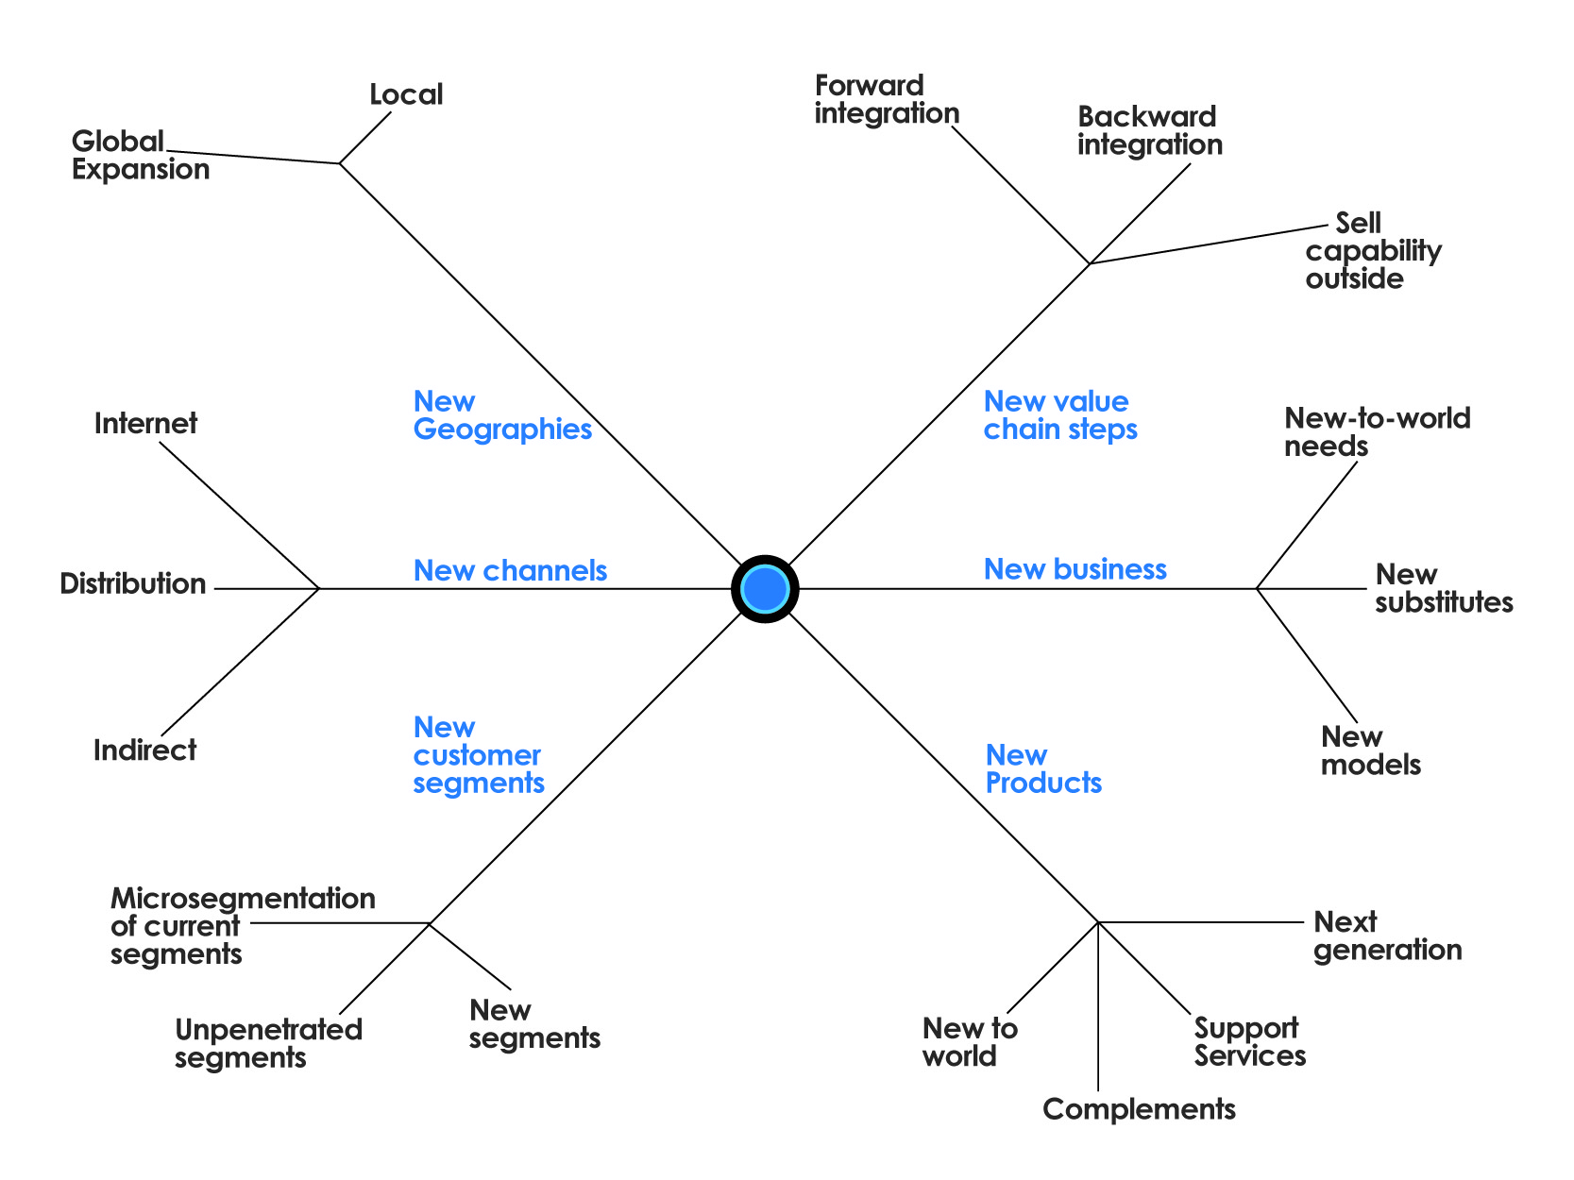

Slide 26
Goddard Enterprises
(IJV)
Kersten’s Housing (IJV)
Ansa’s Water Treatment Solutions (Alliance)
Angostura
(Alliance)
Beverage Company
Access Colmados in DR (Alliance)
Almonde Popular
Engineering (GF)
Micro Insurance for BOP
(GF)
Massy Auto Insurance
Massy Ecosystem (GF)

Slide 27
What growth vehicles are preferred?
Acquisitions
Distribution Alliances
Greenfield
Least Used: International JV

Slide 28
Key Findings of the Study
First Mover Advantage Vs. Unique Mover Advantage
Lack of Volume/Critical Mass not enough to attract enough competition
Most growth is based on the attaining operational excellent in already mature markets/businesses
LRF are too regional centric. Global benchmarks are rarely used.

Slide 29
Key Findings of the Study
Fear of Cannibalization (Innovations might not create new markets but cannibalize existing ones)
Success breeds conservatism (fear of failure)
Localization of assets, resources, and capabilities constrain expanding behavior
Technology is not a mainstream ingredient in growth trajectories

