Slide 1




We are
Innovation that
accelerates dreams!

Slide 2


Our dream is to transform
the region and Colombia into the most innovative, competitive and sustainable country in Latin América.

Slide 3










The beginning of a dream…
TODAY WE ARE
UNIVERSIDAD EMPRESA ESTADO
IS BORN
TRAVELTO EEUU
A NON PROFIT ORGANIZATION WITH
70
ADVENTURE
OF 30 QUIJOTES THAT STARTED THIS PURPOSE
SAN DIEGO
MEMBERS

Slide 4



















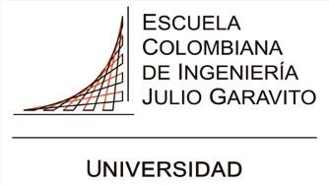

































Our Network of Members
FOOD & AGRIBUSINESS
/AGRO
MEDIA & COMMUNICATIONS
AUTOMOTIVE
HEALTH & PHARMA
SERVICES
ENERGY
EDUCATION
CONSUMER GOODS
CONSTRUCTION
FINANCIAL
PETROCHEMICAL
GOVERNMENT
& OTHERS

Slide 5
Today we are
The largest innovation network in Colombia.
Center for innovation and productivity, recognized by the Ministry of Sciences.
One of 5 tech transfer offices in Colombia..
Climatech and deeptech accelerator
Quadruple helix: university-business-state entrepreneurs Committee (CUEE), from Bogotá and Cundinamarca.

Slide 6

More than a decade of achievements
+370
Research Projects Supported
Entrepreneurship and SMEs Empowered and Accelerated
+330
Supported Patent Applications
+1.800
Connections that have led to successful agreements and business deals
10
Countries impacted through our services
+19.000
Millions mobilized to finance high-impact projects, technologies, and ventures
+$231.000
+75.000
People empowered and trained in innovation
+490
Key ecosystem players highlighted through our alliance with EL TIEMPO Publishing House
Empresas

Slide 7













We are ecosystem connectors
+5000
EMPRENDEDORES
Global Partners
Local Partners
Public Sector
La gráfica muestra solo a algunos de los actores que articula Connect.

Slide 8
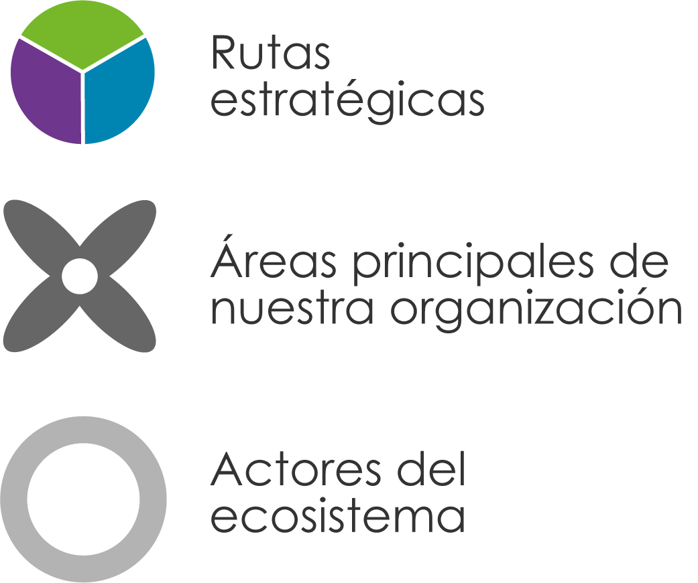
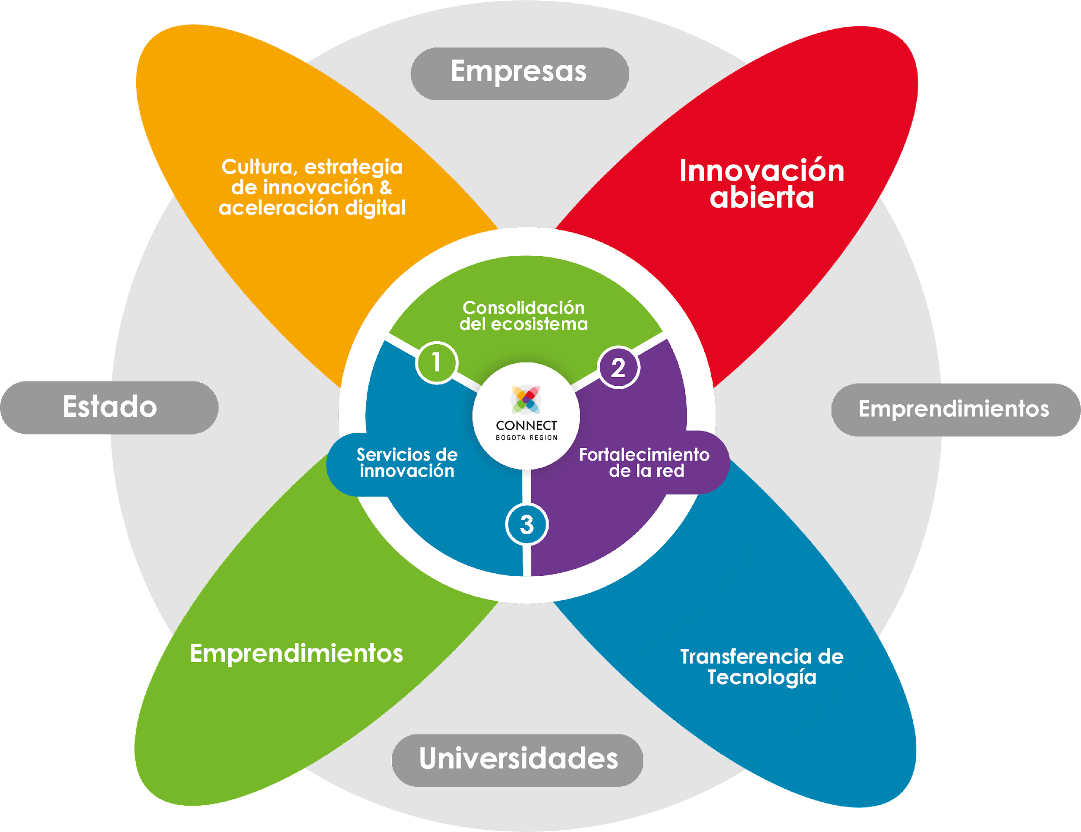

This is how we are organized to
accelerate dreams
Strategic
Pillars
Key Areas of Our Organization
Ecosystem
Actors
Industry
Innovation Culture and Strategy
Open innovation
Ecosystem Consolidation
Government
Entrepreneurs
Strategic Innovation Consulting
Empowering the Network
Innovative Entrepreneurship
Tech transfer
Academia

Slide 9

Nuestra gestión con
las empresas
Innovation Lounge
Two-day visit to six leading organizations in Cali.
Key topics: health innovation, technological development, university collaboration, and Agri-Industry 4.0.
Industrial Symbiosis Project
We supporedt companies in implementing strategies based on industrial waste symbiosis.
148 waste synergies were identified, and 10 pilot projects were launched.
Latin American Genomics Alliance
Consulting on strategic planning for the Latin American Genomics Alliance.
Genomics: an interdisciplinary field that studies the function, structure, evolution, mapping, and editing of an organism’s entire DNA.

Slide 10



Corporate Open Innovation Challenges
Utilization of excess gas (below 50,000 cubic feet per day) in oil fields across the Llanos Orientales, Huila, and Tolima regions.
Improving natural gas fuel efficiency in oil field engines.
Selected proposals moved forward to negotiation and pilot development.
3 corporate groups and 2 partner companies
A multi-corporate accelerator that drives the growth of innovative ventures tackling major industrial challenges and contributing to the mitigation, prevention, and remediation of climate change impacts.
45 startups accelerated in just two years
Aliados estratégicos

Slide 11
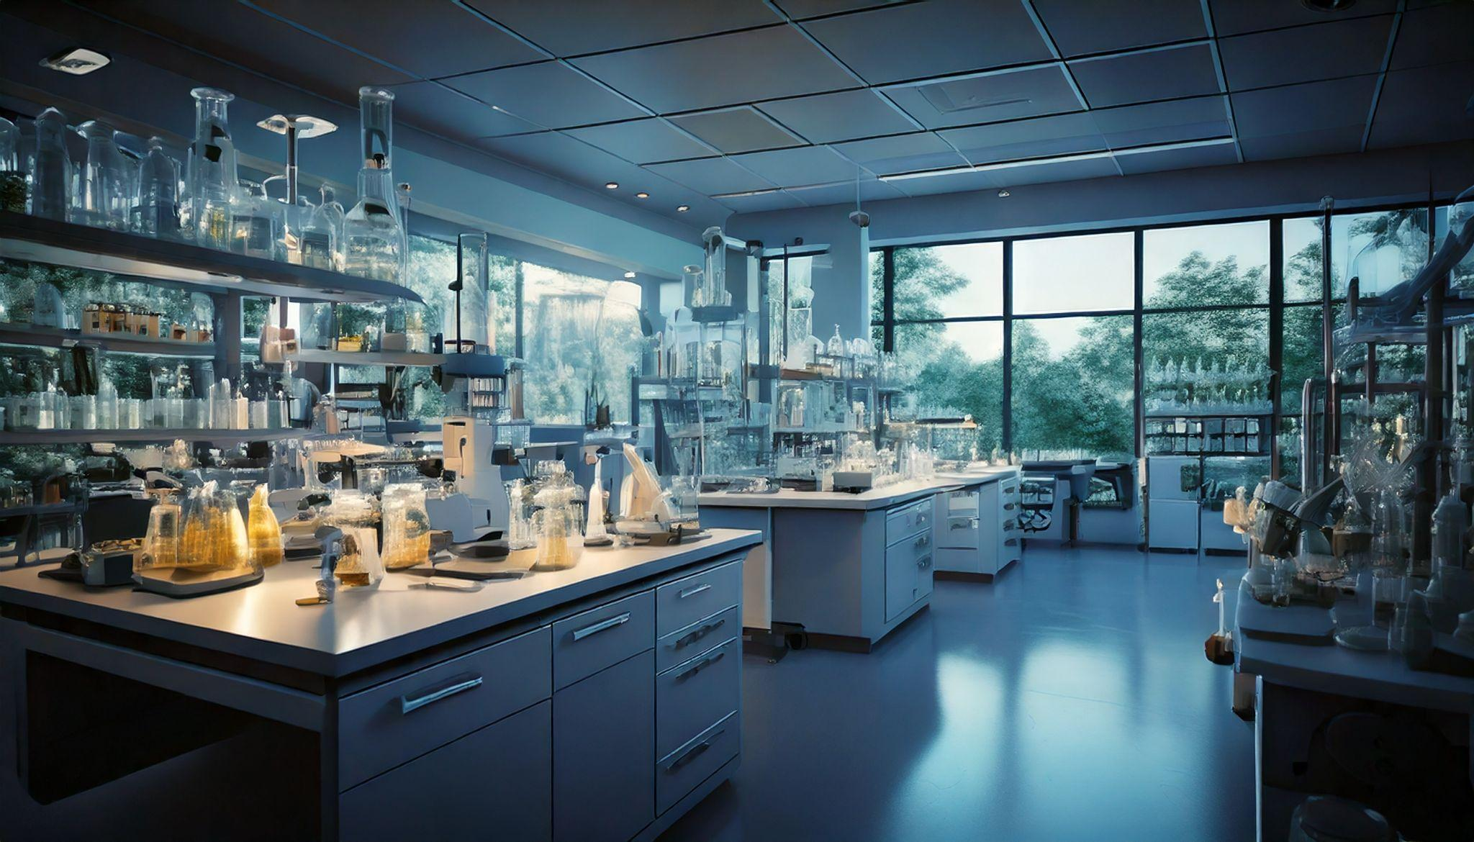
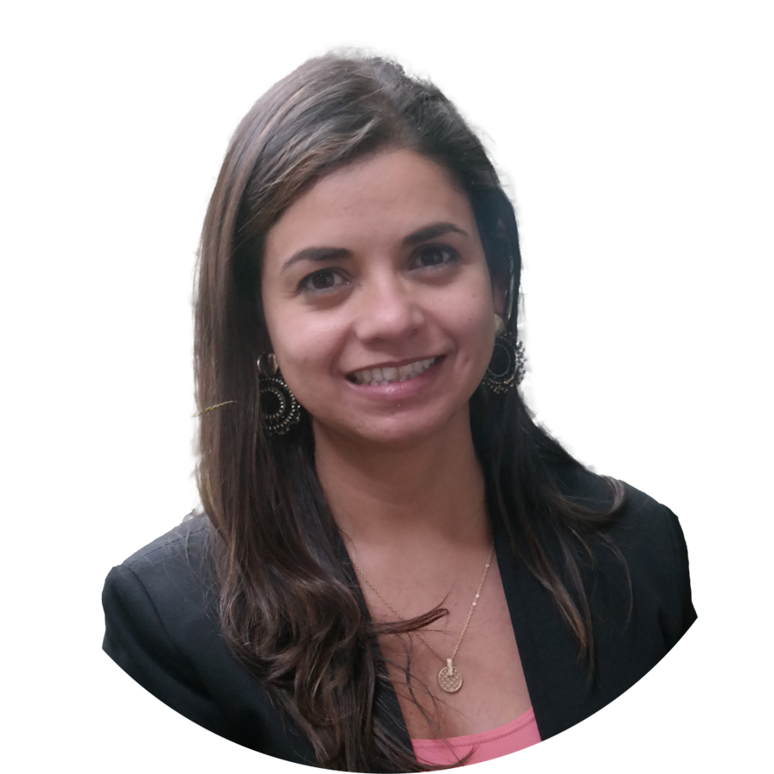





Transforming Lives Through Innovation
Transforming Lives Through Innovation
From Science
to Entrepreneurship
Viviana Clavijo
CEO - Sciphage
A new company emerges, building the first facility in Colombia to produce the virus that combats Salmonella.
“Connect’s methodology, expertise, and network have truly enriched us. We’re deeply grateful for their commitment to our success”
Patent Support Program
Helped make this dream a reality through its programs
Notes:
Sciphage es un emprendimiento que nace en la Universidad de Los Andes (empezó siendo una investigación y fue madurando hasta convertirse en una empresa constituida). Su foco fue la creación de SalmoFree, un cóctel de bacteriófagos o fagos (es decir, virus que se introducen en las bacterias para destruirlas) en este caso para combatir la Salmonella. Su interés surge a raíz de la problemática que existe en el mundo relacionada con la resistencia que generan algunas bacterias a los antibióticos, siendo los fagos una opción destacada, en este caso para atacar la Salmonella.
Connect estuvo presente en varios momentos del proceso de maduración de Sciphage a través de diferentes programas:
2016 con brigada de patentes, lograron obtener la patente de en Colombia.
2022 con Negocios Verdes hicieron el estudio de validación comercial. Y en el mismo año a través de Sácale Jugo a tu Patente, hicieron el diseño de la planta, que hoy es la primera planta en Colombia productora de fagos.
¡IMPORTANTE! No es una Spin-Off de la U. de los Andes.

Slide 12

Our experience
+10,8 MILLION DOLLARS COMMITTED
+220 COMMERCIAL VALIDATIONS
+1 MILLION DOLLARS IN MOBILIZED RESOURCES I
+510 TECHNOLOGIES ASSESSED
REGIONAL
6 TECH TRANSFER ROUTES/AREAS DESIGNED FOR THIRD PARTIES
TECHNOLOGY
+220 EFFECTIVE CONNECTIONS*
TRANSFER OFFICE
+3300 TRAINED PEOPLE
+35 TRANSFER AGREEMENTS
ACHIEVEMENTS
(2018 - 2024)
+180 PATENTS GRANTED (ACCOMPANIED)
+335 MATURE TECHNOLOGIES
*EFFECTIVE CONNECTIONS: Connection led by Connect between two or more actors that we bring together to develop joint projects

Slide 13

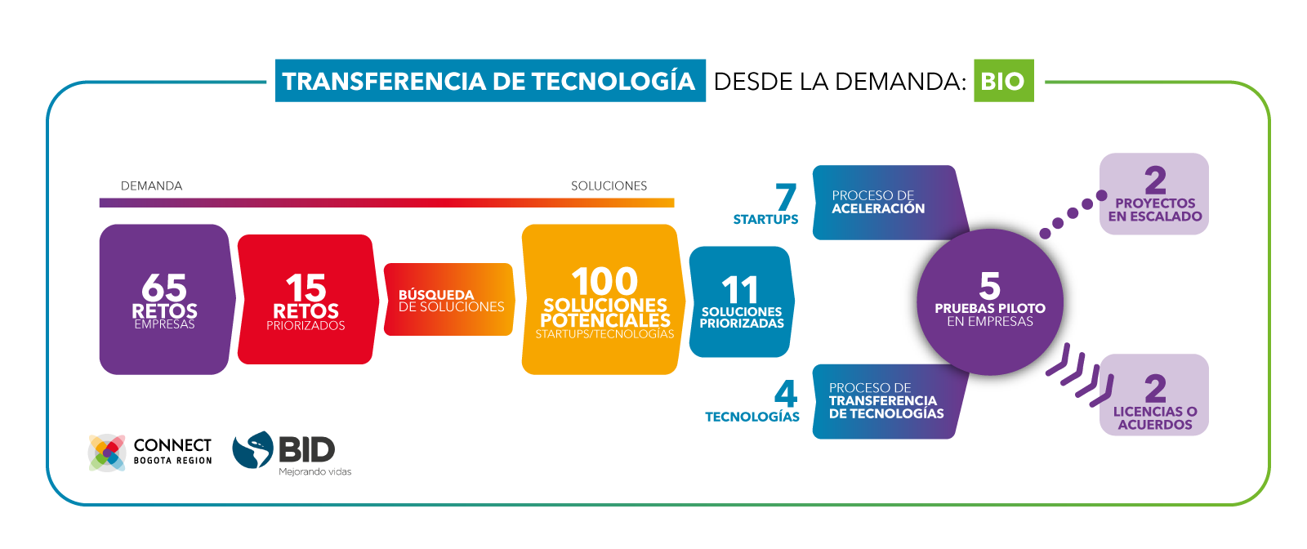



Key Milestones
Demand-Driven Technology Transfer: BIO
2
projects
scaled up
DEMAND
SOLUTIONS
Acceleration process
65
Challenges
15
Challenges priority
100
potential solutions
15
Challenges
priority
5
pilot
projects with companies
Scouting solutions
2
licensing or collaboration agreements
Technology Transfer Process
TECHNOLOGIES
COMPONENT 1
CHALLENGES
COMPONENT 2
SOLUTIONS
COMPONENT 3
CAPACITY BUILDING
COMPONENT 5
MONITORING, EVALUATION, AND AUDIT
COMPONENT 4
SHARING RESULTS

Slide 14










Bio-B
BIO-B
We developed an open innovation program to accelerate high-impact bio-businesses in Colombia, in partnership with the Inter-American Development Bank (IDB).
• 15 priority challenges
• 164 solutions submitted from around the world
• 10 projects supported with an investment of COP $2.18 billion
• 70% of the projects achieved agreements through technology transfer and IP assignment contracts

Slide 15
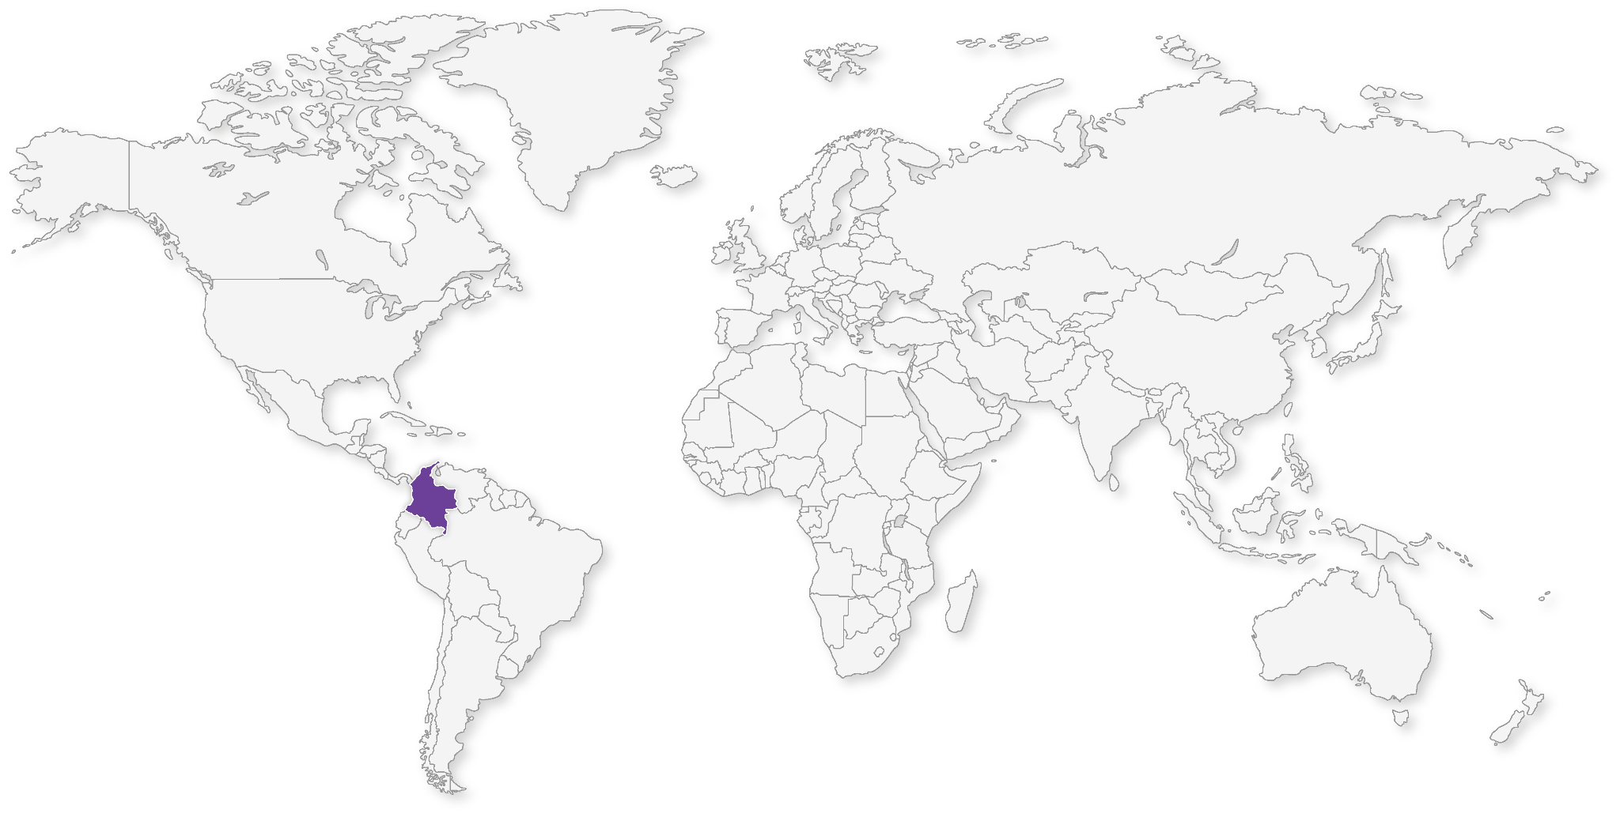
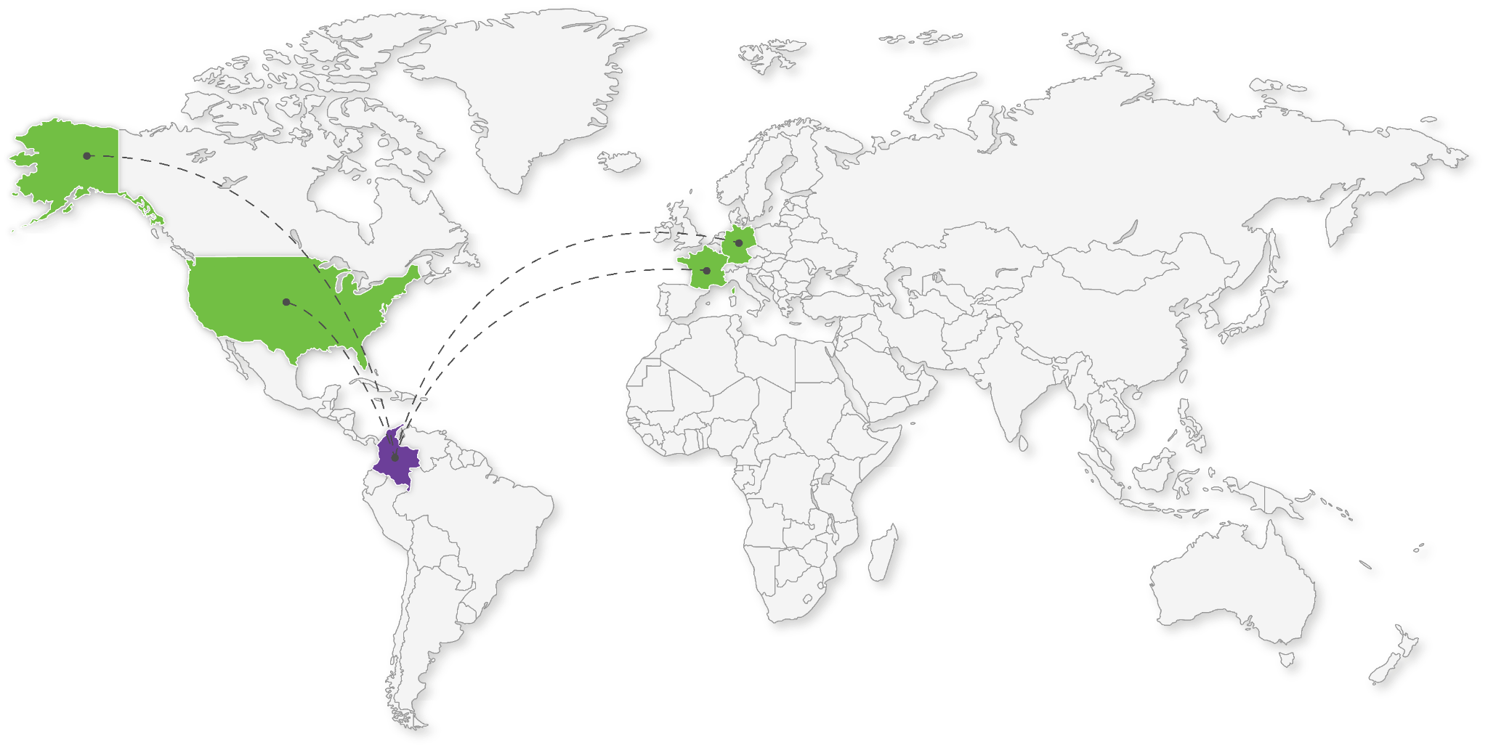
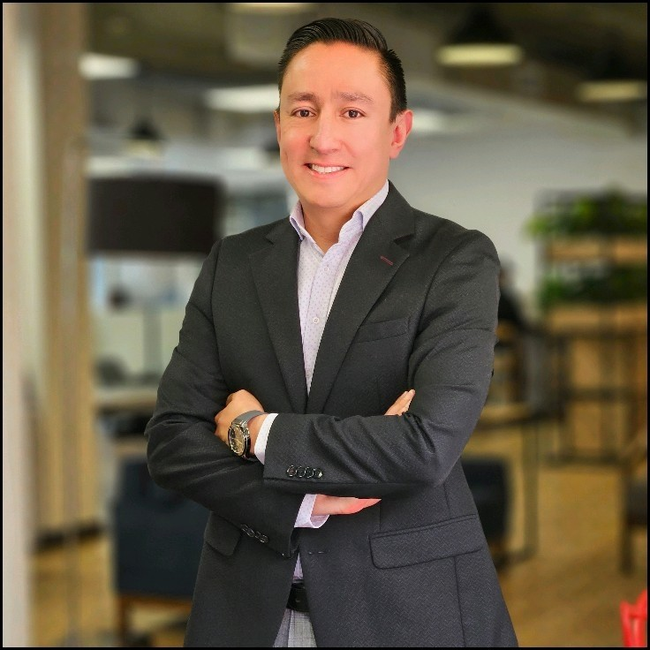




Transforming Lives Through Innovation
José Villarreal
Business Director
Biolev - Levapan
A new business line emerges: a food company now expanding into cosmetics.
“We realized that open innovation truly makes a difference.
The products we developed were showcased at the in-cosmetics trade fair in Paris.
We now have two distributors in Germany, one in Colombia, and will soon expand to the United States.”
Helped make this dream a reality through the program

Slide 16
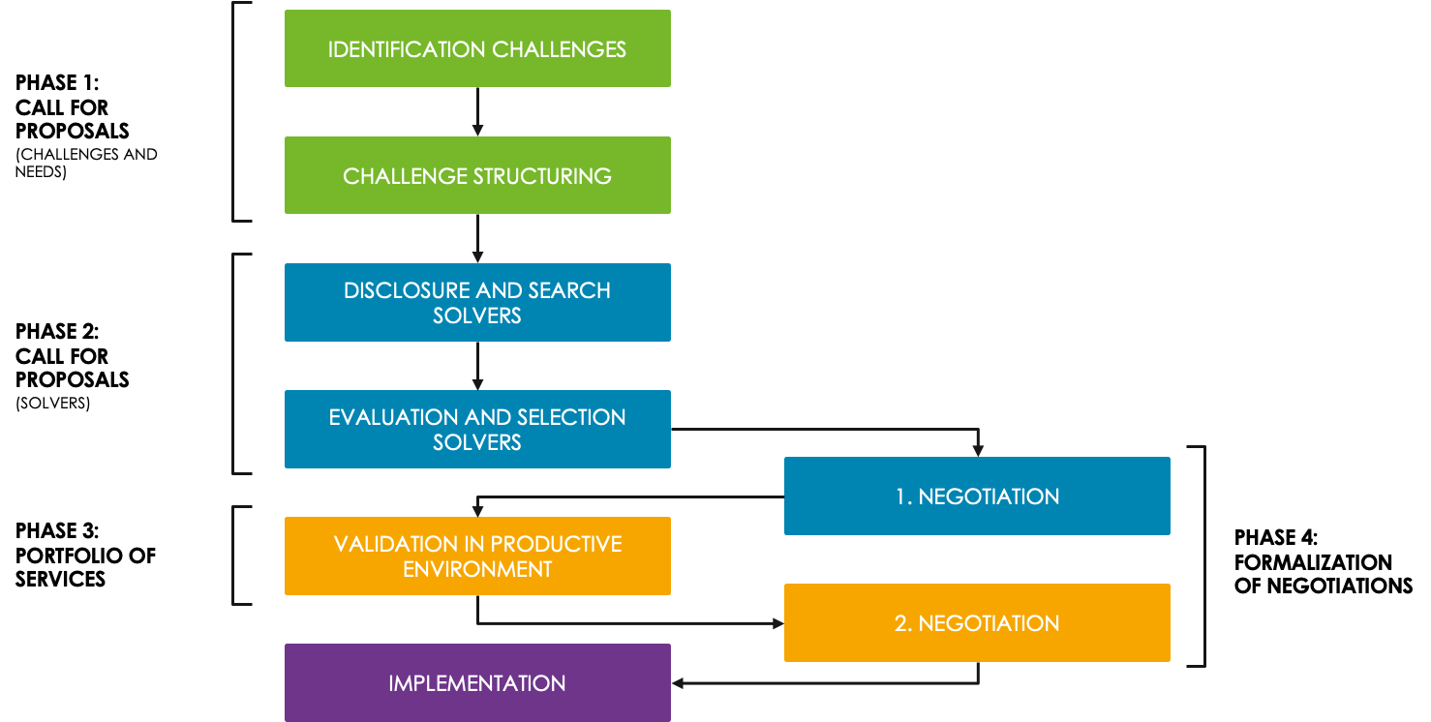


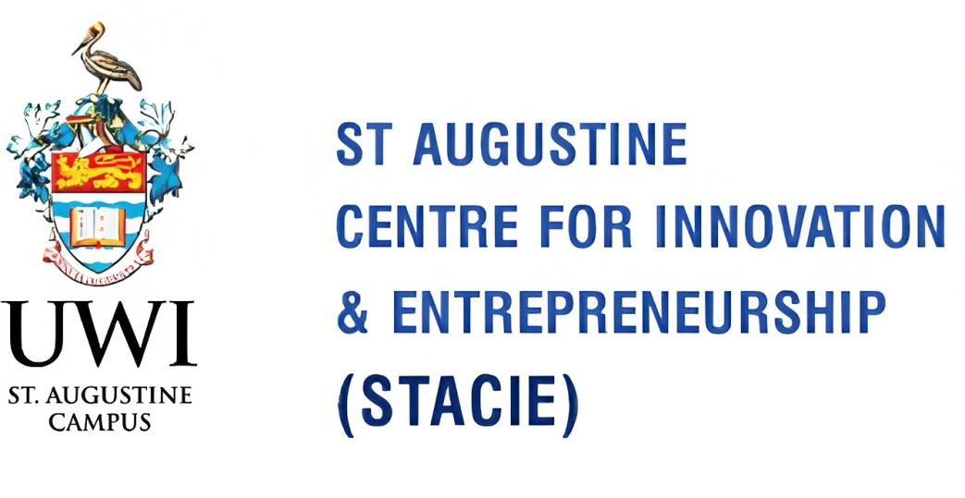

Saiil Program
To strengthen the capacity and galvanize tech transfer and collaboration in the University of the West Indies (UWI) St. Augustine, and contribute to the competitiveness and diversification of the economy of Trinidad and Tobago.
8 challenges
8 challenges
23 solutions
23 solutions
4 solver selected
(4 challengers did not select solver)
4 solver selected
(4 challengers did not select solver)
1 NDA

Slide 17






Saiil Program
Sustainable Supporting Processes or Manufacturing
8 challenges
Optimization of parts management in manufacturing.
Sargassum for innovative skincare
23 solutions
Reducing systemic risk through business intelligence.
Plant-Based building economic clusters for mangrove conservation
Improving the Efficiency at a Lube Oil Blending and Grease Plant
Plant-Based cheese development.
4 solver selected
(4 challengers did not select solver)
Doh waste good food (Don't waste good food)

Slide 18

Lesson learned
Challenger companies were unclear about the technical scope of their own challenges, which led to difficulties in evaluating solutions.
Four challenges were left without any selected solvers, indicating that future editions should better validate the viability of challenges before publishing them.
The expectations between solvers and challengers were not always aligned, especially in terms of intellectual property and the possibilities for scaling solutions.
Importance of facilitating mentoring and co-creation spaces between problem solvers and challengers to fine-tune technical and commercial details of proposals before final selection.
Need for financing models or incentives that allow problem solvers to advance the maturity of their technologies and increase their attractiveness to challenger companies.

Slide 19
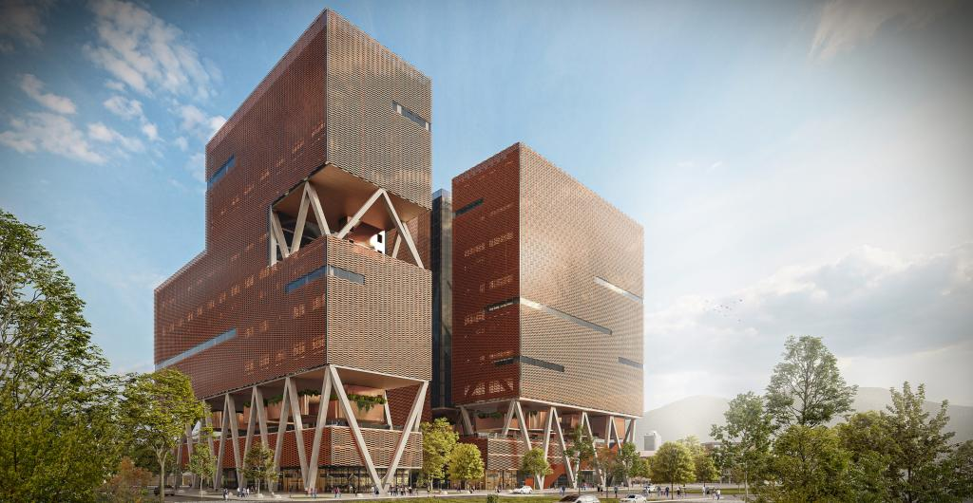
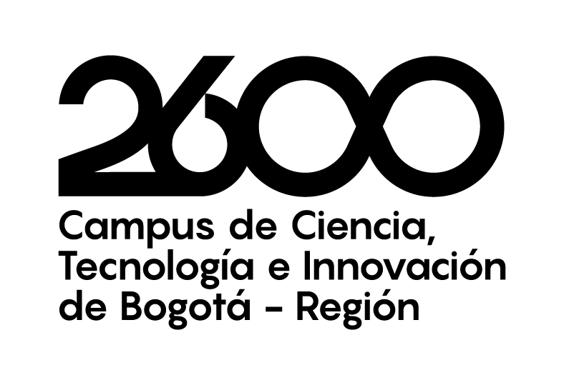






Slide 20










Where to we want to go
“Countries that invest in innovation grow 30% mor tan those that don’t.”
(World Bak, 2023)
In 2009 Colombia was 90th in world ranking
In 2009 Colombia ranked 16th in LATAM
Today we are #61globally
Today we are 4th most innovative country in Latam
Suiza
Suecia
EEUU
Singapur
Reino Unido
Brasil
Chile
México
Colombia
1
2
3
4
5
1
2
3
4
3% of GDP in I+D
1.17% GDP in I+D
0.3% of GDP in I+D
Fuente: Global Innovation Index 2024

Slide 21

Collective leadership results
We have contributed to great achievements of the ecosystem
1ro
in university-business relations in Latam
Based on the global rankings of the indicator Source: elaboration by a consulting team based on GII
2do
Startup ecosystem in Latin America
Source: Global Startup Ecosystem Index 2024
3er
in investment after
São Paulo and Mexico City
Source: Invest in Bogotá
Empresas

Slide 22



Diana Gaviria
Directora ejecutiva
dgaviria@connectbogota.org
(+57) 315 856 5767
@connect_bogota_region
Connect-bogota
@ConnectBogotaRegion
connectbogota.org

