Slide 1


SECTORAL EXECUTIVE BOARDS
FOR PRODUCTIVITY:
A FRAMEWORK FOR A
MODERN PRODUCTIVE DEVELOPMENT POLICY.
INTER-AMERICAN DEVELOPMENT BANK.
OCTOBER 2025
Gustavo Crespi, Competitiveness and Innovation Specialist

Slide 2

What underlies productive development.
The implementation of Sectoral Executive Boards.
Lessons Learned.
OUTLINE

Slide 3
1
What underlies productive development.

Slide 4
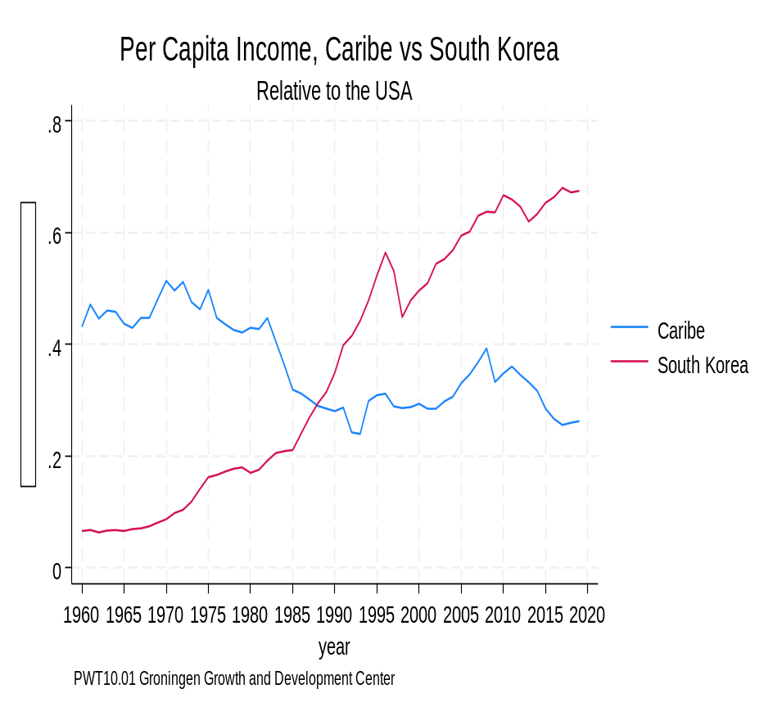
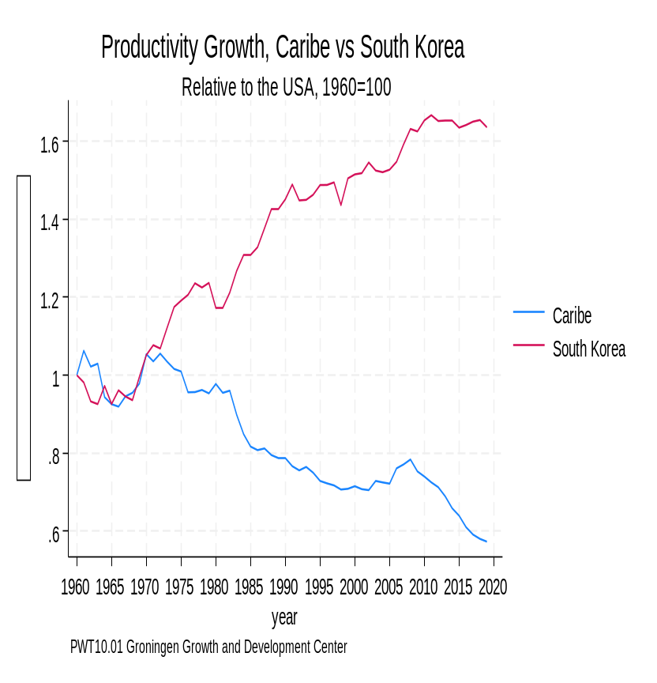
What's behind productivity?
Historically, the Region Has Had Low Aggregate Productivity Growth
GDP PER CAPITA RELATIVE TO THE US
4

Slide 5
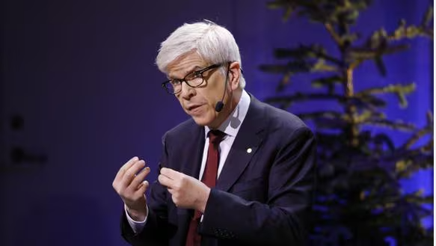

What's behind productivity?
“It is investment in public goods that accounts for almost all productivity growth (Romer, 1995)”

Slide 6
What's behind productivity?
In an economy there are always two kinds of goods:
(a)Private goods (a car).
(b)Public goods (knowledge, regulations, etc.).
Both kinds of goods are complementary in production.
While the market is well "designed" for the provision of private goods, this is not the case for public goods.

Slide 7
What's behind productivity?
Any good can be classified according to two attributes: (a) whether consumption is rival and (b) whether it is feasible to control access to it.
RIVAL GOODS
(physical objects)
NON-RIVAL GOODS
(information)
HIGH CONTROL
(Property rights are well defined and enforceable)
LOW CONTROL
(Property rights not well defined and /or unenforceable)

Slide 8
Categories of Goods
Rival
Non-rival
100%
Cable TV Streaming
Digital Music
Computer Program
Land
House
Car
Control
Human Capital
Non-hybrid seed
Insects for biological control
Country Brand.
General Principles of Engineering
Basic research in genetics.
0%
MARKET FAILURES

Slide 9
Productive Development Policies
We need policies to address market failures for the supply of pure public goods and low-control rival goods (externalities)?
Two objectives, two instruments:
(a)Rival goods of low control: Market incentives (subsidies or taxes) that guide private behavior to invest in this type of goods, when it is not profitable to do so privately
(a)Pure public goods: Through institutional arrangements that organize collective action. This is the focus of the Sectoral Executive Boards.
These policies can be horizontal (without a sectoral focus) or vertical (with a sectoral focus).

Slide 10
Romer's Investment Boards (1995)
Firms may know what the missing public goods are, but they do not agree, nor are they willing to finance (free-riding).
Allow the State to charge a tax to the sector to finance public goods (if more than X% of the sector approves it).
Investment boards are created to provide public goods (training, certification, regulation, etc.).
Each firm allocates its tax to the most appropriate board according to its need. In this way, the boards compete for financing.
It solves free-riding, with competitive mechanisms to allocate resources.

Slide 11
2
The Implementation of Sectoral Executive Boards.

Slide 12
Three Types of Coordination Problems
  Coordination between private parties: Companies must agree on the vector of missing public goods.
  Public-private coordination: The public sector needs the private sector to communicate this vector (for regulations, standards, public investment, etc.). Key to define the rules of the game for the dialogue between the public and the private sectors.
  Public-public coordination: Public entities at different levels of government must simultaneously provide public goods and services necessary for private activity.
  And Romer’s solution is not applicable.

Slide 13
The Sectoral Executive Boards (SEBs)
  Background: SEBs were originally designed in Peru in 2016 (Produce and later in MEF) to solve coordination problems.
  Objective: To implement concrete measures to improve the productivity of a sector (forestry, tourism, aquaculture, etc.) or factor (logistics, public procurement, entrepreneurship, etc.).
  They constitute: A public-private space that identifies constraints that limit productivity due to missing public goods and co-creates the solution. They are not high-level dialogues, but the high level is reached bottom-up (if needed).

Slide 14
The Sectoral Executive Boards (SEBs)
  Key aspects to take into consideration to implement a SEB program:
  Like all PDPs, SEBs’ design must internalize real-world constraints: (a) Political Constraints & (b) Capacity Constraints (Juhaz and Lane, 2024).
  Setting the rules of the game that frame the public-private policy dialogue (Ghezzi, 2019).
  Experiment, Feedback and Adjust (Stein, et.al. 2014)

Slide 15
Internalize Constraints.
Resolves the capacity constraint
Resolves the political constraint
Operational Level Body
High-level body
They complement each other
Private and public stakeholders with contextual and technical knowledge plus.
A dedicated team (DT), with in-depth knowledge of public management
Ministers and superiors (it cannot be a single minister).
Greater coordination and resource allocation capabilities. Processing of laws.

Slide 16
The Rules of the Game
The focus is on public goods that the government must provide to improve the productivity of a sector. Dividing line between MPs ("My Problems") and YPs ("Your Problems"):
YPs are issues (such as business model, product design, pricing strategy, etc) that are corporate responsibility.
MPs are the public goods that the government must provide (regulations, infrastructure, property rights, etc.). The government can fail by deficit or by excess.
A useful recommendation: the instinct of the private sector is to ask for subsidies to compensate for the lack of public goods!!!! In the SEBs subsidies or tax incentives are not on the table, the focus is to provide (rather to compensate) public goods.

Slide 17
Experiment, Feedback and Adjust.
Elevate it to a high-level body
1. Set goal and generate a preliminary list of problems (pre-table)
If the process stalls
Budget allocation
Conflict resolution
Regulation
Convening capacity
4. Incorporate new problems and polish the initial list
2. Pick 2 or 3 problems and start solving them
“Linear designs (diagnosis, design, implementation and evaluation) are a guarantee for failure”.
3. Performance-based, identify new issues
Notes:
Here we want to emphasize the issue of non-linearity.
We tend to think linearly and logically : we think we need to have a full diagnostic of the secto/factor to generate a plan/list of public policies that then basically need to be implemented.
Public policy needs to be much more recursive, a lot is learned during implementation. It makes much more sense to start implementing from the outset. This helps fine tuning/polishing the initial list. There are relatively quick mini feedback loops..
MEs go again the linear logic. They take an unexpected turn. If you wish they are a bit counter intuitive some times.
Generate the initial list of the main problems/bottlenecks and their potential solutions (the “Matrix”)
Not too much time spent in designing a perfectly conceived plan
Make use of public-private information complementarity
Filter problems (MPs and YPs)
Chose 3 or 4 problems from the list and start to solve them
More important than to continue enhancing list is to start solving problems
Those “moving the needle”, combination of important and easier-to-fix
Important to generate positive momentum
Based on execution, polish the initial list
During implementation problems and their solutions are better understood
The “Matrix” (the list of problems and potential solutions) is live. It is continuously polished as new information arrives.
Definitive solutions could be identified during ME sessions or during inter-sessional meetings
Continuous “information sharing” as well as “learning sharing” between public and private participants.
MEs encourage “short learning cycles” to make corrections when needed
Start solving other problems and incorporate new ones
As bandwidth increases start solving other problems
New problems could also be incorporated
Over time, increasing need to include participants from high-level body
Steps (4)-(7) are recursive. Process is not linear where, in an initial phase, all problems and solutions are perfectly identified and, in a second one, agreed solutions implemented.
Instead, there is continuous iteration with many loops and mini loops.

Slide 18
  Experiment, Feedback and Adjust.
  TYPES OF MEETINGS:
  Periodic sessions: regular meetings at the operational level, problems are identified, solution concepts are designed, and progress is presented. High periodicity works as a pressure mechanism (bi-weekly). The private sector "votes with its feet". Moderated by the ED (who preserves the focus on productivity)
  Inter-sessional meetings: smaller meetings (bilateral or multilateral) where the solutions identified during the periodic sessions are detailed. They can include the high-level body. As important or more important than periodic sessions since in them the design is done in detail.

Slide 19
Launch of an SEB Program
Designate ED: exclusive dedication, knowledge of public management (non-sectoral). Transversal capabilities. Based on Convenor Ministry
Launch a SEB
Define a candidate sector
Decide if a SEB is feasible (Pre-SEBs)
Yes
No
Clear sector limits makes it easier to identify common problems.
Carry-out two weeks of pre-board meetings.
Preliminary list of problems.
Commitment of the private sector.
State entities to be coordinated.
No SEB (not yet)

Slide 20
  Forestry Executive Board.
Legality and Traceability of Timber
Zoning and Forest Management
List of protected forest species.
Implementation of Operations Book.
Strengthening of checkpoints.
Creation of forest management departments in Amazonian regions.
Financing, promotion and investment attractions. s
Productivity
Ventajas Comparativas Latentes en el sector forestal
General Regulatory Framework
Build Public Infrastructure
Innovación, Technology transfer

Slide 21
  Forestry Executive Board
Legality and Traceability
Zoning and Zoning
Forest
Grant Property Rights.
Forest zoning methodology.
Improvements in titling deadlines.
Strengthening SUNARP
Financing, promotion and attraction of investments
Productivity
Ventajas Comparativas Latentes en el sector forestal
General Regulatory Framework
Build Public Infrastructure
Innovation, technology transfer

Slide 22
  Forestry Executive Board
Legality and Traceability
Zoning and Forest Management
Adequacy of Fondo Crecer.
Promotion of Green Funds.
Creation of guarantees over forest concessions.
Forestry investment program with KFW.
Financing, promotion and attraction of investments.
Productivity
Ventajas Comparativas Latentes en el sector Acuícola
General Regulatory Framework
Build Public Infrastructure
Innovación, technology transfer

Slide 23
  Forestry Executive Board
Legality and Traceability
Zoning and Forest Management
General Forestry Law (tax, labor and environmental)
New concession model (abbreviated procedure).
Promotion of non-timber forestry activities (Ecotourism).
Public procurement of wood.
Financing, promotion and attraction of investments
Exportaciones Acuícolas
Productivity
Ventajas Comparativas Latentes en el sector forestal
General Regulatory Framework.
Build Public Infrastructure
Innovation, technology transfer

Slide 24
  Forestry Executive Board
Legality and traceability
Zoning and Forest Management
Improvement of rural forest roads.
Improvement of river port infrastructure (Ucayali, Madre de Dios, Amazon rivers)
Feasibility study of the Amazon train.
Checkpoint connectivity
Financing, Promotion and Investment Attractions.
Productivity
Ventajas Comparativas Latentes en el sector forestal
General Regulatory Framework
Build Public Infrastructure
Innovation, technology transfer

Slide 25
  Forestry Executive Board
Legality/Traceability
Zoning and Forest Management
Ucayali Technology Transfer and Innovation Center
National Agriculture Research Institute Forestry Research Program.
Forest chapter in National Agriculture Health Service
Access to Forest Genetic Resources for prospective purposes.
Financing, Promotion and Investment Attraction
Productivity
Ventajas Comparativas Latentes en el sector forestal
General Regulatory Framework
Build Public Infrastructure
Innovation, technology transfer

Slide 26
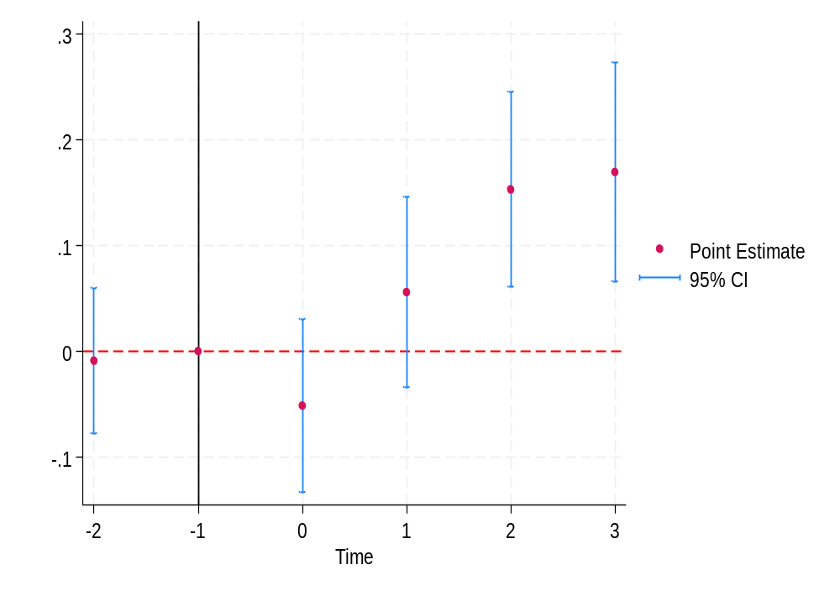
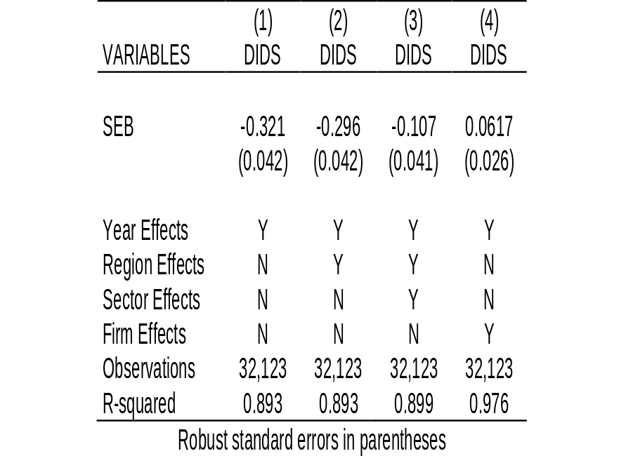
  Forestry Executive Board
PRODUCTIVITY IMPACTS BETWEEN 2016-2019
Difference in Difference estimates 2016-2019

Slide 27
3
Lessons Learned.

Slide 28
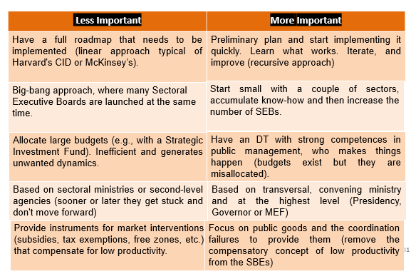
Lessons from SEBs

Slide 29
Challenges
The biggest challenge is scalability due to the capabilities of the dedicated team (DT).
Key to incorporate capacity building in the DT (looking for experts in the private sector, abroad, in universities or other areas of the public sector).
Once created, it is essential to shield these capacities so that they are not lost due to shocks that activate political restrictions. As in other areas, building these capacities can take time, but politicians can destroy them in a matter of days.

Slide 30


