Slide 1
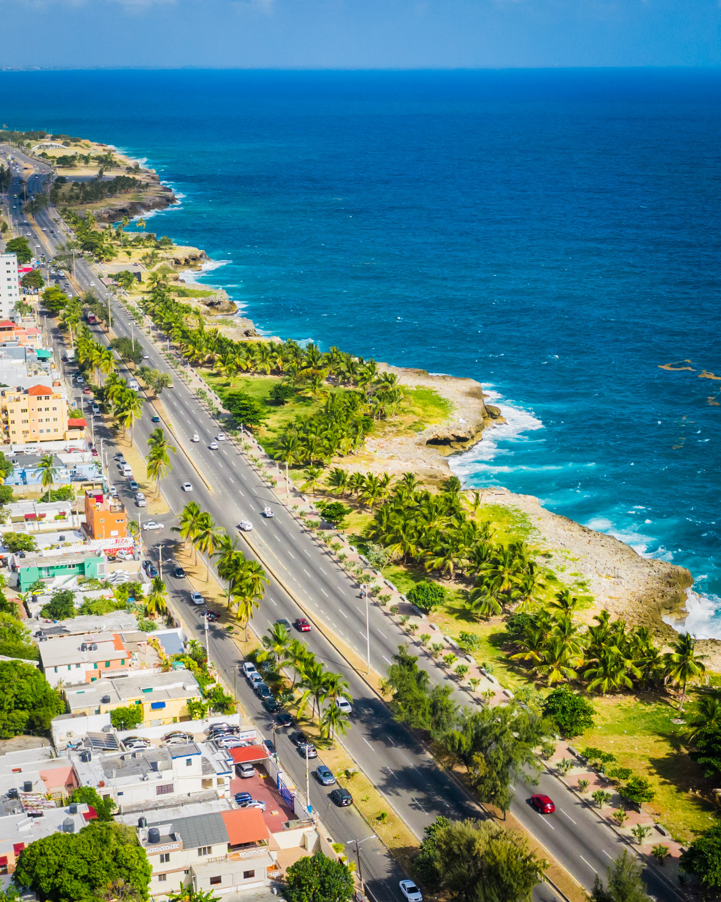


The Experience of the Centers for Productive Innovation and Tech Transfer – CITE: Peru
Henry Espinoza
Director of the General Directorate of Strategy, Development, and Strengthening of the CITE - ITP
October 15th

Slide 2

1. INTRODUCTION

Slide 3

3

Slide 4
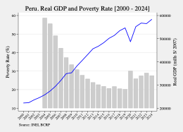
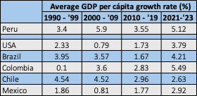
Despite good economic performance, still some challenges remain
4

Slide 5
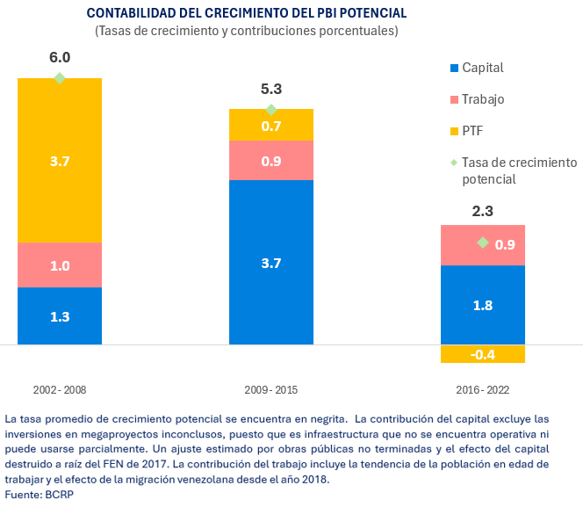
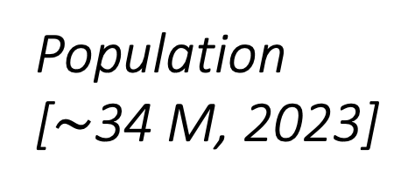
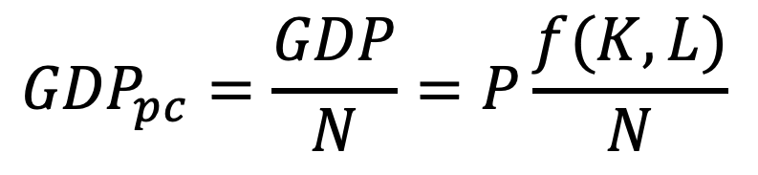
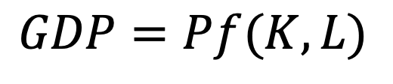
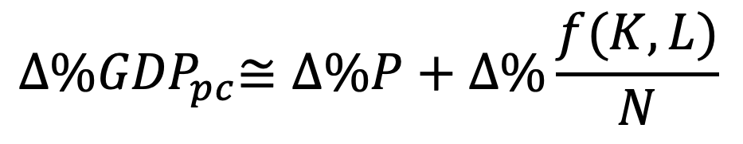
Looking at the sources of growth…
Growth Theory [Solow (1956, 1957),
Romer (1986, 1990)]
Productividad
$$GDP=Pf(K,L)$$
Labour
Capital
Population [$\sim$34 M, 2023]
$${GDP}_{pc}=\frac{GDP}{N}=P\frac{f(K,L)}{N}$$
Growth Identity and sources:
$${∆\%GDP}_{pc}≅∆\%P+∆\%\frac{f(K,L)}{N}$$
5

Slide 6
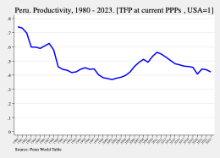
It’s obvious when we observe productivity trends
6

Slide 7





Importance of working on increasing the productivity of Peruvian firms
In case of one firm
Share of productive factors ($K$ and $L$) in firm 1
99% of formal firms are micro, small and medium-sized (SUNAT).
Medium, small and micro firms are as 50%, 16% and 6% productive as of large firms (ECLAC, 2017).
More than 80% of the workforce works in companies with less than 51 employees (INEI, 2024).
We need less informality and more productivity.
$${GDP}^{PER}=P_{1}b_{1}$$
[All factors in firm 1]
In case of two firms
[firm 1 and firm 2 share the productive factors]
$${GDP}^{PER}=P_{1}b_{1}+P_{2}b_{2}$$
In case of $n$ firms
$${GDP}^{PER}=P_{1}b_{1}+P_{2}b_{2}+⋯+P_{n}b_{n}$$
[$K$ and $L$are distributed among $n$ firms] ➞ distribution matters!!!
7

Slide 8
2. OUR MISSION

Slide 9
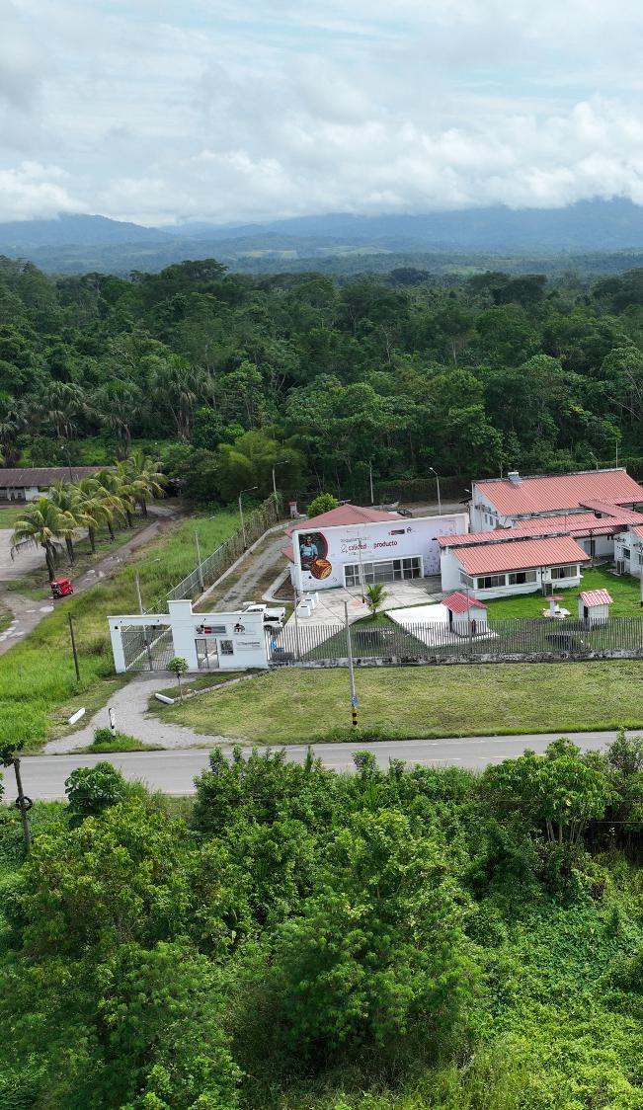
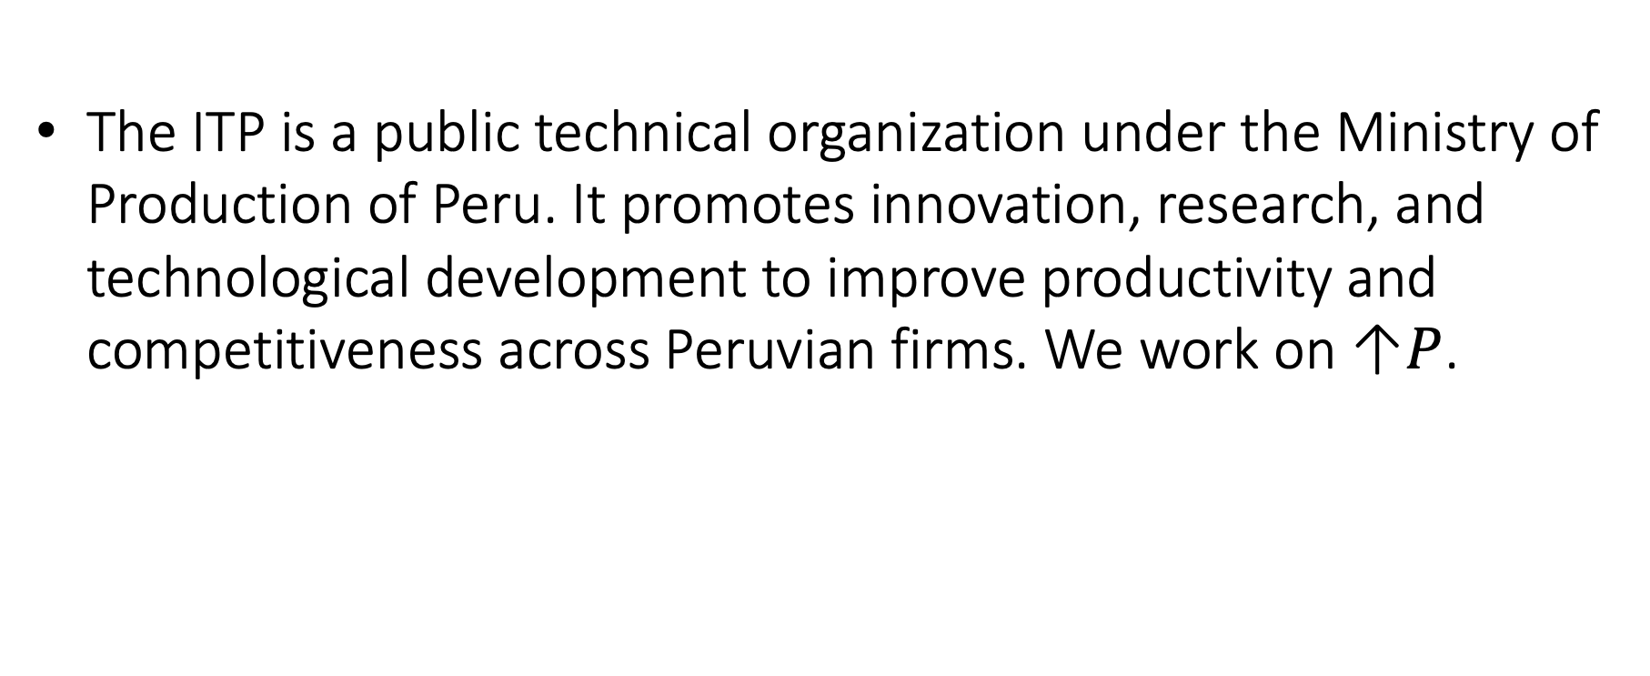
The Technological Institute of Production – ITP of the Ministry of Production
The ITP is a public technical organization under the Ministry of Production of Peru. It promotes innovation, research, and technological development to improve productivity and competitiveness across Peruvian firms. We work on ↑$P$.
ITP contributes to Peru’s industrial competitiveness by improving product quality, efficiency, and innovation capacity. It plays a key role in regional development and supports economic diversification through sustainable technology adoption.

Slide 10













ITP works all over the country
SAN MARTÍN
LORETO
CITEproductivo San Martín
CITEcafé especiales PERHUSA
CITEproductivo Maynas
CITEforestal Maynas
PIURA
CITEpesquero acuícola y agroindustrial Piura
CITEagroindustrial Piura
PASCO
CITEagroindustrial Oxapampa
Agroindustrial
UCAYALI
LAMBAYEQUE
CITEproductivo Pucallpa
CITEforestal Pucallpa
25
CITE públicos
Unidad Técnica agroindustrial Lambayeque
Textile
CAJAMARCA
MADRE DE DIOS
Unidad Técnica madera Cajamarca
CITEproductivo Madre de Dios
CITEminería y medio ambiente Ayuda Que Vale Oro APCAQV
LA LIBERTAD
Fishing-aquaculture
CITEcuero y calzado Trujillo
CITEagroindustrial Chavimochic
CITEagropecuario CEDEPAS Norte
CUSCO
09
Unidades Técnicas
CITEtextil camélidos Cusco
CITEagroindustrial VRAEM
HUÁNUCO
CITEagroindustrial Huallaga
Unidad Técnica Agroindustrial Ambo
CITE papa y otros cultivos andinos ADER'S
PUNO
Mining
CITEtextil camélidos Puno
CITEacuícola Puno
CITEcafé y cultivos asociados CECOVASA
JUNÍN
13
CITE privados
Unidad Técnica cuero y calzado Junín
CITEagroindustrial CaféNARSA
AYACUCHO
AREQUIPA
Forestry and wood
Unidad Técnica agroindustrial Ayacucho
CITEtextil camélidos Arequipa
CITEcuero y calzado Arequipa
CITEagroindustrial Majes
LIMA Y CALLAO
Energy, Logistics and Supply Chain,
Metalworks and Creative Industries
CITEcuero, calzado, textil y confecciones Lima
CITEmadera y del mueble Lima
CITEpesquero, acuícola y agroindustrial Callao
Unidad Técnica agroindustrial Huaura
Unidad Técnica textil y confecciones Lima
CITElogística GS1
CITEacuícola UPCH
CITEmateriales PUCP
CITEagroindustrial café Central de Organizaciones Productoras de Café y Cacao del Perú - Café Perú
CITEenergía Silicon Technology
ICA
ICA
MOQUEGUA
CITEagroindustrial Ica
CITEagroindustrial Moquegua
CITEpesquero Ilo
HUANCAVELICA
Leather and footwear
CITE textil camélidos Huancavelica
Unidad Técnica acuícola pesquera Huancavelica
10
APURÍMAC
TACNA
CITEagroindustrial Apurímac
Unidad Técnica agroindustrial Tacna

Slide 11




ITP’s Strategy
Integration into competitive, sustainable and inclusive value chains
MSMEs
Low productivity
Low added value
Noncompliance with standards
Inefficient processes
High degree of informality
Good practices
Compliance with standards
Safety and certifications
Modern and technological processes
Formality
Access to national and international markets
Technological Services
11

Slide 12
3. PROVIDING TECHNOLOGICAL SERVICES

Slide 13





CITE technological services (1)
The CITE Network (provide R&D services, training, technical assistance, and quality improvement programs for multiple industries including food, textiles, fisheries, and forestry.
Technical Assistance
Increase productive capacity and ensure the competitiveness of companies through personalized consulting services
Training
Through theoretical and practical courses, the skills and abilities of company personnel are strengthened, improving their performance and productivity.
Product Design and Development
It works from modeling to prototype development to create innovative products that allow it to enter new markets.
Promotion of Research, Development and Innovation
It promotes technological solutions, process improvements, and applied research in firms to improve their production processes and products.

Slide 14
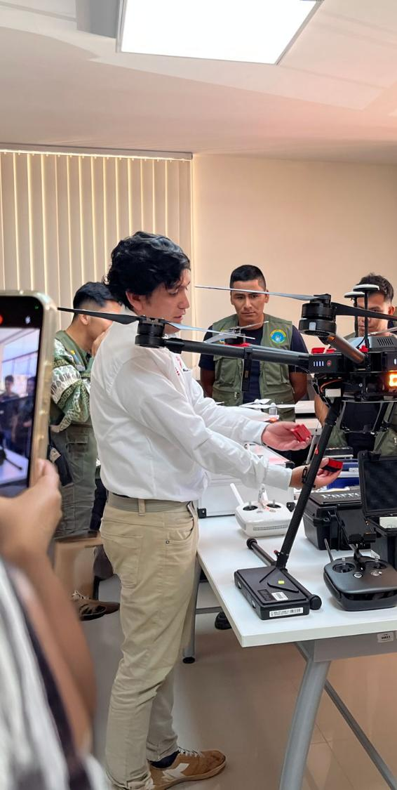



CITE technological services (2)
The CITE Network (provide R&D services, training, technical assistance, and quality improvement programs for multiple industries including food, textiles, fisheries, and forestry.
Certification of labor competencie
Strengthens the competitiveness of companies with qualified personnel in specific profiles, both theoretically and practically, enabling an improvement in the performance of companies' human capital.
Laboratory tests
It performs physical-chemical, microbiological, organoleptic, and other tests based on technical standards and national and international protocols, ensuring product quality.
Productive support
It facilitates the use of specialized technology and machinery for small-scale production of processed or semi-processed products at CITE facilities.

Slide 15
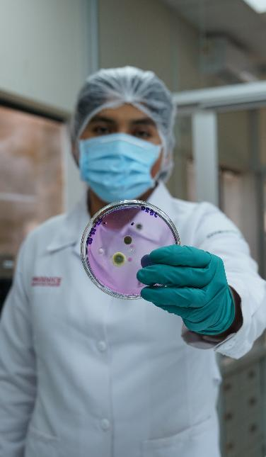
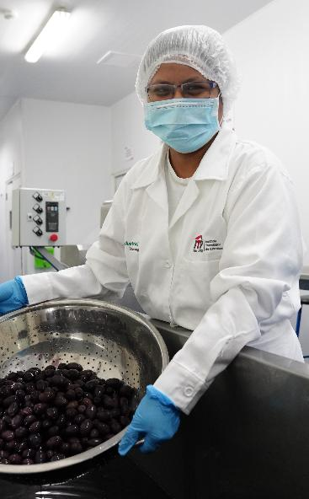
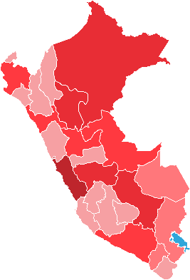



ITP red CITE services in the last 10 years
99,543
650,315
1,477
Agroindustrial | 44,893 | 283,102 | 1,246
Fishing-aquaculture | 21,433 | 82,054 | 837
Forestry and wood | 16,518 | 126,242 | 704
Leather and footwear | 13,504 | 95,504 | 497
Textile | 13,132 | 63,413 | 593
15

Slide 16
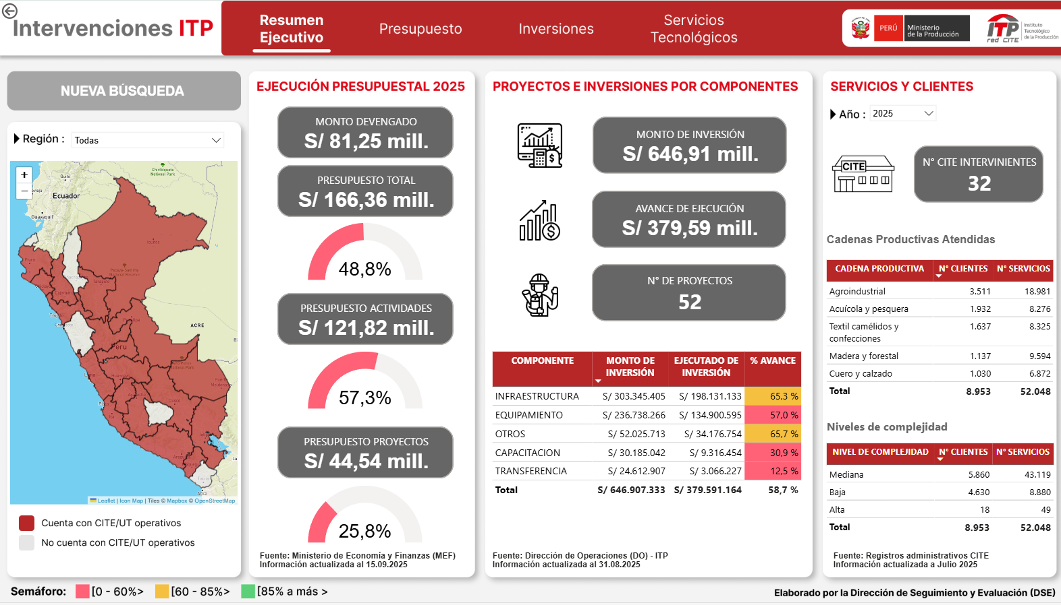
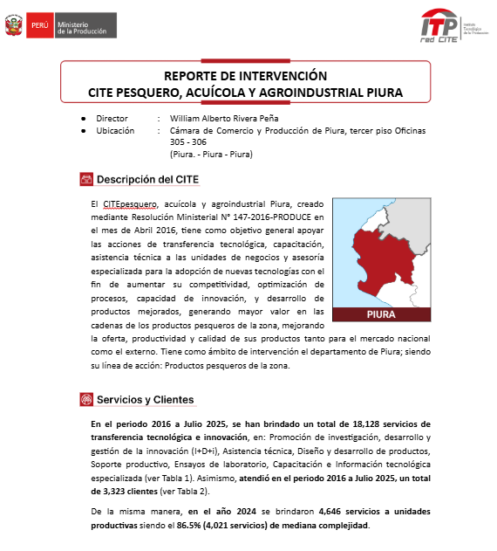
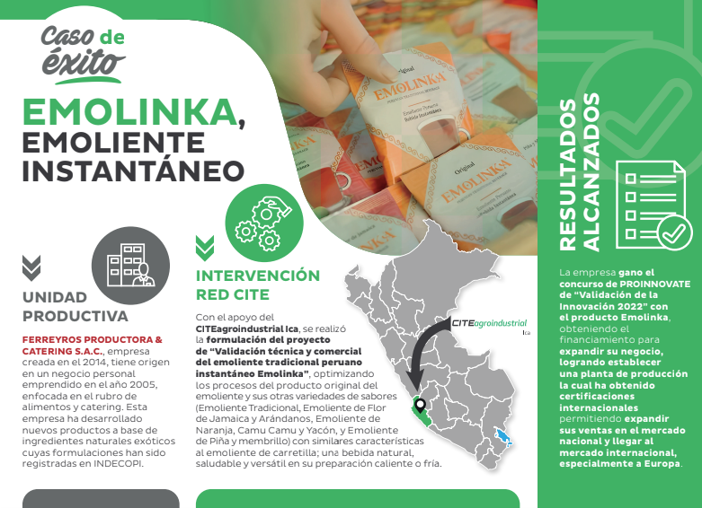
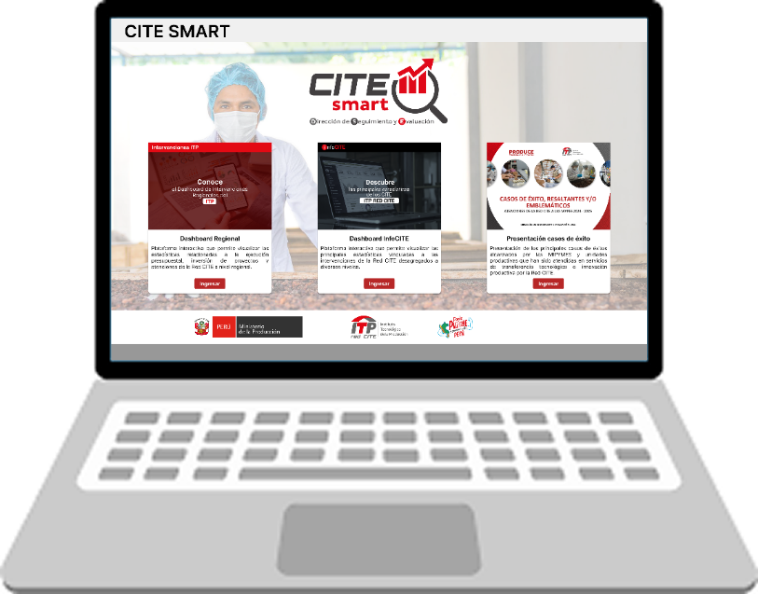
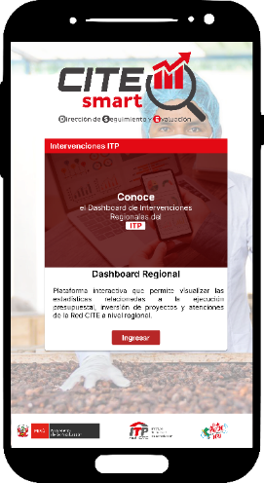
CITE SMART
WEB CITE SMART is the ITP statistics and information platform.
It offers high-quality data for evidence-based decisions, including the InfoCITE Interactive Dashboard and Regional Interventions, accessible from PCs and mobile devices.
It also presents the main success stories of MSMEs and productive units that have received technical support from the CITEs.
http://citesmart.itp.gob.pe/
16

Slide 17
4. WHAT WE DO?

Slide 18

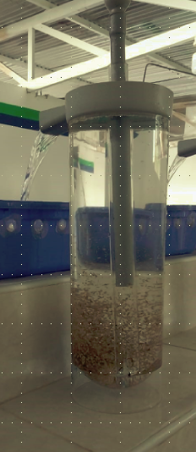



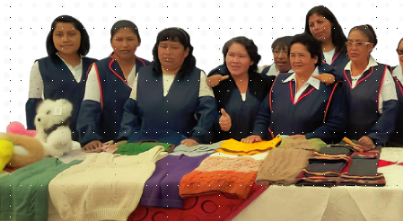
Some examples of our work
18

Slide 19
5. WRAPPING UP

Slide 20

Conclusions
By promoting innovation, productivity, and sustainability, it strengthens the foundation for long-term economic growth.
Still some challenges ahead:
  Innovations as incentive for formalization.
  Improve commercial networks → access to global markets.
  More academic involvement.
Final message: ↑ Productivity: the only way to welfare.
20

Slide 21
The Experience of the Centers for Productive Innovation and Tech Transfer – CITE: Peru
Henry Espinoza
Director of the General Directorate of Strategy, Development, and Strengthening of the CITE - ITP
October 15th

