Slide 1

Trade in Services to Stimulate Growth in the Caribbean
Krista Lucenti
Lead Specialist, Trade and Investment Division, IDB
RPD Promoting Private Sector Development and Economic Diversification in the Caribbean| October 2025

Slide 2
Global Trade in Services: Rapid Growth, Rising Share
Services trade is outpacing goods trade worldwide: In 2023, global services exports grew 9%, while goods trade declined by 5%.
Services now represent about 27% of total world trade, up from 21% ten years ago—a clear structural shift in global commerce.
Digitally delivered services—such as IT outsourcing, software, and creative content—now account for over 55% of services exports, reflecting rapid digitalization.
Creative and cultural services are among the fastest-growing categories, expanding 2.8× in the past decade.
These trends underline a strategic opportunity for the region to leverage its strengths in global business services, the creative economy, and logistics to capture high-value growth.

Slide 3
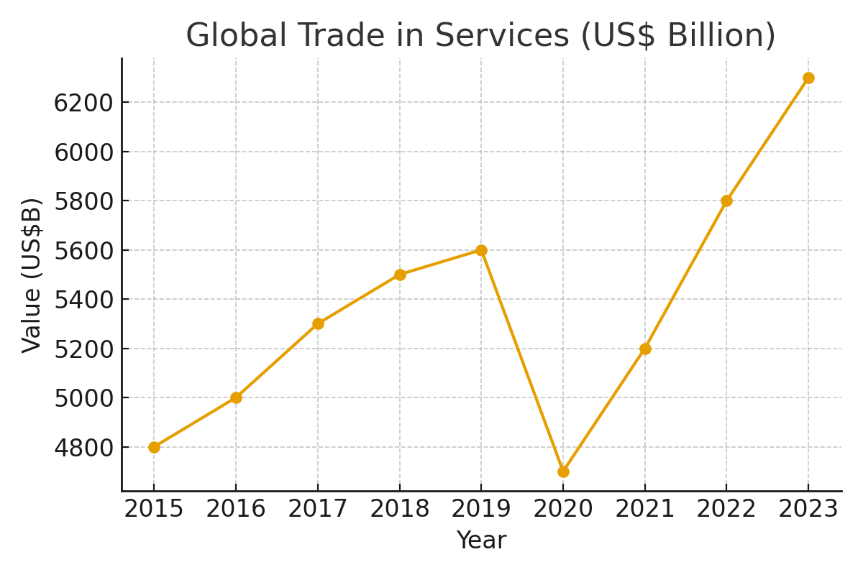
Why Trade in Services Is Strategic for Development in a Shifting Global Landscape
Services as a Resilient Growth Engine
From 2020 to 2023, global services trade rebounded sharply—from $4.75 trillion to over $6.3 trillion—outpacing goods trade in recovery and growth.
For developing economies, services offer a pathway to structural transformation, enabling a shift from resource-dependent exports to knowledge-intensive, higher-margin activities.
Employment, Skills, and Inclusion
Services sectors—particularly digital, creative, and professional services—are more inclusive and scalable. They absorb diverse talent pools, including youth and women, and require lower capital intensity than manufacturing.
Digitalization and Global Reach
Remote work, cloud platforms, and AI-driven service delivery has redefined market access = small firms can now serve global clients in real time.
Democratization of trade enables countries to leapfrog traditional infrastructure constraints and participate in global value chains through virtual exports.

Slide 4
Why Trade in Services Is Strategic for Development in a Shifting Global Landscape
Cultural and Creative Industries as Soft Power Assets
Creative services—film, music, animation, fashion—are not only exportable but also enhance national branding and tourism.
Countries that integrate cultural exports into their trade strategy (e.g., South Korea, Jamaica) benefit from cross-sector spillovers and global visibility.
Policy Leverage and Strategic Diversification
Services trade is highly responsive to regulatory reform, investment promotion, and trade agreements.
In the current climate of nearshoring and digital decoupling, countries with agile service sectors and favorable business environments are better positioned to attract FDI and diversify their export base.
Strategic alignment of services with national development plans—such as SEZ regimes tailored to services, digital infrastructure investment, and skills pipelines—can unlock long-term competitiveness.
Notes:
Digital decoupling refers to the practice of adding new technologies on top of legacy applications to increase their functionality = refers to the separation of digital components from traditional business structures, enabling organizations to leverage specialized digital services independently. This concept empowers businesses to adapt rapidly to technological advancements and stay competitive in the digital era.

Slide 5
Is Nearshoring Still Strategic for the Caribbean?
Global shift: U.S. reshoring and onshoring have increased for critical goods (semiconductors, EVs, pharma), but services and non-strategic operations are still moving nearshore.
Services trade remains dynamic: U.S. services imports from LAC grew 8–10% annually (2020–2024), reflecting demand in key niches:
  Global services (BPO/ITO/KPO)
  Digital content and creative industries
  Specialized logistics and maritime services
Advantages | Challenges
English-speaking U.S. aligned time zones Cultural affinity and stable political systems Expanding digital infrastructure and talent pool | High energy and logistics costs Limited scale Infrastructure (physical and digital) gaps Reduced competitiveness vs. Central America

Slide 6
The Caribbean’s “Nearshore-Plus” Strategy
Nearshoring alone isn’t sufficient — Caribbean economies must diversify across high-value service clusters.
Digital transformation and creative exports are major global growth engines
Policy priorities: Regional integration, talent development, digital infrastructure, IP and data frameworks, export and investment promotion, green incentives.
Strategic diversification pillars:
Pillar | Focus Areas | Examples
Digital services | BPO, ITO, fintech, health tech | Jamaica, Barbados
Creative exports | Music, film, design, fashion | All Caribbean countries
Logistics & connectivity | Port services, e-commerce logistics | Jamaica, T&T
Green industries | Renewable energy, climate finance | Barbados, Belize, Guyana, Suriname
Knowledge services | Education tech, research hubs | Barbados, Jamaica, T&T

