Slide 1

Identifying Economic Sectors with Dynamic Growth Potential in Caribbean SIDS
IDB 2025 Sub-Regional Policy Dialogue
Bridgetown, Barbados on October 15-16, 2025
Dr Preeya Mohan, Senior Fellow
Sir Arthur Lewis Institute of Social and Economic Studies, University of the West Indies, St Augustine

Slide 2
The Low-Growth Trap: Why Caribbean SIIDS Can't Compete
Structural deficiencies have locked Caribbean SIDS into a low growth cycle.
1. The Climate Debt Trap
  Climate Change Impact: Major storms reduce GDP by up to 17% in impact years, compounding debt and recovery costs (UNDP 2025).
  High Energy Rates: Retail electricity rates (US$0.22/KWh) are among the highest globally, undermining competitiveness (Mohan 2022).
2. Barriers to Private Sector Development
  Brain Drain: 68% of the tertiary-educated workforce emigrates, reducing innovation (Mishra 2006).
  Credit Constraint: 71% of firms are fully credit-constrained, unable to modernize or scale (Beuermann et al. 2024).
  Small Markets: Innovators state the local market is “too small for the cost of innovation” (Beuermann et al. 2024).
3. High Cost of Doing Business
  Poor Infrastructure: Power and internet outages cost firms an average of 2.2% of annual sales (Beuermann et al. 2024).
  Systemic Corruption: 66% of firms make informal payments to public officials to operate (Beuermann et al. 2024).

Slide 3
Strengths and Opportunities for Future Growth
Inherent Natural Assets
Caribbean SIDS are global leaders in tourism offering traditional “sun, sea, and sand” but also niche markets like heritage, culture, and wellness tourism.
While small in land mass, Caribbean SIDS control vast Exclusive Economic Zones (EEZ), averaging 28 times their land area.
Caribbean SIDS possess significant forest resources and are biodiversity hotspots.
Leadership in Climate Action and Clean Energy Transition
Caribbean SIDS are global leaders in pushing for climate justice and have demonstrated a strong commitment to climate action.
Human Capital and Global Connectivity
While Brain Drain is a significant challenge, the large, highly-educated Caribbean diaspora represents a massive, untapped source of human, financial, and intellectual capital.

Slide 4

Our Approach: Identifying Economic Sectors with Dynamic Growth Potential
Objective
To identify specific sectors where expansion rates significantly exceed the national economic growth average.
Dynamic Growth Sector (DGS)
Defined as sectors with an accelerated rate of expansion, where the average GDP growth rate over the last 5–10 years surpasses the national average.
Scope of Analysis
13 Caribbean SIDS analyzed- Antigua and Barbuda, The Bahamas, Barbados, Belize, Dominica, Grenada, Guyana, Jamaica, St. Kitts and Nevis, St. Lucia, St. Vincent and the Grenadines, Suriname, and Trinidad and Tobago.

Slide 5
Methodology
Phase 1:Structural Transformation Analysis and Historical Growth Analysis- Macroeconomic Screening and Initial Sector Identification
1
Phase 2: Prospective Analysis – Incorporating Global Trends, Technology and Climate Change Impacts
2
Phase 3: Detailed Sector Characterization and Prioritization
3
Phase 4: Bottleneck Analysis and Policy Recommendations
4

Slide 6
Data Sources
National Accounts Statistics:
GDP by Economic Activity, Value Added by Sector.
Sources: National Statistical Offices, World Bank (WDI), IMF, UNECLAC
Labor Force Statistics: Employment by Sector,
Sources: National Statistical Offices, World Bank (WDI), ILO
Innovation and Technology Indicators:
Global Innovation Index (GII) Data, Frontier technology readiness index, National Statistics (R&D, Patents, Digital Adoption).
Sources: WIPO, UNCTAD, National Statistical Offices, World Bank (ICT indicators)
Climate Change Impacts: Climate Risk Indices, Reports.
Sources: UNDRR, IPCC, regional climate centers (CIMH), Climate Watch, IRENA, UNEP, WTO, FAO, national environmental ministries, regional development banks (CDB, IDB)
Trade Statistics/consumer demand: Exports by Product/Service Category
Sources: National Statistical Offices, ITC Trade Map, UN Comtrade, WTO
Industry/Technical Reports, Policy documents, Academic Research
Source: Government websites, McKinsey and Company, WEF

Slide 7

Inventory of DGS
Hotels and Restaurants: Most consistently dynamic, a pillar for sustained tourism.
Construction: Widespread growth driven by tourism infrastructure and public works.
Mining and Quarrying: Large-scale oil/gas and local quarrying for construction.
Specialized Services: Financial, Real Estate, Telecoms- indicates increasing economic sophistication.
Transport and Supporting Activities: Crucial enabler for tourism and general services.
Electricity, Gas and Water Supply: Reflects necessary critical infrastructure investment.
Agriculture and Fishing: Localized potential for targeted development in resilient export sectors.
Manufacturing: Localized potential for targeted development in resilient non-traditional export sectors.

Slide 8
DGS Across a Heterogeneous Economic Landscape
Tourism-based Service Economies
The Bahamas, Barbados, St. Kitts and Nevis, St. Lucia, St. Vincent and the Grenadines
Hotels and Restaurants, Construction (fuelled by tourism/investment), Financial Services
Commodity-based Economies
Guyana, Trinidad and Tobago, Suriname
Mining and Quarrying
Emerging Diversified Economies
Jamaica, Dominica, Grenada
Construction, Mining and Quarrying, Specialized Services (Financial Intermediation, Real Estate, Agriculture, Hunting, Forestry, and Fishing

Slide 9
Dynamic Growth Sector | Countries | Average Growth Rate (2014-2023) %
Hotels and Restaurants | Antigua and Barbuda | 6.02
 | The Bahamas | 8.81
 | Belize | 0.62
 | Dominica | 12.83
 | Grenada | 11.95
 | Guyana | 8.19
 | St. Kitts and Nevis | 8.38
 | St. Vincent and the Grenadines | 6.50
Construction | Dominica | 9.87
 | Grenada | 7.01
 | Guyana | 11.00
 | St. Lucia | 5.96
 | St. Kitts and Nevis | 2.33
 | St. Vincent and the Grenadines | 3.51
Mining and Quarrying | The Bahamas | 12.85
 | Dominica | 11.19
 | Guyana | 55.16
 | St. Lucia | 9.29
 | St. Vincent and the Grenadines | 10.98
Specialized Services (Financial, Real Estate, Telecoms) | Jamaica | 0.15¹
 | Trinidad and Tobago | 1.00²
Transport and Supporting Activities | Antigua and Barbuda | 4.26
 | The Bahamas | 6.82
 | Dominica | 5.80
 | Grenada | 5.74
 | St Kitts and Nevis | 3.62
 | St. Vincent and the Grenadines | 3.40
 | Suriname | -0.17
Electricity, Gas and Water Supply | Antigua and Barbuda | 3.23
 | The Bahamas | 9.59
 | Guyana | 5.83
Agriculture and Fishing | Dominica | 7.62³
 | Jamaica | 0.12
Manufacturing | Grenada | 5.11

Slide 10
Aligning DGS with Global Demand Opportunities
Future growth lies in specializing in niche, high-value services and sustainable, ethically sourced goods.
Hotels and Restaurants
Experience Economy: Wiser Wallets, Aging Population, Global Consumer Class Growth.
Expand Niche Tourism: Target new source markets and high-value, culturally immersive experiences.
Agriculture and Fishing
Lean Local: Health/Wellness, Sustainability, Global Value Chain Reconfiguration.
Enhance Food Security: Capitalize on demand for ethically sourced, locally produced goods.
Specialized Services
Digital Disruption: AI, Personalization, Near-Shoring of Services, Gen Z/Aging Population Demand.
Develop Tech-Driven Services: Create tailored financial/business products leveraging AI and near-shoring trends.
Electricity, Gas and Water
Sustainability & Energy Transition.
Invest in Renewables: Reduce fossil fuel reliance through solar, wind, and geothermal infrastructure.
Transport & Supporting Activities
Logistics Reconfiguration: Tech Disruption, Supporting Near-Shoring.
Optimize Supply Chains: Leverage digital platforms to facilitate trade and support near-shoring logistics.

Slide 11

Technology as a Core Enabler: Frontier Tech Applications
AI & Big Data
Hotels & Restaurants Experiential AI Platforms: Hyper-personalize tourism, optimize operations, and enhance revenue yield.
Specialized Services FinTech & RegTech Hubs: Automate compliance, enhance fraud detection, and enable cross-border digital banking.
IoT (Internet of Things)
Agriculture & Fishing Precision Agriculture: Use sensors for climate-smart yields, optimizing water/fertilizer use.
Electricity, Gas & Water Decentralized Smart Grids: Build resilient, modern infrastructure essential for clean energy transition.
Advanced Manufacturing (3D Printing)
Construction/ Manufacturing Resilience-Focused Modular Systems: Rapidly 3D-print climate-resilient, affordable housing and specialized components locally, reducing high import reliance.
Biotechnology
Agriculture & Fishing Agri-Biotech Labs: Develop high-value, climate-resilient food crops and new bio-based products (e.g., from Sargassum) to enhance food security.
Blockchain
Specialized Services Secure Financial Transactions: Enhance trust, immutability, and efficiency for smart contracts and fractional ownership, deepening FinTech sophistication.

Slide 12
Climate Change: Risks, Resilience, and Strategic Opportunities
Hotels & Restaurants
Risk: Coastal Damage; High Imported Fuel Costs.
Opportunity: Blue Economy: Sustainable Eco-Tourism & Wellness Retreats. Clean Energy Transition.
Electricity, Gas & Water
Risk: Fuel Dependence; Centralized Grid Risk.
Opportunity: Renewable Energy: Decentralized Smart Grids; Investment in Geothermal for resilient power.
Construction
Risk: Infrastructure Destruction; Lack of Resilient Capital.
Opportunity: Climate-Resilient Infrastructure: Green Construction (sustainable materials); 3D Printing for rapid housing.
Agriculture & Fishing
Risk: Yields Threatened by Heat, Rain, Sea-Level Rise.
Opportunity: Climate-Smart/Blue Economy: Agroforestry (carbon sink); Sustainable Aquaculture; Forest Management.
Specialized Services
Risk: Digital Disruption; Rising Sovereign Disaster Debt.
Opportunity: Innovative Climate Finance: Green/Blue Bonds; Tailored Insurance; Resilient Digital Infrastructure.
Transport & Supporting
Risk: Coastal Erosion of Ports/Airports; Supply Chain Risk.
Opportunity: Resilient Port Infrastructure: Climate-Adaptive Hardened Logistics; Transition to Clean Transport (EVs).
Manufacturing
Risk: High Energy Costs; Supply Chain Vulnerability.
Opportunity: Circular Economy: Waste-to-Value Industries (biofuels/plastics); On-site Solar Power.
Mining & Quarrying
Risk: ESG Scrutiny; Environmental Impact.
Opportunity: Sustainable Resource Management: Implement robust ESG Compliance and real-time monitoring; Restoration Services.

Slide 13
Sector Characterization and Prioritization (1)
Strategic Sector | High-Priority Sub-Sectors | Core Growth Potential | Key Employment Potential | Strategic Competitive Advantage
High-Value Tourism | Personalized/Niche Tourism, Eco-Tourism | High (Global trend for custom, ethical, and authentic experiences). | Medium (Tech experts, specialized guides, conservation/park management). | High (Unique culture, pristine natural resources, and authentic experiences are key assets).
Circular Economy | Sustainable Manufacturing, Green Construction Recycling, Waste Management | High (Converts waste liability into economic asset; essential for resilient infrastructure). | Medium (Specialized jobs in material science, advanced manufacturing, recycling). | High (Necessity creates advantage; attracts environmentally conscious investment; transforms waste problem).
Climate-Resilient Infrastructure | Built Infrastructure, Ecosystem-Based Adaptation (EBA) | High (Urgent, non-negotiable need to protect key economic assets). | Medium (Green construction, specialized engineering) to Low (Ecological restoration). | High (Inherent vulnerability drives unique expertise that can be exported globally).

Slide 14
Sector Characterization and Prioritization (2)
Strategic Sector | High-Priority Sub-Sectors | Core Growth Potential | Key Employment Potential | Strategic Competitive Advantage
Knowledge Economy | ICT, Digital Services, FinTech, Logistics | High (Global tech demand; high mobile penetration). | High (High-skill, high-wage roles in software, data science). | High (English-speaking, strategic time zone/location, strong finance base).
Blue Economy | Marine Biotechnology, Blue Carbon Services, Sustainable Fisheries | High (Vast marine biodiversity; emerging global carbon market). | High (Marine Biotech: High-skill R&D) to Low (Blue Carbon: specialized management). | High (Rich marine biodiversity, extensive coastal/mangrove ecosystems, large EEZ).
Clean Energy & Decarbonization | Solar/Wind, Green Hydrogen, Energy Efficiency | High (High fossil fuel cost arbitrage; global decarbonization push). | High (Green Hydrogen: high-skill engineering/production) to Medium (Installation/Maintenance). | High (Abundant natural resources; strategic location for Green Hydrogen export/bunkering).

Slide 15
Sector Characterization and Prioritization (3)
Strategic Sector | High-Priority Sub-Sectors | Core Growth Potential | Key Employment Potential | Strategic Competitive Advantage
Climate Smart Agriculture | Agri-Biotech/Agri-tech, Precision Farming, Sustainable Farming Systems | High (Urgent need for climate-resilient yields; reduced import dependency). | Medium (New, higher-skilled roles in data analysis, science, and sustainable systems). | High (Tropical climate, leveraging global trend for ethical/sustainable sourcing, strengthened food security).
Land and Forestry | Green Carbon Ecosystem Services, Agroforestry, Sustainable Forest Management | High (Rapidly expanding global carbon credit market; resilient revenue streams). | Medium (Conservation, surveying, tree management) to Low (Specialized data analysis for carbon credits). | High (Rich natural capital, extensive forests, unique position to generate high-quality carbon credits).

Slide 16
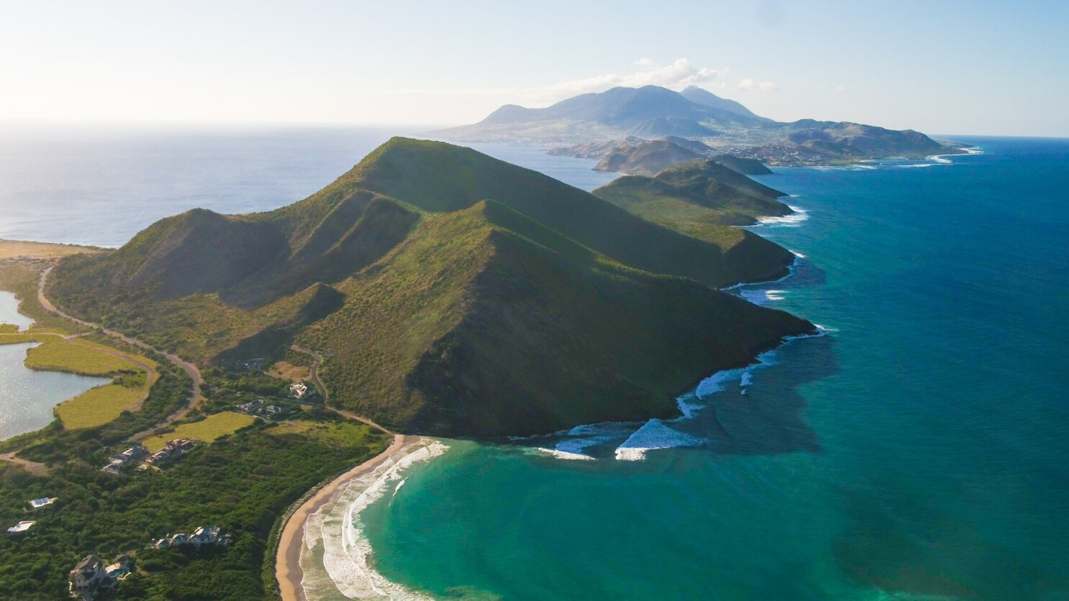
Preeya.Mohan@uwi.edu
Thank you

