Slide 1

Business Innovation, Productivity and Performance in the Caribbean
Sylvia Dohnert, Rodrigo Sierra, and Nathalia Amarante-Pufal

Slide 2
Stagnation in the 21st Century
“Productivity is not everything, but in the long run it is almost everything” – Paul Krugman
Business innovation is one of the main drivers of productivity growth

Slide 3
Understanding business innovation patterns
IFPG data: 13 countries, 1979 businesses (formal, >5 employees)
Innovative: new or significantly improved good or service, organizational methods to produce or provide the service, marketing, and business models in the past 3 years
Potentially innovative: did not introduce innovations but plan to innovate in the next 2 years or consider at least one of the 14 barriers to innovation to be major or very severe.
Non-innovative: did not introduce any innovation and are not potentially innovative
Digital innovation: introduced new methods for information processing or communication
Green innovation: reduced units of input to create same units of output, reduced energy use, CO2 footprint, reduced pollution, recycled.

Slide 4
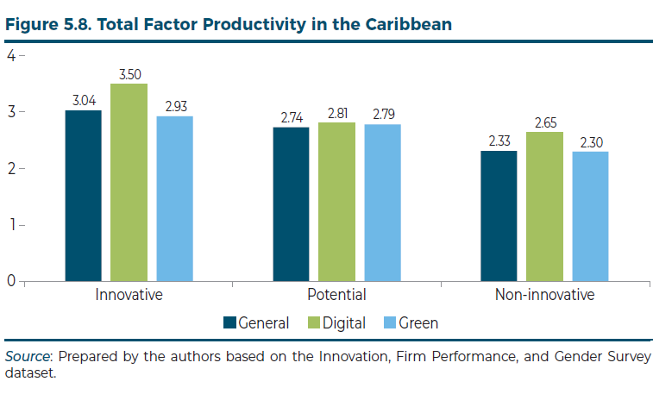
Caribbean businesses that innovate…
Have higher productivity on average, and less dispersion around the mean
Had up to 81% higher sales per worker!!
Those that invested in innovation before COVID had a better chance to withstand the downturn caused by the pandemic
Independent categories: a firm can fall into any of the three categories for general, digital and green innovation

Slide 5
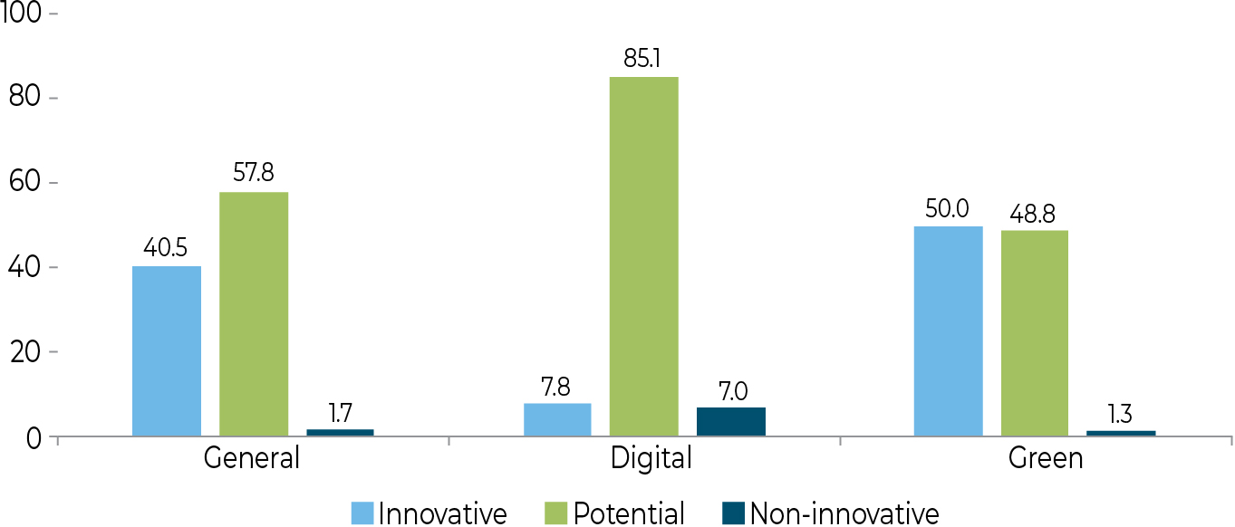
Most Caribbean firms want to innovate, but face obstacles
In other words, we’re leaving money on the table
(There are also very few digitally innovative businesses)
Notes:
This chapter traces the innovation behavior of Caribbean businesses across three dimensions: General (new product, process, marketing, organizational method), Digital (introduction of new digital technology across the firm) and Green (reduction of waste, pollution, carbon, recycling efforts, reduction in use of materials), and where the data makes it possible, it makes comparisons to Latin America and the rest of the Caribbean region. Innovation behavior is analyzed with respect to size, type of sector, gender of ownership, and compares past behavior using the 2010 and 2014 datasets. It also examines the impact of policy and makes some recommendations.
Only 10% of Caribbean businesses accept mobile money
Only 8% accept electronic payments through money transfers
Over 70% of even large businesses are potential digital innovators

Slide 6
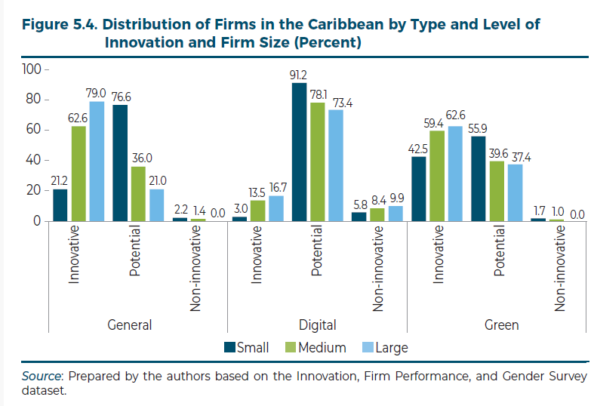
Smaller firms face greater obstacles
(Yet firms of all sizes face obstacles for digital innovation)

Slide 7
Context – Characteristics of firms
 | Caribbean | Latin-America
Small (<20 employees) | 57.6% | 35.9%
Medium (20-99 employees) | 32% | 38.9%
Large (>=100 employees) | 10.4% | 25.2%
Manufacturing | 16.4% | 64.8%
Services | 83.6% | 35.2%
Direct exporters | 35.6% | 23.6%
Average firm age | 30 years | 28 years

Slide 8
Top 6 obstacles to innovation
Caribbean
Latinamerica
Qualification of employees
Level of available financial resources
Degree of self-confidence for innovation
Current organizational/managerial culture
Labor force lacks skills required for innovation
Market too small for the cost of innovation
Financing of innovation is too costly
Level of available financial resources
Competitors are too strong
Flexibility/openness of other companies in the sector for collaborative approaches
Market too small for the cost of innovation
Compliance requirements to meet international standards
Notes:
It would seem that in the Caribbean, we are in a much more incipient stage – in LatinAmerica, issues related to labor market and training have been solved, as well as degree of self-confidence for innovation and the current organizational/managerial culture.
Public policy can address many of the bottlenecks in the Caribbean
A few things to note with respect to the top 6 obstacles to innovation:
first, they are consistently the top 6 for the three kinds of innovation analyzed in the chapter, even if they may present in a different order for each of the types of innovation
Second, some of them are very different than the rest of LAC. For example, the rest of LAC does NOT have the qualification of employees, the current organizational/managerial structure and the skills present in the labor force among the top 6.
Third and most important – four of these are clear market failures that require a policy response. The level of available financial resources is restricted by difficulties in accessing finance in general – but also access to finance for innovative behavior by businesses, which in many instances is hard to price and therefore unavailable to businesses. The degree of self-confidence for innovation denotes a lack of information about what to do in order to create new products and processes, or progress on the digital and green fronts. 3) the market too small for cost of innovation requires trade policy, and 4) the labor force lacks skills required for innovation is a function of the general education and vocational training context.

Slide 9
Top 4 impacts of innovation in the Caribbean
Opened access to new markets
Increased capacity for producing goods and services
Increased sales
Improved the quality of goods/services
Only 13.7% of Caribbean businesses were aware of technical assistance programs for technology adoption and management improvements
Only 1.3% had received support from these programs - yet those that participated saw significant effects on sales and the ability to develop new goods and services or production processes, and to obtain quality certifications

Slide 10
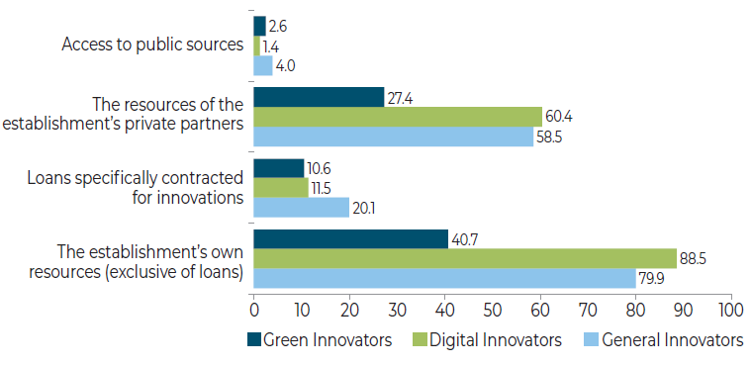
Sources of innovation financing
Caribbean
Latin America
Public institutions: 9.43%
Own resources: 87.9%
Banks: 34.75%
Others: 11.97%

Slide 11
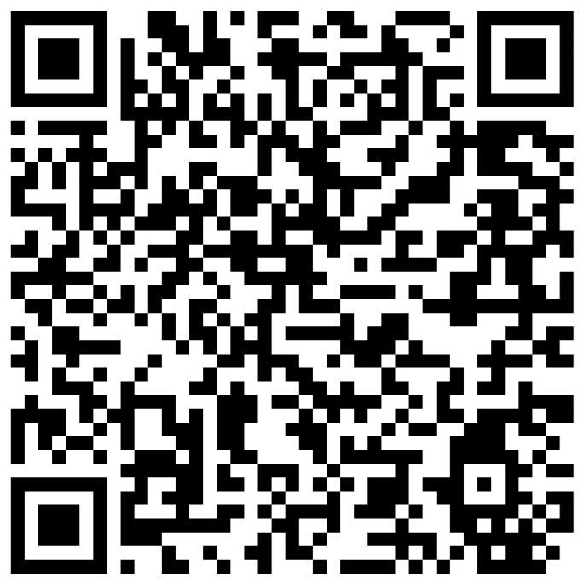
DOWNLOAD THE BOOK NOW!

