Slide 1

+2,000 engaged Afro-entrepreneurs
Online platform, workshops and national and international business rounds

Slide 2
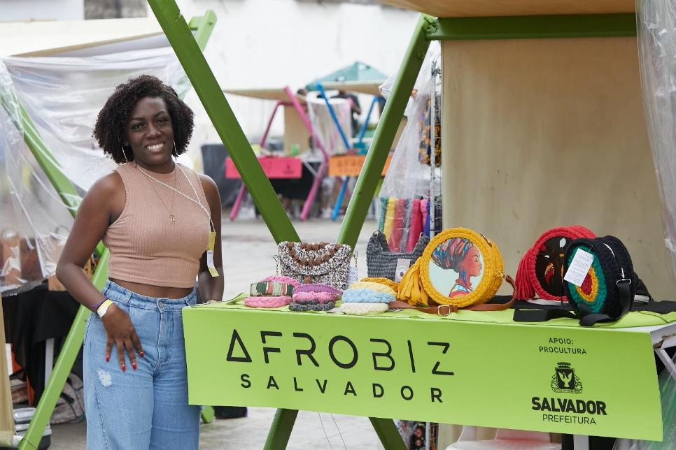

Slide 3


+1.000
CERTIFIED PERSONS
Knowledge trails for general and specific training and business mentoring

Slide 4
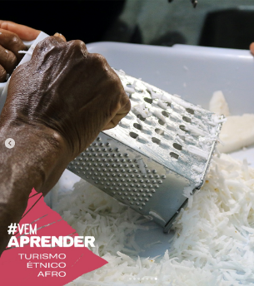
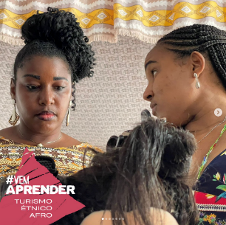
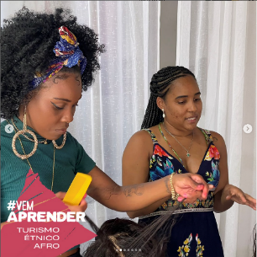
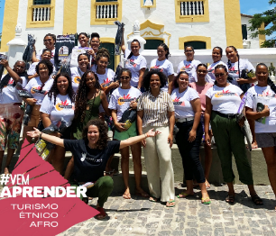
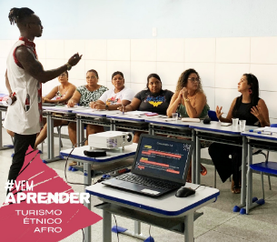
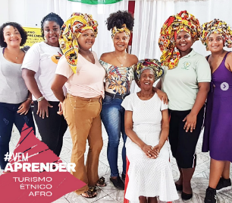

Slide 5

ROLÊ AFRO
Afrocentric tourist itineraries and experiences in the capital of Bahia mapped and published

Slide 6


Movement to strengthen and promote Afro tourism, with PR, press and event organization actions
+17.000
PARTICIPANTS IN 2 EDITIONS

Slide 7
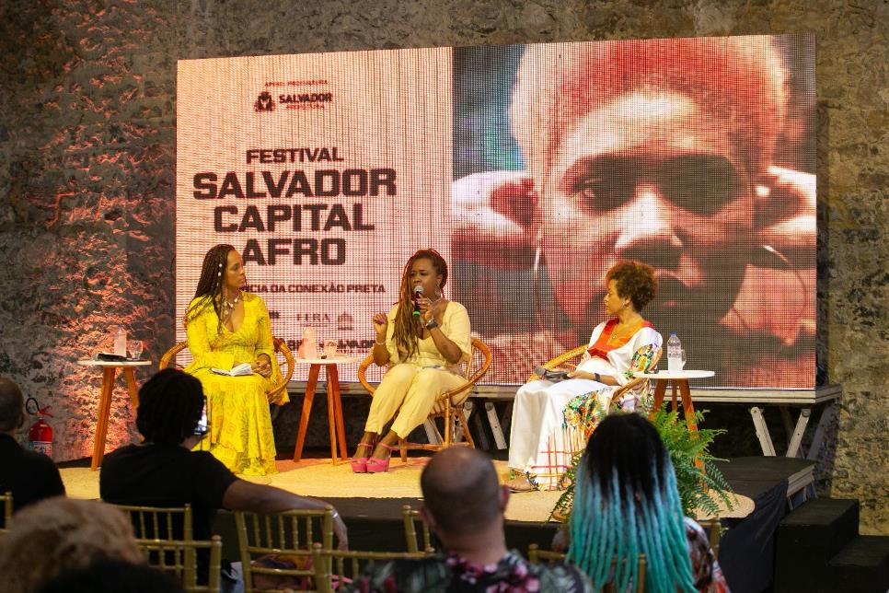

Slide 8
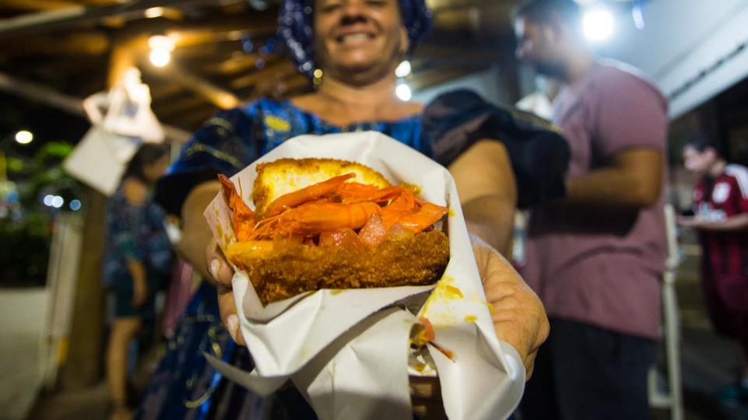

Slide 9
