Slide 1



BOOSTING INNOVATION, GROWTH & ENTREPRENEURSHIP ECOSYSTEMS
(BIGEE)
Programme Presentation
October 2025

Slide 2






BOOSTING INNOVATION, GROWTH AND ENTREPRENEURSHIP ECOSYSTEMS (BIGEE)
CHALLENGES FACING THE SECTOR:
THE SOLUTION:
The Boosting Innovation, Growth and Entrepreneurship Ecosystems (BIGEE) Programme was launched in 2020 by the Government of Jamaica (GOJ), demonstrating a commitment to private-sector growth.
Access to Funding
Lack of Technical Support
Commercialisation for Inventions
Co-financed by a US$25M loan from the Inter-American Development Bank (IDB).
ECOSYSTEM GAPS:
Limited access to financing for high-potential firms.
Low levels of commercialisation of local research and innovation.
Inadequate technical support & weak links between academia, BSOs & private sector.
Supported by an additional US$8.2M grant from the European Union (EU), often targeting women entrepreneurs and climate-resilient projects.

Slide 3
THE ROLE OF MSMES IN JAMAICA
THE MSME LANDSCAPE IN JAMAICA
90%
60%
44%
15%
425k
MSMEs constitute over 90% of all registered businesses, serving as the foundation of the national economy.
MSMEs account for approx. 60% of all employment in Jamaica
MSMEs contribute approximately 44% to Jamaica's GDP
MSME actors account for approximately 15% of Jamaica’s population.
MSME actors account for approximately 15% of Jamaica’s population.
MSMEs in Jamaica
Economic Backbone
Employment Creation
Growth Engine
Entrepreneurial Development
Economic
Impact

Slide 4



WHAT WE HOPED TO ACCOMPLISH WITH BIGEE
GOAL: To promote sustainable and robust growth among Startups & MSMEs in Jamaica by strengthening the entrepreneurial value chain.
COMPONENT I
COMPONENT II
COMPONENT III
COMPONENT IV
Established MSMEs
Scalable Startups
High Potential Startups
Project Management
Promote innovation & productivity through funding, technical assistance, and mentorship.
Promote sustainable and
disruptive growth.
Create a robust, sustainable pipeline of future high-growth firms.
Strengthened the network to deliver structured support and foster a strong entrepreneurial mindset

Slide 5
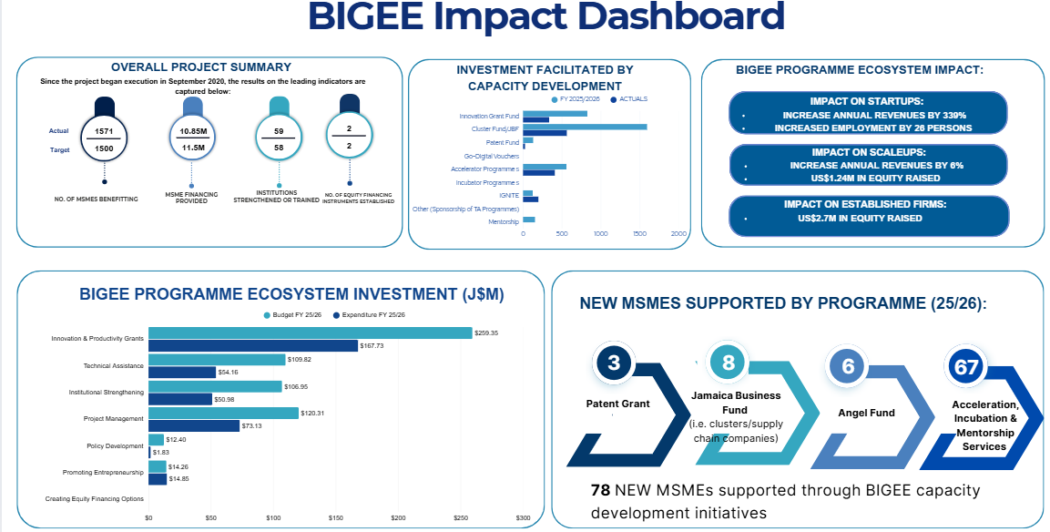
BIGEE IMPACT DASHBOARD

Slide 6
BIGEE IMPACT DASHBOARD

Slide 7






SUPPORTING THE BUSINESS LIFE CYCLE
SCALE UP / GROWTH
BUSINESS SUPPORT
Reaching new horizons
Ecosystem Development
Deployed innovative financing instruments to facilitate expansion:
  Equity financing via Angel Fund and Venture Capital Fund
  Technical assistance in business planning, financial managment & market strategy
Holistic Support:
Using the Ecosystem - Based Approach, to support entire ecosystem not just startups.
ESTABLISHED
Boost Productivity
Focused on innovation management & technology adoption to boost productivity & global competitiveness
Inclusivity & Data
Targeted support for women, youth & underserved groups guided by data
STARTUP
From idea
to reality
Provided grant funding & technical assistance to encourage risk-taking and business formalisation.
Business Incubation & Acceleration
Strengthening the Institutions that support startups and scaleups:
•Improve training and mentorship for clients
•Provide financing to support closing the gaps

Slide 8
POLICY COHESION
DBJ & ECOSYSTEM ALIGNMENT
INNOVATION FUND
DBJ’s Complementary Programmes Addressing Financing Gaps
Holistic Approach
Market Capitalisation
The DBJ's suite of products works in cohesion with BIGEE to ensure businesses have continuous support:
Works alongside other GOJ/Private Sector initiatives to deepen capital markets
Non-BIGEE Interventions
BIGEE Interventions
Micro Market (JSE)
GOJ-approved initiative (spearheaded by the Jamaica Stock Exchange) to allow Micro and Small Entities (MSEs) to raise J10M–J49.9M in patient, equity capital, providing an ultimate exit pathway for high-growth firms nurtured by BIGEE.
Credit Enhancement Facility (CEF)
Provides partial loan guarantees to Approved Financial Institutions, reducing lending risk and increasing MSME access to commercial debt capital.
Angel Fund
Co-investment financing arrangement to support angel investing
Jamaica Business Fund (JBF)
Supports supply chain strengthening and competitiveness, often prioritizing critical areas like climate resilience.
IGNITE & Patent Grant Fund
Specific BIGEE components that provide targeted grant funding for new ideas and intellectual property protection.

Slide 9
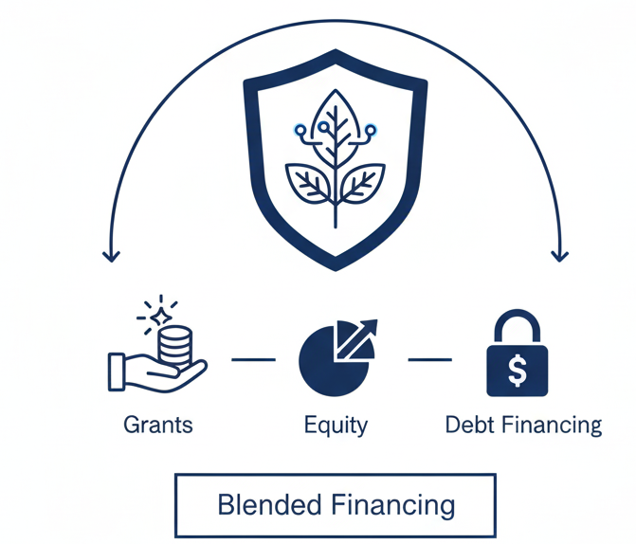


ASSESSING CURRENT IMPACT & BUILDING SUSTAINABILITY
TANGIBLE
RESULTS
SUSTAINABLE
ENVIRONMENT
THE FUTURE:
BIGEE II
BIGEE II
Momentum
Deepen impact & expand reach
BIGEE I
Phase I has disbursed over US$9.9M, supporting over 1,500 MSMEs.
IGNITE Grant Recipients reported an average 60% increase in sales.
IGF Recipients reported a 25% increase in employment.
50+ individuals trained in Incubator Accelerator Training Programme
Four established Technology Commercialization Offices
Created a sustainable environment for innovation by reducing risk for entrepreneurs through a blend of grants, equity, & debt financing.
The success of Phase I has laid the foundation for BIGEE II, which is currently being designed to build on this momentum, deepen impact, and further expand reach across the entrepreneurial landscape.

Slide 10








LESSONS LEARNED
LESSONS LEARNED
  New Innovations
New innovations landscape still in a nascent state – limited patentable, commercialisable inventions
  Cluster Development
Cluster Development programmes are effective tools to identify or test innovations, new technologies or practices for productivity improvement.
There is increased interest in investing equity in early stage companies in Jamaica – Equity platform is growing. US$2M over last 2 years.
  Investing Equity
Specialised business incubators and accelerators are effective to support MSMEs given industry knowledge. Now better able to support those firms.
  Business Incubators
  Access to Finance
Technical assistance support / BIGEE has supported access to financing (debt & equity) for MSMEs & startups – US$13M in debt & equity for MSMEs & startups.

Slide 11




LET’S TALK SUCCESS
CaribShopper
Kingston, Jamaica
EduFocal
Kingston, Jamaica
MD Link
Kingston, Jamaica
Veekle
Kingston, Jamaica
Founded: Jamaican diaspora e-commerce platform
Funding: US$500K investment
Current Status: Operating and growing, serving diaspora customers
Founded: Educational technology platform
Historic Achievement: First tech company to IPO on Jamaica Stock Exchange (2022)
Founded: Telemedicine and healthcare platform
Platform Growth: AI-based COVID diagnosis tool led to 13,000+ registered users
Jobs Created: Made developers full-time, added team members (all Jamaica-based)
Founded: Automotive technology platform
Innovation: Created first on-demand insurance solution in the
Caribbean
DBJ Relevance: Jamaica-rooted company innovating in insurance tech. Woman Owned business.

Slide 12


Thank You!!!
THANK YOU!

