Slide 1



ONE Caribbean:
Regional Cooperation for Sustainable Development
Private Sector Regional Policy Dialogue
16 October 2025

Slide 2




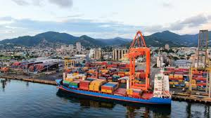
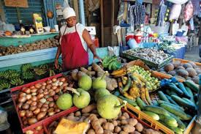
Overview
Launched in March 2024 as the IDB Group’s strategic framework and 5-year regional program to foster regional cooperations to tackle shared challenges.
4 Strategic Pillars and 2 Cross-Cutting Areas (Institutions and Digital):
Pillar 1:
Climate and DRM
Pillar 2:
Citizen Security
Pillar 3:
Private Sector
Pillar 4:
Food Security
Enhancing climate resilient infrastructure, water and energy sector resilience and DRM across the region
Strengthening capacities to prevent and effectively respond to crime
Enhancing the enabling environment to foster private sector development and boost productivity
Reducing trade barriers and increasing production and access to nutritious foods
.

Slide 3
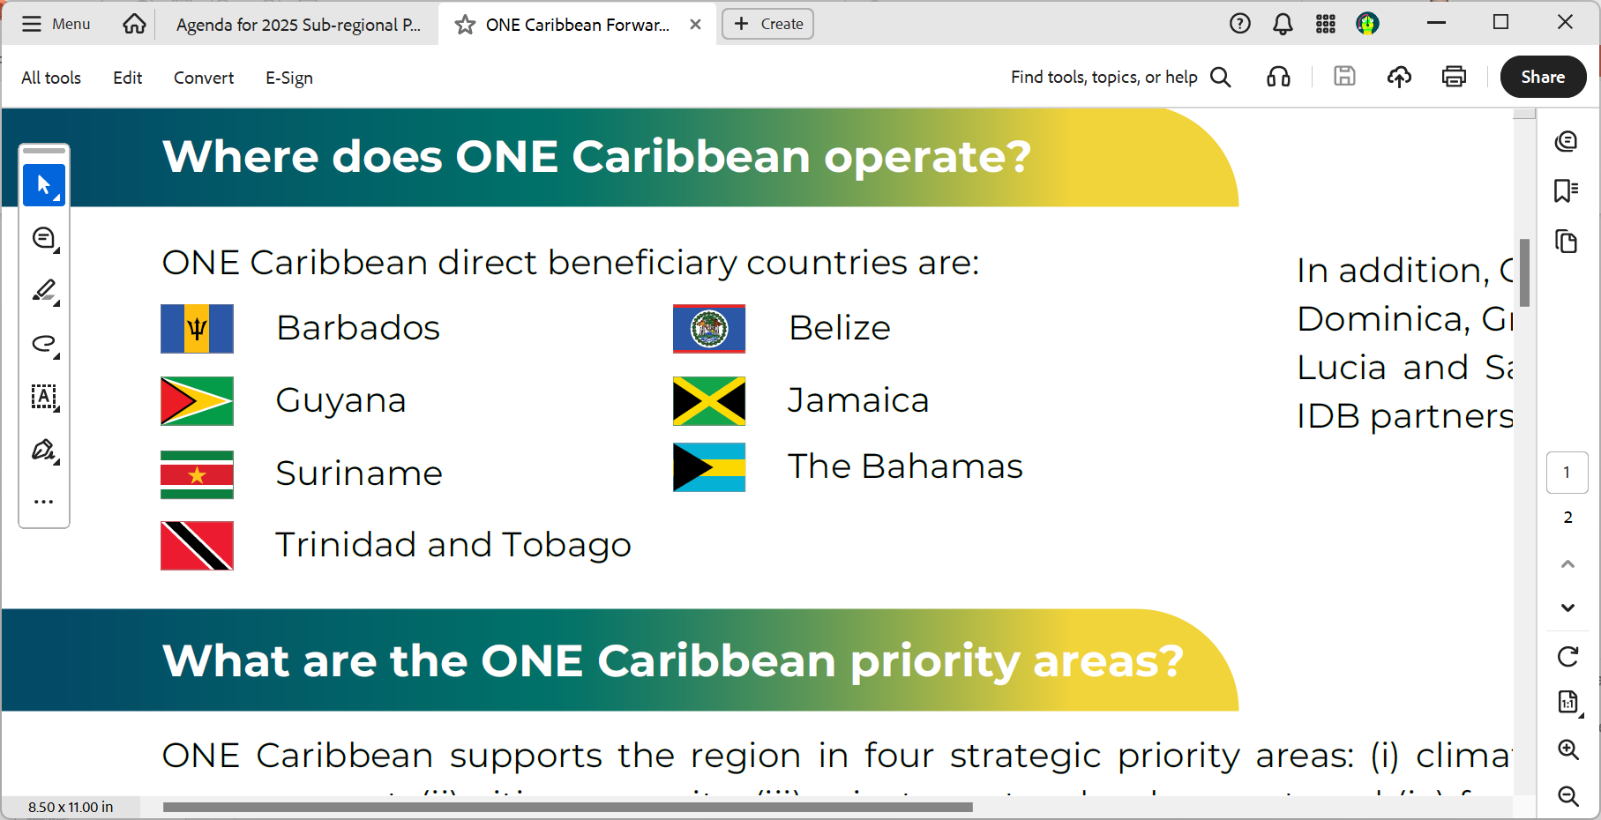
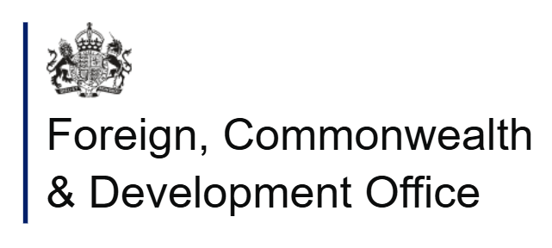

Overview
Direct beneficiary countries: IDB Caribbean country members (including Belize).
Led by the ONE Caribbean Unit​ within the IDB Caribbean Department. A whole of bank approach to align projects, policy and partnerships to deliver regional results.
Resources:
          IDB Ordinary Capital $20m
          Multi-Donor Trust Fund with $13m commitments from founding donors: UK and Canada.
Private Sector Pillar – deep dive to follow:
          1) Flagship: Project Preparation Coordination Mechanism (private, PPPS, public)
          2) SME TA Facility
          3) Catalyzing Impact Investment

Slide 4
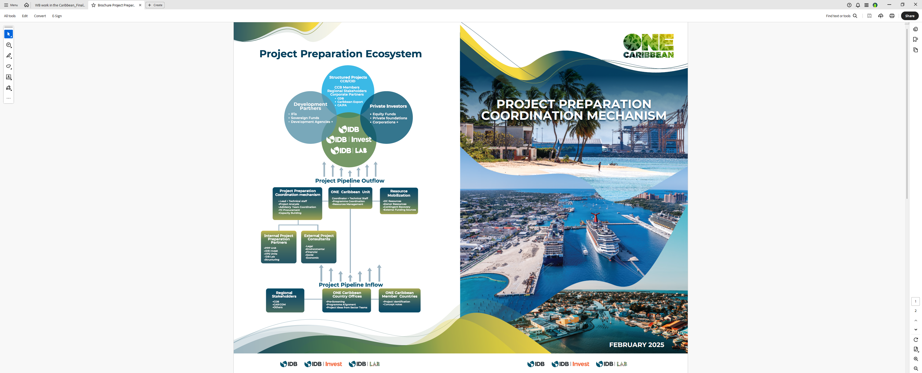
1) Flagship: Project Preparation
Flagship offer to support project preparation –Private, PPPs or Public Sector; and upstream (i.e. feasibility) or downstream (structuring).
Launched in February 2025 in The Bahamas. Brochure, Guidance Note and Concept Note/Project Proposal Templates available.
Internal Technical Advisory Committee (TAC) established to review submissions (Sr technical reps from IDB Invest, Lab, Sectors, Country Teams).
Projects – In our first 6 months, 11 projects assessed with 1 already receiving funding.

Slide 5
1) Flagship: Project Preparation
Partnerships – Widespread engagements with stakeholders and MOU signed with the Caribbean Export Development Agency in July to support pipeline development.
Roadshow underway :
  Jamaica: Held on 28 July
  The Bahamas: Held on 11 September
  Trinidad and Tobago: To be on 3+4 November
  Barbados: To be on 10 November
Capacity building – Complementary offer of on-the-ground PPP training in countries.

Slide 6

2) SME TA Facility
SMEs face limited access to business support services and affordable finance to compete in global markets.
A partnership being established between the IDB Group, Government of Canada, Sygnus Capital, the CARICOM Development Fund (CDF) and CDB.
Targeted technical assistance to be provided to high-growth SMEs, pursuing climate-resilient or adaptation-related projects.
SMEs to gain access to both technical expertise to strengthen business models and governance structures as well as be well positioned for equity or debt investments through the Caribbean Community Resilience Fund (CCRF).

Slide 7

3) Catalyzing Impact Investment
Catalyzing impact investment into the Caribbean is urgently needed to drive economic resilience, reduce inequality, and build climate adaptation in a highly vulnerable region.
Through a joined up IDB-Invest-Lab project, ONE Caribbean is providing:
  Tailored training to PE/VC fund managers on impact measurement, deal structuring, and fund management in Caribbean markets; and
  Knowledge exchange – taking policy makers and innovators from the region to learn from best practice and best fit models for developing private sector ecosystems.
First Caribbean Impact Masterclass for Fund Managers held in Jamaica in May.

Slide 8



More Information
ONECaribbean@iadb.org
Brochure
Website

Slide 9


