Slide 1


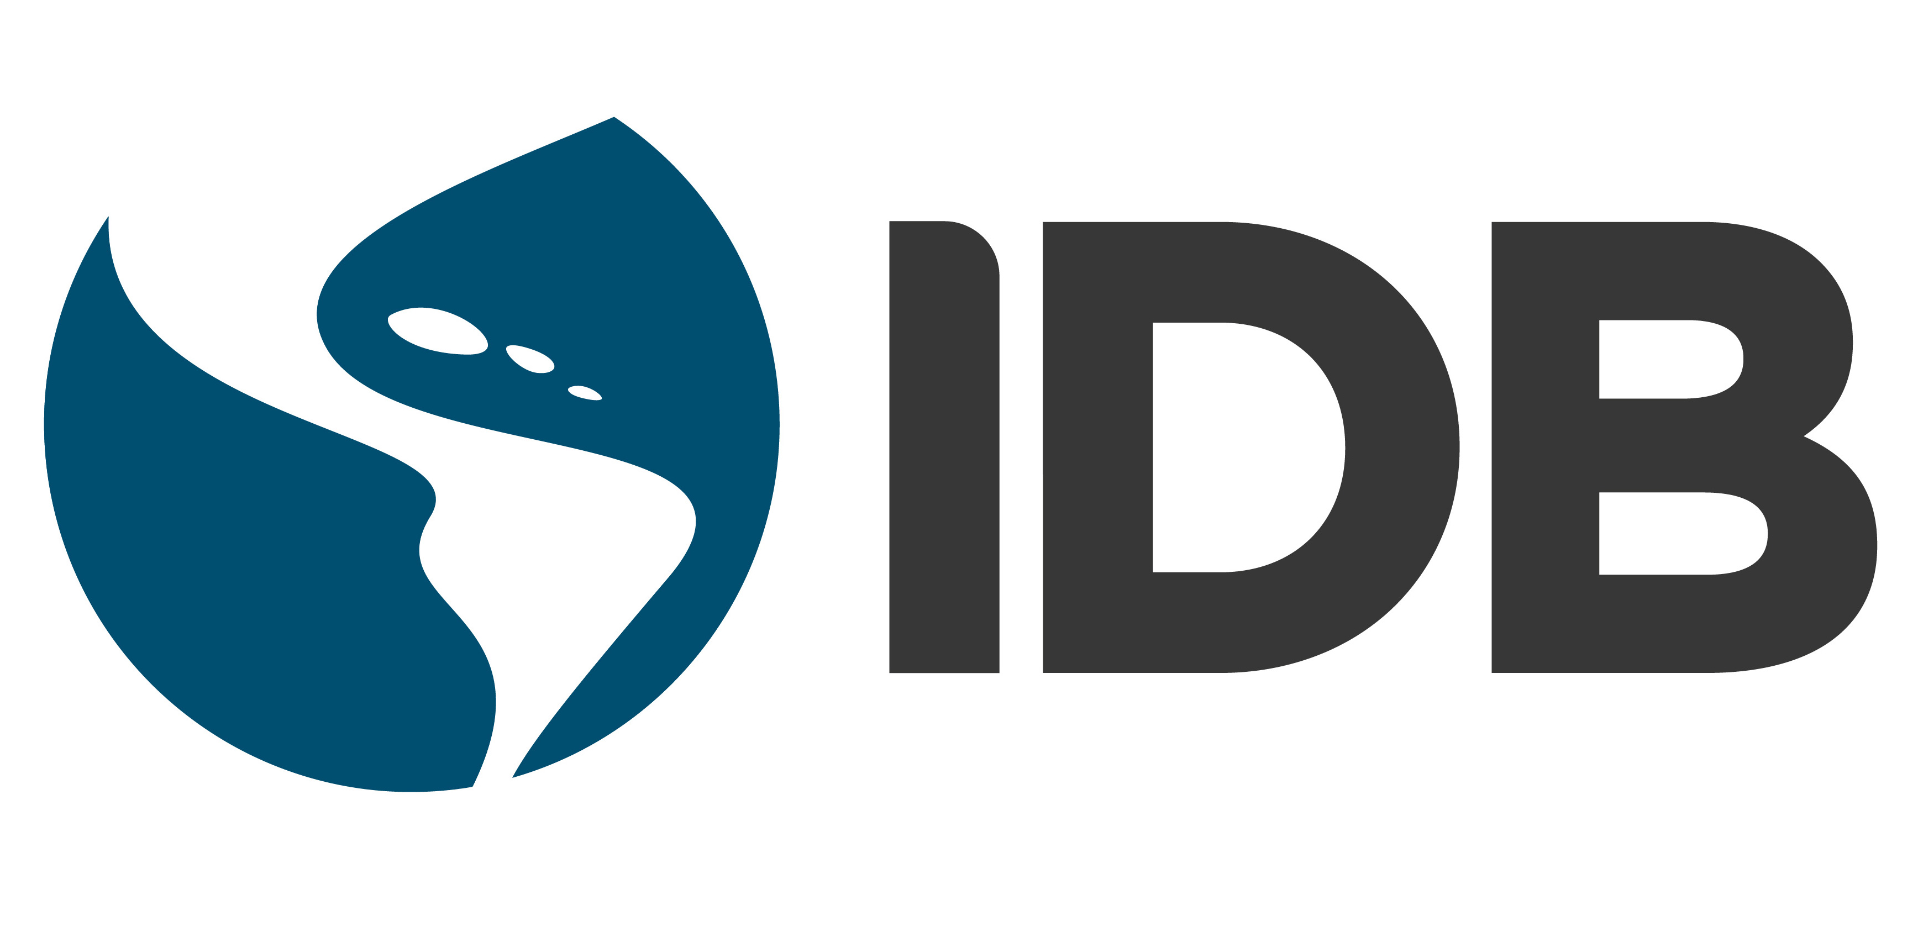
CONNECTING DISPARATE DATA: How Blockchain can Improve Access to Finance for Caribbean SMEs
Brooke Hadeed, Georgia Perrine,
Rebecca Turczynowicz, and Haisley Wert

Slide 2
The problem
Between 2010 and 2013
0.8%
growth rate in the Caribbean
3.6%
growth rate in ROSE
Declining competitiveness
Stagnant Caribbean economy
Declining productivity
Notes:
Stagnant economy: between 2010 and 2013 Caribbean growth rate fell to an average of 0.8 percent while ROSE grew by 3.6 percent.
Exogenous factors
Unfavourable business environment
One on hand, the Caribbean economy has been stunted by exogenous factors such as the global financial crisis of 2008, with de-risking having a negative impact on growth, innovation, and the stability of financial systems.
On the other hand, within the Caribbean business environment is particularly unfavourable.
SMEs are the backbone of the Caribbean economy
Constitute 69% of the formal sector
Contribute over 50% of GDP
Backbone of the economy: 69% of the formal sector
Face significant credit and security barrier
Barriers stand in the way of their success
Access to Finance
Privacy and data security
Given the right support, SMEs can end the stagnancy of the Caribbean economies and be powerful drivers of growth.
However, many barriers stand in the way of their success.
The biggest is access to finance.
Underlying this is privacy and data security – intrinsic parts of a functioning financial system.

Slide 3
Solution components
SMEs
69%
of the formal economy
50%+
of GDP
Distributed
Economic prosperity
Access to finance
Stagnant Caribbean economy
FinTech
Banks
The most reliable
source of finance
Secure
Blockchain
Incorruptible
Notes:
Exogenous factors
Unfavourable business environment
One on hand, the Caribbean economy has been stunted by exogenous factors such as the global financial crisis of 2008, with de-risking having a negative impact on growth, innovation, and the stability of financial systems.
On the other hand, within the Caribbean business environment is particularly unfavourable.
SMEs are the backbone of the Caribbean economy
Constitute 69% of the formal sector
Contribute over 50% of GDP
Backbone of the economy: 69% of the formal sector
Face significant credit and security barrier
Barriers stand in the way of their success
Access to Finance
Privacy and data security
Given the right support, SMEs can end the stagnancy of the Caribbean economies and be powerful drivers of growth.
However, many barriers stand in the way of their success.
The biggest is access to finance.
Underlying this is privacy and data security – intrinsic parts of a functioning financial system.

Slide 4
Our proposal
A credential management system that will incorporate alternative data points placed on a secure blockchain-based Self-Sovereign Identification System

Slide 5
Methodology & Limitations
Main findings:
Three categories of alternative information
Applications of blockchain technology
Limitations
Gaps in primary data - informal sector excluded
Caribbean often left out of regional groupings
Economic and legal heterogeneity of the region
Notes:
Desk based research, interviews, consistent data across cases, accuracy, availability
-lacking data on informal sector
-heterogeneity

Slide 6
Problems to overcome
Asymmetric Information
Collateral requirements
Lack of Credit Reporting Agencies
Internet Data Security & Cybercrime
Notes:
cannot acquire necessary information to ascertain a small firm’s ability and willingness to pay
Collateral inequitable distribution of credit: poor, good-quality entrepreneurs are excluded from the market.

Slide 7
'channels of finance that emerge outside of the regulated banking system'
Alternative finance
Solution to market failure of banks and credit unions
Certain degree of innovation required to
assess risk
Notes:
It is estimated that half of all SMEs have unmet credit needs as a result of these barriers to finance that Brooke has mentioned.
Alternative finance has emerged as a solution to the market failure of banks and credit unions inability to transform the data points they look at to assess creditworthiness.
Online alternative finance has taken both debt and equity forms such as crowdfunding and marketplace lenders.
Due to the lack of hard information available to alternative lenders, investors have had to engage in a certain degree of innovation to assess credit risk.
It is within these alternative forms of finance that we have found the appropriate variables to be used in the Caribbean.
Incorporating alternative indicators of creditworthiness directly addresses the transparency market failure and the problematic pre-loan requirements requested.

Slide 8
Alternative data for creditworthiness:
Alternative Payment Data
Accounting Certificates
Mobile and Social Data
Psychometrics
Notes:
Based on our research we have decided that the following four data points will be most useful for the Caribbean. I will now outline the benefits of using such information:
A new data source will ideally:
Have broad and consistent coverage
Contain detailed data elements about an individual (such as on-time and late payments over a significant time series)
Be accurate and frequently updated
Have a system for ongoing data verification and management
Contain information relevant to the behaviour being predicted
Be additive to the predictive accuracy of traditional CRA data

Slide 9
Alternative Payment Data
Utility payments:
Standardised online financial literacy courses
Accounting certificates
23% went from thin to thick-file (Experian 2015)
Rental payments:
E.g. TransUnion Credit in Trinidad
20% went from thin to thick-file (Experian 2014)
Notes:
Alternative payment data encapsulates the regular bill payments of telecommunications, utilities and rental properties, and even alternative lending payments.
Incorporating such data would be particularly useful due to the concentration of utility providers.
Some of this data is already being leveraged in the Caribbean through the TransUnion Credit report system in Trinidad.
Rental payments are another source of data that can be added to consumers credit portfolio. However, this market is far less concentrated than utilities. Given that landlords represent a wider pool of stakeholders, this would also increase coordination costs and make data collection less feasible.
As can be seen behind me, we picked this data as it has proven results in moving around 20% of respondents into a low risk segment.
It is well known that SMEs suffer from low levels of financial literacy, which greatly impacts their ability in writing effective business plans, negotiating terms and managing accounts.
Providing a standardised online financial literacy course that can then be used as additional information would provide multiple benefits for SMEs in the region.

Slide 10
"Mobile phone behaviour is not random, it is a rich proxy for the consumer's lifestyle"
Mobile and Social Data
Mobile data
Information likely already being collected
Provide real-time financial information about spending habits
Social data
Provides and verifies important unobservable information
Default rates less than 13% (Kreditech)
Notes:
Mobile and social data has become a popular tool for credit assessment in the developing world due to the proliferation of ICTs. It can present itself in the form of airtime top-up payments, information on outgoing and incoming calls and texts, mobile internet usage, e-payments and transactions through mobile wallets, and value-added services such as text-message subscriptions or downloads.
Prepaid mobiles and phone history are effective sources of real-time financial information about an individual's spending habits.
For example, an individual that tops up a large amount once a week suggests regular salaried work, whereas small but frequent amounts indicates a flexible, possibly informal, worker (Scharwatt, et al., 2014). Phone call information, such as, how often a user makes, rather than receives, calls, the length of the conversation, and the time of day that calls are made, can all be effective predictors of creditworthiness (McEvoy, n.d.).
Mobile phone activity is already being collected by networks and operators at a relatively low cost and provides a rich history of both financial and non-financial information that credit bureaus, or financial institutions, cannot currently access.
Social data can provide an even richer dataset on a borrower. It includes both social media information, such as existing relationships and size of networks, and other online information, such as websites visited, downloaded apps, locations visited and chat history (Ibid, 2016).
Social data is therefore a useful tool for credit scoring as it provides and verifies important information about the borrower that tends to be unobservable by traditional financial institutions
- Mobile and social data can provide great benefit in developing markets with high unbanked populations with no credit bureau presence. Their use is particularly feasible given the high mobile and internet penetration rates throughout the Caribbean. In most Caribbean countries there are fewer than three mobile phone providers simplifying the sharing of data that is likely already being collected.

Slide 11
Psychometric testing
low-cost way to make more information about the loan applicant available
23% reduction in default rate and 50% increase in thin file acceptance rate (VisualDNA)
Initial results have proved positive in the Caribbean
Haiti 2013 – MIF, the IDB, and SogeSol
Jamaica 2016 – Scotiabank and MIF
Notes:
A 20-30 minute test that produces a score based on the potential borrower's answers and on metadata (e.g. the way they to interacted with the test)
Psychometric testing has also proved a popular form of providing additional information for thin-file customers
In the absence of collateral or financial history to determine whether a borrower will repay a loan, psychometric testing is a low-cost way to make more information about the loan applicant available
In the Caribbean, the use of psychometrics is still in its early stages, but initial results have proved positive. In particular, Haiti saw the tool being tested in 2013 and Scotiabank Jamaica began testing in 2016 for micro and small businesses.

Slide 12
The Role of Blockchain
Data vulnerability to manipulation and overall disjointedness
Aggregation needed
Blockchain-backed Self-Sovereign Identity System for complete digital data integrity
  Cryptographic
  Regulatory
  Human Rights

Slide 13
Blockchain is to value as the internet is to information.

Slide 14
Blockchain replaces trust in humans with trust in mathematics.
The Sovrin Foundation

Slide 15
Security on the Blockchain:
Unique Cryptography
Cryptographic
Regulatory
Human Rights
Type of DLT, consists of blocks in a chain
Three main features (Campos 2018):
  Digital signatures
  Hashes
  Consensus Protocols
No centralized repository of information

Slide 16
Resistance to Attacks &
Resilience of Personhood

Slide 17
The Self-Sovereign Identification System
A SSI system is a digital identity landscape where every incorporated human being holds ultimate and autonomous authority over all of their own data.
Alternative information to demonstrate credit-worthiness
Can be expanded to other use cases
Security, controllability, and portability

Slide 18
Controllability, Consent & Minimization
Controls all of what have been piecemeal data points at once
Claims are subject to consent and algorithms
Zero-knowledge proofs allow for maximum privacy

Slide 19
Portability, Persistence & Interoperability
Identity can be transported
Persists as long as the individual wants
Mobility among platforms

Slide 20

Visualising the SSI
Alternative Payment Data Providers
Psychometric Test Providers
Data minimisation and zero-knowledge protocol
Lenders
Mobile and Social Providers
Accounting Certificate Providers

Slide 21
Existing and Emerging Regulations
Cryptographic
Regulatory
Human Rights
Public sector
  GDPR
Private sector
  KYC
Civil society
  Equifax, Yahoo!, and Cambridge Analytica scandals

Slide 22
Human Rights
Cryptographic
Regulatory
Human Rights
Sovereignty and privacy as rights in the UN's Universal Declaration of Human Rights

Slide 23
Recommendations:
Building bridges
SMEs
Facilitator
Banks
Stagnant Caribbean economy
Data providers
Notes:
Exogenous factors
Unfavourable business environment
One on hand, the Caribbean economy has been stunted by exogenous factors such as the global financial crisis of 2008, with de-risking having a negative impact on growth, innovation, and the stability of financial systems.
On the other hand, within the Caribbean business environment is particularly unfavourable.
SMEs are the backbone of the Caribbean economy
Constitute 69% of the formal sector
Contribute over 50% of GDP
Backbone of the economy: 69% of the formal sector
Face significant credit and security barrier
Barriers stand in the way of their success
Access to Finance
Privacy and data security
Given the right support, SMEs can end the stagnancy of the Caribbean economies and be powerful drivers of growth.
However, many barriers stand in the way of their success.
The biggest is access to finance.
Underlying this is privacy and data security – intrinsic parts of a functioning financial system.

Slide 24
Q&A

Slide 25
Annex

Slide 26
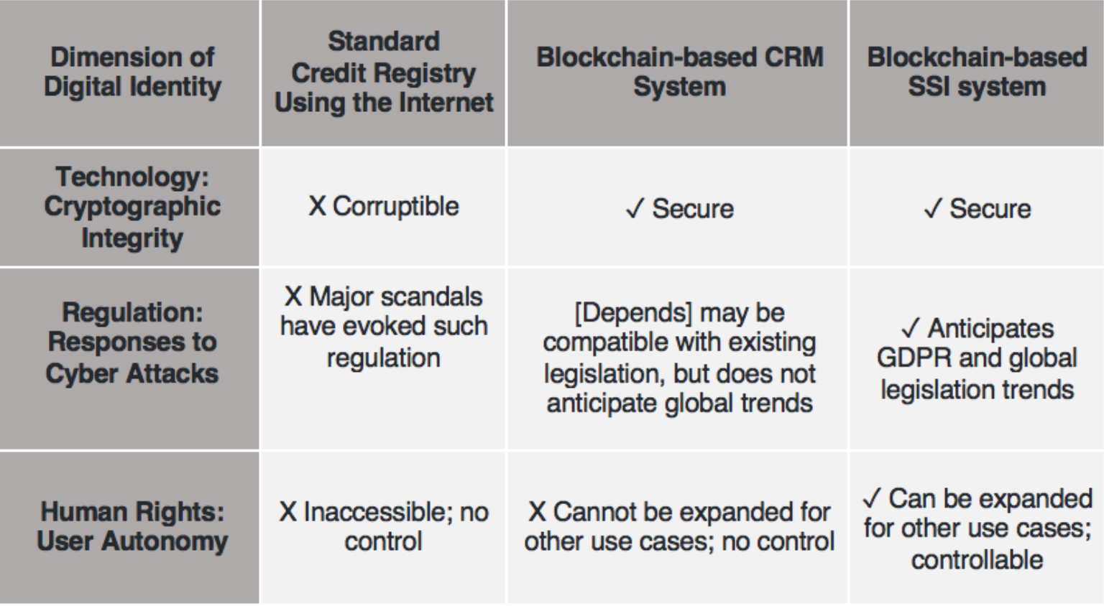
Why Blockchain-based SSI

