Slide 1

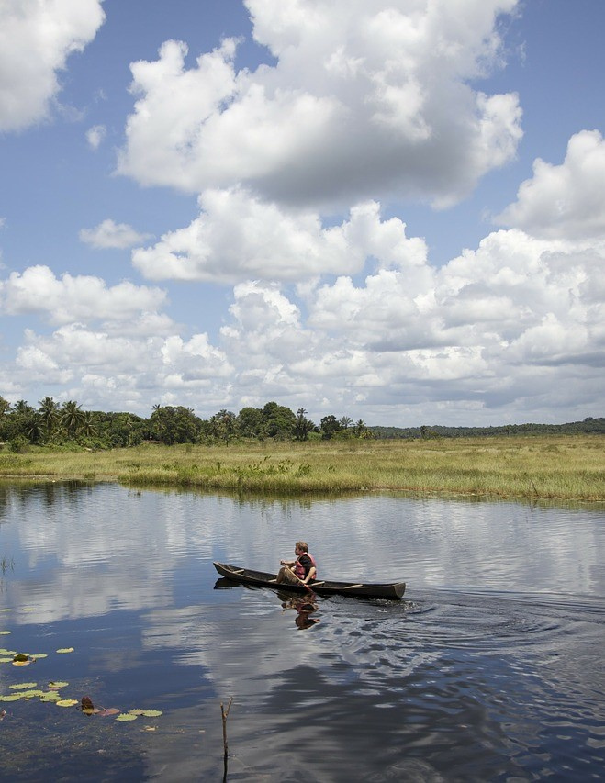


Tourism Product
Development
Playbook

Slide 2





This playbook has been developed by Target Euro as part of the Compete Caribbean Consultancy to Develop Tourism Products & Proposing a Governance Model with the help of the Guyana Tourism Authority and the Tourism & Hospitality Association of Guyana.
Target Euro
Compete Caribbean
Guyana Tourism Authority
Tourism & Hospitality Association of Guyana

Slide 3

INTRODUCTION
This playbook is a step-by-step guide to product development across Guyana. It is based on a market demand-driven approach combined with the valorisation of existing and potential tourism businesses and attractions.
The objective is to develop a product that exceeds market expectations through compliance with tourism and hospitality industry standards, resulting in tourism products that are market ready.

Slide 4
WHAT IS A TOURISM PRODUCT?
The United Nations World Tourism Organisation (UNWTO) defines a Tourism Product as "a combination of tangible and intangible elements, such as natural, cultural and man-made resources, attractions, facilities, services and activities around a specific centre of interest”. Some examples of Tourism products are Cultural tourism, Gastronomy and Wine tourism, Sun&Beach tourism, etc.
For more information see: https://www.unwto.org/tourism-development-products#:~:text=As%20defined%20by%20UNWTO%2C%20a,and%20creates%20an%20overall%20visitor

Slide 5













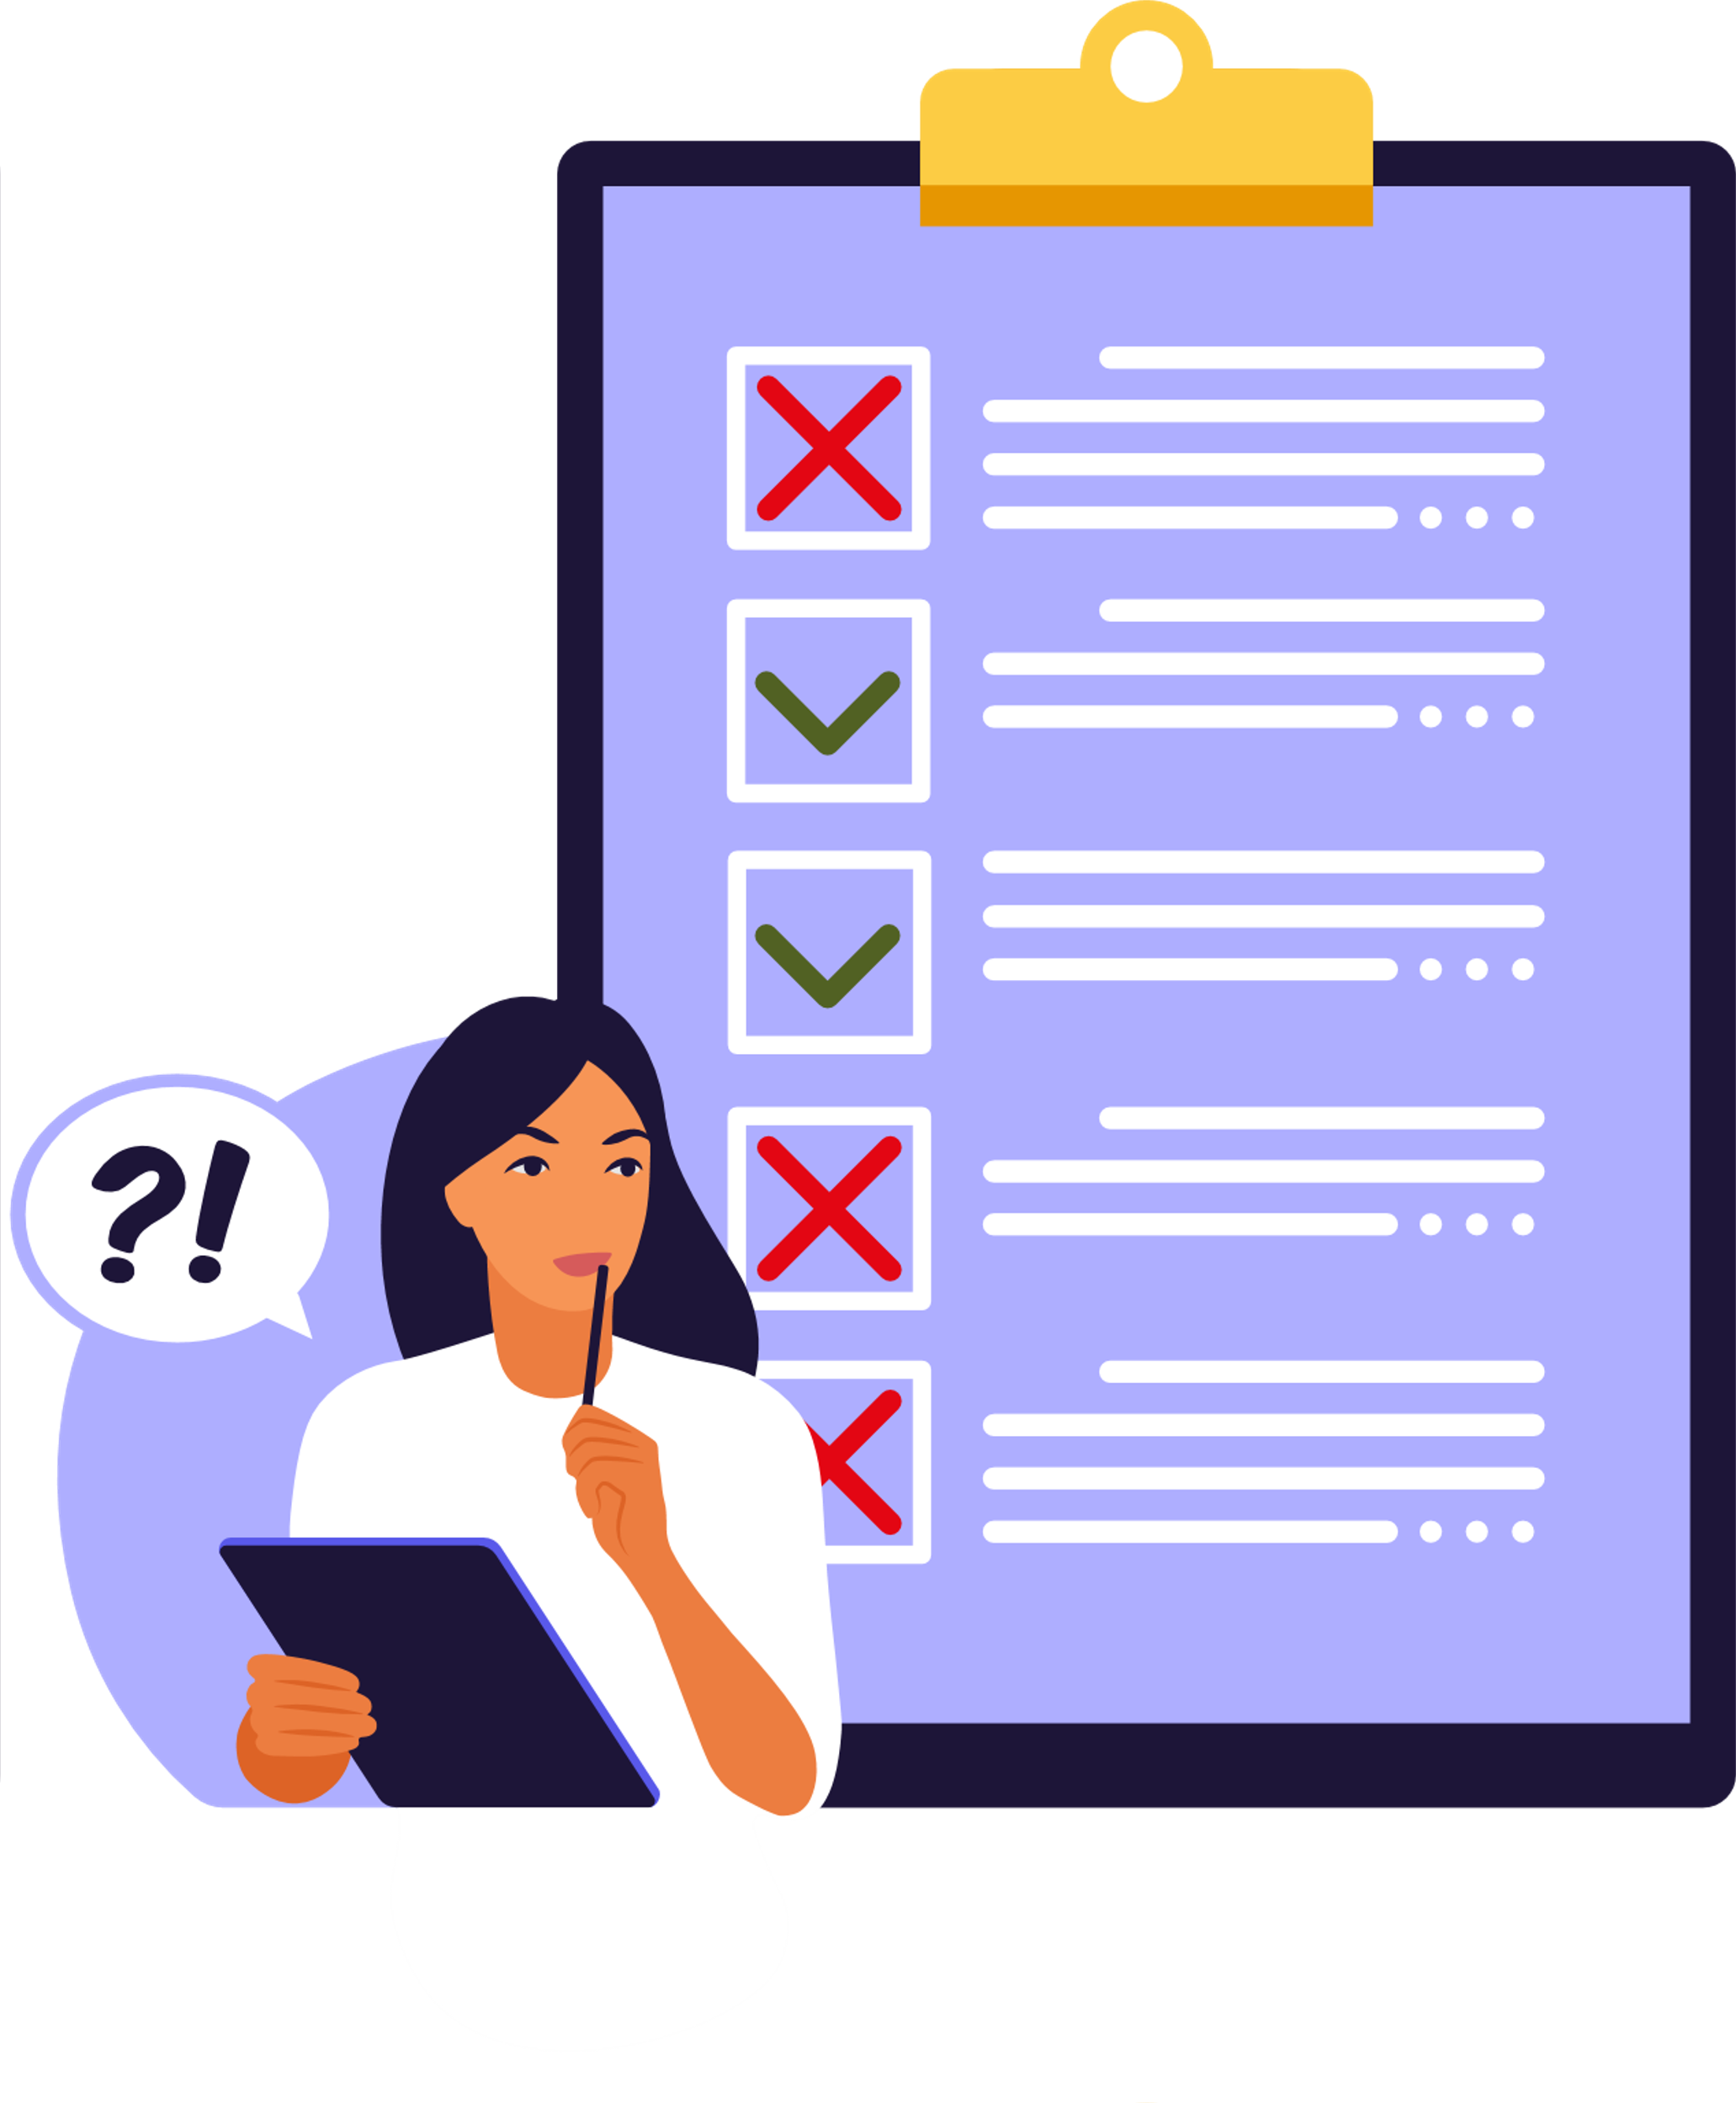



PHASE 1
IDENTIFYING POTENTIAL
ROAD MAP
STEP 1: Inventory of Tourism Assets
STEP 2: Conduct Market Research
STEP 3: Stakeholder Roles
PHASE 2
MARKET REDINESS ASSESSMENT
PHASE 3
BUILDING A TOURISM PRODUCT
STEP 4: Quality Assessment & Gap Analysis
STEP 5: Define Product Concept
STEP 6: Public Polices & Investment Plans
STEP 7: Cooperation with Local Suppliers
STEP 8: Quality Human & Technical Resources
STEP 9: Create a Detailed Itinerary
STEP 10: Determine a Pricing Strategy
STEP 11: Create a Range of Tour Packages
STEP 12: Create a Marketing Plan
PHASE 4
PRODUCT LAUNCH
STEP 13: Launch your Product
STEP 14: Provide Excellent Customer Service
PHASE 5
FINE TUNING & UPSCALING
STEP 15: Continuously Monitor & Improve

Slide 6
PHASE 1
IDENTIFYING POTENTIAL

Slide 7


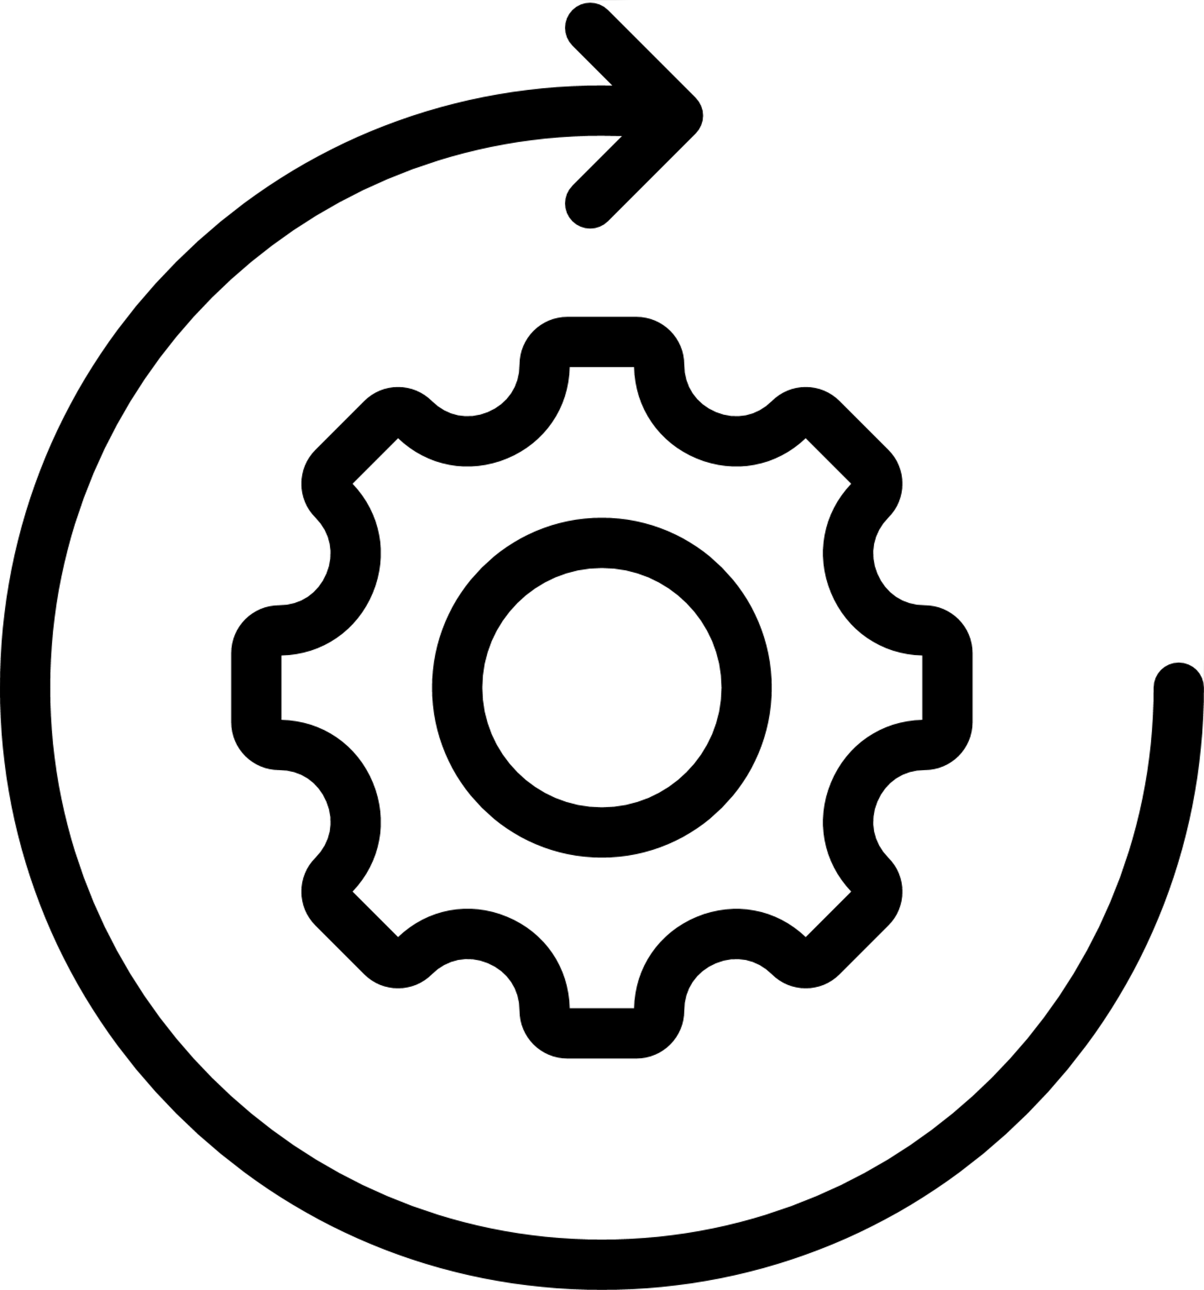
STEP 1:
PHASE 1
IDENTIFYING POTENTIAL
Develop a detailed inventory of all tourism assets in your destination *
OBJECTIVE
Baseline information is the foundation of the development of tourism products. This involves mapping tourism assets, conducting market research, understanding the role of stakeholders, and determining the potential for developing tourism products and experiences. Additionally, identifying the target markets, understanding the needs and preferences of tourists, and past market data is a helpful activity.
STEP 2:
Conduct market research to learn who is visiting your destination
STEP 3:
Identify stakeholder roles and responsibilites
*see CTO Tourism Asset Inventory format http://ourtourism.onecaribbean.org/wp-content/uploads/2019/11/Tourism-Asset-Inventory-Oct-15-2019-v1.xlsx

Slide 8
STEP 1:
INVENTORY OF TOURISM ASSETS
The process involves identifying and assessing key attractions, experiences, services, facilities, infrastructures, and resources that can be used to create tourism products and experiences. The inventory can be created using the 6 A’s of Tourism Products.
1
Attractions
4
Amenities
2
Activities
5
Accessibility
3
Accommodation
6
Ancillary Services

Slide 9







HOW TO DEVELOP A TOURISM INVENTORY
Tick the boxes as you complete the list
Identify all key Tourist Attractions that can attract visitors to your destination
Map all the Tourism Activities and Experiences that tourists can do
Assess all Tourism Facilities, Amenities and Services that tourists can use
Analyse all the Resources that your product will need to be successful
Identify Complementary Services and Infrastructure that can be included in your product

Slide 10
EXAMPLES OF TOURIST ATTRACTIONS
Tourist Attractions can be any place, business, event, or site that attracts tourists to your destination. They can be natural or man-made.
1
2
3
4
Events & Festivals
Cultural Heritage Attractions
Nature & Wildlife Attractions
General Tourist
Attractions
  Carnival
  Food festival
  Agricultural event
  Community fair
  Music festival / concert
  Religious festival
  Sporting event
  Artisans
  Archaeological site
  Art Gallery
  Historical Building
  Castle or fortress
  Church or temple
  Indigenous village
  Beach
  Bird watching site
  Botanical Park
  Fishing spot
  National Park
  Mangroves
  Lakes
  Waterfall
  Amusement Park
  Casino
  Cinema
  Aquarium
  Stadium
  Thermal Spa
  Zoo
  Theatre

Slide 11
EXAMPLES OF TOURISM ACTIVITIES AND EXPERIENCES
Activities and experiences are things tourists can do during their visit. To best fit the Guyana offer we have divided these activities into 3 groups: Cultural Heritage experiences, Water-based adventure, and Land-based adventure.
1
2
3
Cultural Heritage Experiences
Water based Adventure
Land based Adventure
  Cooking class
  Dance performance
  Traditional medicine
  Traditional music
  Tour of an indigenous community
  Handicraft workshop
  Farm tours
  Boating
  Canoeing / Kayaking
  SUP
  Snorkelling
  Fishing
  Kite surfing
  Jet skiing
  Swimming
  Cycling
  Jungle trek
  Hot air balloon tour
  Wildlife watching
  Bird watching
  Horseback riding
  Canopy walkway
  Rappelling

Slide 12
1
EXAMPLES OF ANCILLARY
SERVICES & ACCOMMODATION
Accommodation
  Hotel
  Apartment rentals
  Camping / Glamping
  Resort
  Caravan / Motor home
  Bed & Breakfast
  Homestay
This includes a range of services and facilities that are key components in a tourist's stay.
2
3
4
5
Food & Beverage
Shops
Transportation
Tourism Professionals
  Restaurants
  Bars
  Coffee Shop / Café
  Food Truck
  Food stall
  Fast food restaurant
  Home restaurant
  Supermarket / Food stores
  Clothes stores
  Souvenir store
  Craft centre
  Artisan store
  Market
  Pop-up store
  Car rental
  Airport shuttle
  Boat charter
  Public transport
  Bike /Scooter rental
  Taxi services
  Private airline/ Helicopter rental
  Tour guides
  Tour operator
  DMC (Destination Management Company)
  Travel Agent
  Adventure guide
  Event planner

Slide 13
EXAMPLES OF TOURISM RESOURCES
Tourism resources includes the local workforce, local industries, and natural environment. This can help to establish partnerships and identify opportunities to collaborate with local businesses.
1
2
3
Local Workforce
Local Industries
Natural Environment
  Assessing skills and experience
  Assessing language proficiency and communication skills
  Identifying potential gaps in the workforce, such as a shortage of skilled chefs, tour guides etc
  Turnover rates and job satisfaction levels within the local tourism industry
  Range and quality of local businesses and industries
  Potential for collaboration and partnership
  Availability of locally produced goods and services
  Strengths and weaknesses of local businesses
  Potential for diversifying the local economy
  Climate and natural attractions
  Potential for nature-based tourism activities.
  Environmental risks
  Accessibility to natural attractions
  Potential for ecotourism to contribute to conservation efforts or support local communities.

Slide 14
EXAMPLES OF COMPLEMENTARY SERVICES AND AMENITIES
1
2
Accessibility
Information
  Roads, Airports, Ports.
  Visa policies.
  Access for people with mobility issues – ramps, elevators etc.
  Visitor Centres/ info points
  Maps and Guides
  Signage
These are services and amenities that may not be directly part of the tourism offer but provide additional services to visitors.
3
4
5
6
Communication
Health & Safety
Financial Services
Urban &
Environment
  Internet connection
  Cell phone coverage
  Internet / Cell phone shops
  Travel insurance providers
  Emergency services: police, ambulances etc
  Hospitals / Medical centres
  Credit card payments
  Banks / ATMs
  Currency exchange / Money transfer
  Drainage and sewage systems
  Waste management and recycling
  Green energy

Slide 15
Once you have analysed and assessed the 6 A’s, then you can create a rough list of potential tourism products that you can develop based on what is available in your destination.

Slide 16
STEP 2:
CONDUCT MARKET RESEARCH
Market Research involves identifying target markets, understanding their needs and interests, and researching the destination's competition. Through market research, you can gain valuable insights into the demand for your product, the competition, and the current trends in the industry.
To conduct effective market research, it's essential to identify the target markets for each product. This involves determining the characteristics of the ideal customer, including their age, gender, interests, and spending capacity.

Slide 17
HOW TO DO EFFECTIVE MARKET RESEARCH
Tick the boxes as you complete the list
Identify the target market for each product, their needs and interests: age, gender, travel preferences
Research the competition to understand their products, pricing strategies, and marketing tactics
Gather data on tourism trends by observing first hand or ask for data from trusted sources like the GTA or THAG.
Use the insights gained to refine each product concept

Slide 18
STEP 3:
STAKEHOLDER ROLES
Tourism product development is the result of the collaboration of various stakeholders. It involves identifying all the stakeholders in the private and public sectors, DMOs, tourism and allied businesses, and their respective roles in creating or developing a part of a tourism product.

Slide 19
HOW TO CARRY OUT AN EFFECTIVE STAKEHOLDER ANALYSIS
Tick the boxes as you complete the list
Identify stakeholders and understand their roles
Engage local communities
Conduct meeting with stakeholde to discuss roles, expectations, issues and input in tourism products
Create a project plan that outlines vision and action plan

Slide 20
HOW TO CARRY OUT AN EFFECTIVE STAKEHOLDER ANALYSIS
Foster collaboration and develop partnerships
Address any areas of conflict
Getting feedback from your customers is a key step. This can be done through a short survey
Encourage environmental, social, and economic sustainability

Slide 21
Now that you have carried out steps 1, 2 and 3 you can draft a long list of current and potential tourism products

Slide 22

PHASE 1 FINAL CHECKLIST
Develop a detailed inventory of all tourism assets in your destination using the CTO Tourism Asset Inventory and the six A’s of Tourism products
Conduct market research to better understand who is interested in your potential products and how to attract them to your destination
Identify stakeholder roles – who can be involved in product development and how they can participate

Slide 23
PHASE 2
MARKET
READINESS ASSESSMENT

Slide 24
PHASE 1
IDENTIFYING POTENTIAL
ROAD MAP
STEP 1: Inventory of Tourism Assets
STEP 2: Conduct Market Research
STEP 3: Stakeholder Roles
PHASE 2
MARKET REDINESS ASSESSMENT
PHASE 3
BUILDING A TOURISM PRODUCT
STEP 4: Quality Assessment & Gap Analysis
STEP 5: Define Product Concept
STEP 6: Public Polices & Investment Plans
STEP 7: Cooperation with Local Suppliers
STEP 8: Quality Human & Technical Resources
STEP 9: Create a Detailed Itinerary
STEP 10: Determine a Pricing Strategy
STEP 11: Create a Range of Tour Packages
STEP 12: Create a Marketing Plan
PHASE 4
PRODUCT LAUNCH
STEP 13: Launch your Product
STEP 14: Provide Excellent Customer Service
PHASE 5
FINE TUNING & UPSCALING
STEP 15: Continuously Monitor & Improve

Slide 25



PHASE 2
MARKET READINESS ASSESSMENT
STEP 4:
Carry out a quality assessment and gap analysis of the identifed products
OBJECTIVE
PHASE 2 is focused on assessing the quality and potential of each identified tourism product. Through this process, you can then draft a final tourism product portfolio based on the level of market readiness and criteria for prioritisation and timing.
STEP 5:
Define a product concept that captures the essence of your product
STEP 6:
Identify what public polices and investment plans are needed

Slide 26


STEP 4:
QUALITY ASSESSMENT AND GAP ANALYSIS
This is a step up from the tourism inventory and relates to each specific tourism product. This activity is important to evaluate the product’s quality level.
1-3 = Very poor - significant deficiencies which require urgent attention
4-5 = Poor - some deficiencies which may discourage visitors and require improvement
6-7 = Average - meets the minimum requirements but may not stand out from other assets
8-9 = Good - exceeds the minimum requirements and provides a high-quality experience
10 = Excellent - exceeds expectations and visitors are highly satisfied

Slide 27
EXAMPLES OF QUALITY ASSESSMENT PARAMETERS
1
Ease of access, including transportation and infrastructure
6
Educational value, including its cultural, historical, or environmental significance
2
Attractiveness and proximity to other attractions
7
Quality of customer service provided by staff and the availability of information and assistance
3
Cleanliness and maintenance, including facilities and surrounding areas
8
Value for money, including the price of admission, activities, and services
4
Visitor safety and security level
9
Sustainability, including impact on the environment and local communities
5
Overall visitor experience, including the quality of facilities, activities, and services.

Slide 28
STEP 5:
DEFINE PRODUCT CONCEPT
A product concept captures the essence of a tourism product and communicates its unique selling points and value proposition to the target market. A product concept should be developed in alignment with the destination's tourism strategy and vision.

Slide 29


HOW TO DEFINE A PRODUCT CONCEPT
Tick the boxes as you complete the list
Give your product a catchy, simple, and memorable name and an exciting theme
The product description should be clear, concise and compelling. It must highlight unique selling points and communicate value to the target market
Identify key feature and benefits, such as, location, activities or cultural or historical significance, such as a legend or interesting story
Identify your target market based on market research and stakeholder input

Slide 30
HOW TO DEFINE A PRODUCT CONCEPT
Identify competitive advantages, such as, unique features, quality or pricing. Offer something no one else does to give visitors a 'wow' moment.
Identify a competitive pricing strategy that is aligned with
the product's value
Identify main distribution channels where your target market shops such as, travel agencies or online platforms
Identify a marketing approach developed based on market research and stakeholder input

Slide 31
STEP 6:
PUBLIC POLICIES & INVESTMENT PLANS
The Public Policies & Investment Plan provides a roadmap for government agencies and private investors to invest in the development of tourism products and infrastructure.
They should prioritise the greatest needs and opportunities, based on market research, stakeholder input, and the destination's strategy and vision. It should also include a timeline and budget for the implementation of the various initiatives and activities. Consult with the GTA, THAG and other agencies to find out what is happening

Slide 32
KEY AREAS FOR PUBLIC POLICIES AND INVESTMENT PLANS
1
Infrastructure
4
Capacity Building and Training
2
Regulations and Licensing
5
Funding and Investment
3
Marketing and promotion

Slide 33
Based on steps 4, 5, and 6 you can now draft a final tourism product portfolio

Slide 34

PHASE 2 FINAL CHECKLIST
Carry out a quality assessment and gap analysis of your identifed products
Define a product concept that captures the essence of your product and appeals to your identified market
Identify what public polices and investments are needed to help develop your product

Slide 35
PHASE 3
BUILDING A TOURISM PRODUCT

Slide 36
PHASE 1
IDENTIFYING POTENTIAL
ROAD MAP
STEP 1: Inventory of Tourism Assets
STEP 2: Conduct Market Research
STEP 3: Stakeholder Roles
PHASE 2
MARKET REDINESS ASSESSMENT
PHASE 3
BUILDING A TOURISM PRODUCT
STEP 4: Quality Assessment & Gap Analysis
STEP 5: Define Product Concept
STEP 6: Public Polices & Investment Plans
STEP 7: Cooperation with Local Suppliers
STEP 8: Quality Human & Technical Resources
STEP 9: Create a Detailed Itinerary
STEP 10: Determine a Pricing Strategy
STEP 11: Create a Range of Tour Packages
STEP 12: Create a Marketing Plan
PHASE 4
PRODUCT LAUNCH
STEP 13: Launch your Product
STEP 14: Provide Excellent Customer Service
PHASE 5
FINE TUNING & UPSCALING
STEP 15: Continuously Monitor & Improve

Slide 37



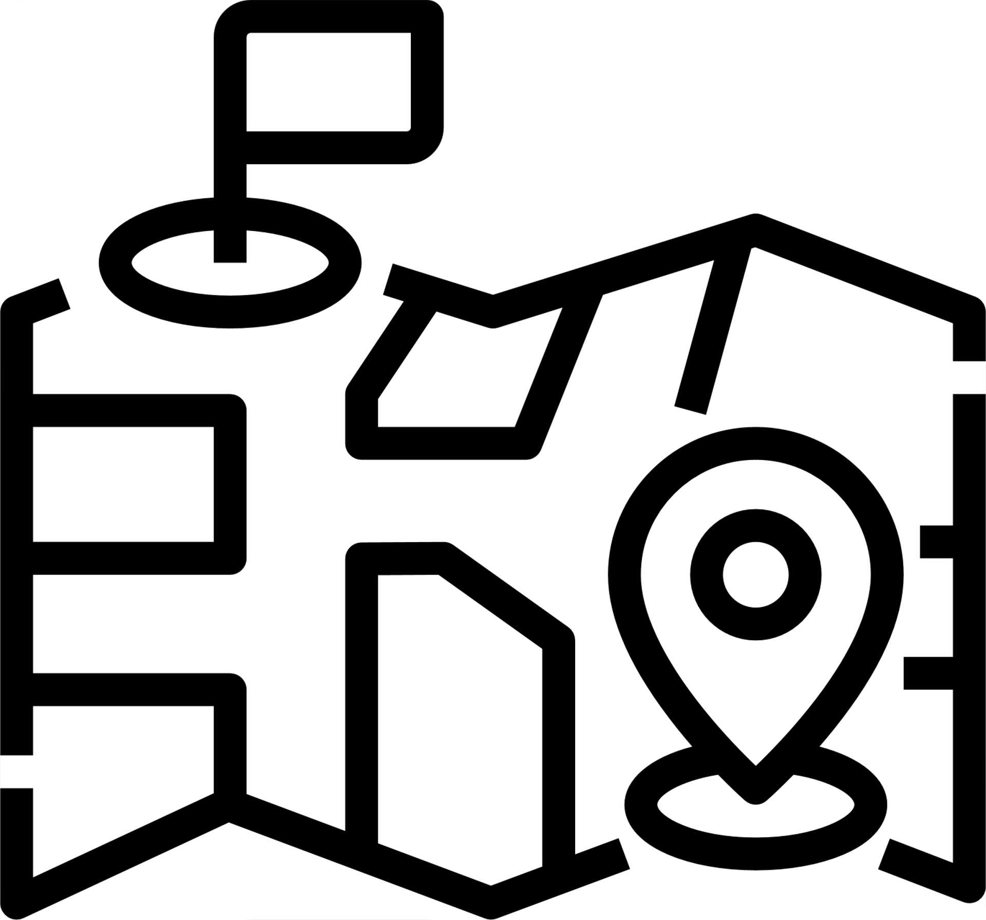

PHASE 3
BUILDING A TOURISM PRODUCT
STEP 7:
STEP 8:
OBJECTIVE
Cooperation with local suppliers is key to sustain the local economy
Quality human and technical resources will help improve the quality of your product
PHASE 3 involves creating a detailed itinerary for each product, matching the product with the market through the outline of tour packages, determining the cost and pricing strategy, establishing partnerships with local suppliers, developing a marketing plan, and providing human and technical resources.
STEP 9:
STEP 10:
Create a detailed itinerary covering multiple days
Determine a realtistic and competivite pricing strategy
STEP 11:
STEP 12:
Use parts of your intineray to develop various tour packages
Create a marketing plan that refelcts the best of your product and attracts your target market

Slide 38
STEP 7:
COOPERATION WITH LOCAL SUPPLIERS
By working closely with local suppliers, you can create a high-quality tourism product that meets the needs and expectations of your customers while supporting the local economy and community. Local suppliers can offer a wealth of knowledge, resources, and expertise

Slide 39
EXAMPLES FOR DEVELOPING A SUCCESSFUL WORKING RELATIONSHIP WITH LOCAL SUPPLIERS
Set clear expectations and guidelines for working with your local suppliers, including quality standards, pricing, and payment terms
Provide constructive feedback on the quality of their services
Take the time to get to know your local suppliers and build relationships
Keep your local suppliers informed about your tourism product plans, target market, and pricing strategy
Work with local suppliers to develop new products and experiences that showcase the destination
1
4
2
5
3

Slide 40
STEP 8:
QUALITY HUMAN & TECHNICAL RESOURCES
By providing skilled staff and contemporary technology you can improve the efficiency and effectiveness of tourism-related operations in your destination, leading to a positive customer experience.

Slide 41

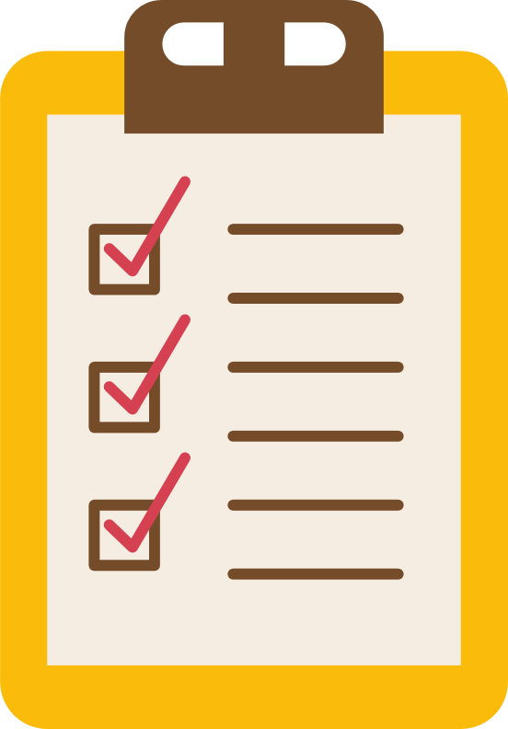
HOW TO ENSURE SKILLED RESOURCES
Tick the boxes as you complete the list
Hire staff who know the destination and have excellent customer service skills
Provide regular training on the tourism product, customer service and communication skills
Invest in technology that can help streamline operations and improve customer experience
Ensure all tourism-related operations are handled effectively, including transportation, accommodation, activities, etc
Provide clear communication channels for staff such as cell phone, messaging apps etc

Slide 42
STEP 9:
CREATE A DETAILED ITINERARY
A detailed itinerary is a plan that outlines the activities, accommodations, transportation, and other services that will be included in your tourism product. It provides a clear roadmap for your customers, allowing them to understand what they will be doing and where they will be going during their trip.

Slide 43
HOW TO DEVELOP AN ITINERARY
Tick the boxes as you complete the list
Activities like sightseeing, adventure or cultural experiences. Include the duration of each activity and any necessary logistics such as transportation or equipment
Transportation such as jeep, bus or plane. Include information on the departure and arrival times
Meals including the number of meals (per day) the type of food
Allow for free time in the itinerary to give customers the opportunity to explore on their own and provide recommendations
Accommodations such as hotels or campsites. Provide details on the type of room, amenities, and services included

Slide 44
HOW CAN I MAKE SURE MY ITINERARY IS
WELL-BALANCED?
When designing your itinerary, it's important to consider the preferences and interests of your target market.
By including a variety of activities and experiences in your itinerary, you can appeal to a wider range of customers and make sure that everyone has a memorable and enjoyable experience.

Slide 45
STEP 10:
DETERMINE A PRICING STRATEGY
Determine the cost of developing and operating your tourism product, including marketing expenses. Based on your costs, competition, and demand, set a pricing strategy that will cover your expenses and generate a profit.

Slide 46
HOW TO DEVELOP A PRICING STRATEGY
Tick the boxes as you complete the list
Consider the spending capacity and expectations of your target market
Analyse the pricing provided by your competition to make sure your prices are competitive
Determine your profit margin
Determine a range of realistic costs

Slide 47
HOW TO DEVELOP A PRICING STRATEGY
Choose a pricing strategy: This could include cost-plus pricing, value-based pricing, or dynamic pricing
Diversify your pricing strategy by offering the product at different price points and measuring customer response
Monitor and adjust pricing if necessary

Slide 48
STEP 11:
CREATE A RANGE OF TOUR PACKAGES
The itinerary that you have developed can developed into a range of day tours, weekend breaks, weeklong packages etc. You can create a range of tour packages that meet the price range and needs of your identified markets.

Slide 49
HOW TO DEVELOP A TOUR PACKAGE
Tick the boxes as you complete the list
Identify your main markets: spending, age, groups size and interests
Develop a range of tours and packages that meet their
specific needs
Be realistic with pricing and times, don’t bite off more than you can chew!
Test your product with a small group of target market customers, this is key to developing a successful product
Get detailed test customer feed back, this is key for adjusting your tour packages accordingly and increasing success

Slide 50
STEP 12:
DEVELOP A MARKETING PLAN
Tailoring your marketing plan to different demographics involves understanding the unique needs, interests, and behaviours of each group.

Slide 51

HOW TO DEVELOP A MARKETING PLAN
Tick the boxes as you complete the list
Define your target audience
Conduct market research
Use language and imagery that resonate
Offer personalised experiences and promotions
Use targeted advertising and partner with influencers
Monitor and adjust as needed

Slide 52
EXAMPLES OF MARKETING CHANNELS
1
Social media platforms such as Facebook, Instagram, and Twitter
Creating high-quality content such as blog posts, videos, and infographics
Email newsletters, promotional offers, and personalized messages
Search engine marketing (SEM) using paid search ads to appear at the top of search engine results pages using Google AdWords or other platforms
5
Partnering with travel agencies can help you reach customers who book through this traditional method
Attending trade shows and events to networking with industry professionals
Encouraging satisfied customers to refer their friends and family. You can offer incentives such as discounts or freebies to customers who refer new customers
2
6
3
7
4

Slide 53



PHASE 3 FINAL CHECKLIST
Cooperate with local suppliers for goods and services
Determine a realtistic and
competivite pricing strategy
Employ excellent and well trained human and technical resources
Use parts of your intineray to
develop various tour packages
Create a marketing plan that
refelcts the best of your
product and attracts your
target market
Create a detailed itinerary covering multiple days

Slide 54

PHASE 4
PRODUCT
LAUNCH

Slide 55
PHASE 1
IDENTIFYING POTENTIAL
ROAD MAP
STEP 1: Inventory of Tourism Assets
STEP 2: Conduct Market Research
STEP 3: Stakeholder Roles
PHASE 2
MARKET REDINESS ASSESSMENT
PHASE 3
BUILDING A TOURISM PRODUCT
STEP 4: Quality Assessment & Gap Analysis
STEP 5: Define Product Concept
STEP 6: Public Polices & Investment Plans
STEP 7: Cooperation with Local Suppliers
STEP 8: Quality Human & Technical Resources
STEP 9: Create a Detailed Itinerary
STEP 10: Determine a Pricing Strategy
STEP 11: Create a Range of Tour Packages
STEP 12: Create a Marketing Plan
PHASE 4
PRODUCT LAUNCH
STEP 13: Launch your Product
STEP 14: Provide Excellent Customer Service
PHASE 5
FINE TUNING & UPSCALING
STEP 15: Continuously Monitor & Improve

Slide 56


PHASE 4
PRODUCT LAUNCH
STEP 13:
Launch your product using the PRE-identified national and international marketing channels
OBJECTIVE
Once you have completed all the steps above, you can launch your product. It's essential to monitor the performance of your product, collect feedback from customers, and make necessary adjustments to improve it.
STEP 14:
Provide excellent customer service, this will help your product's reputation and online rating

Slide 57
STEP 13:
LAUNCH YOUR PROJECT
Your new product deserves a product launch in both the national and international press. The marketing used should include language and imagery that resonates with your target audiences and you should market through the key channels identifed in your marketing plan.

Slide 58


HOW TO LAUNCH YOUR PRODUCT
Tick the boxes as you complete the list
Launch the product through targeted marketing campaigns, including social media, email marketing, and influencer marketing
Use data analytics to monitor customer behaviour, website traffic, engagement rates, and bookings
Monitor customer satisfaction by collecting feedback through surveys, reviews, and direct communication
Address any issues promptly, including customer complaints or concerns
Continuously evaluate the performance of the product and make necessary improvements based on customer feedback and market trends

Slide 59
STEP 14:
PROVIDE EXCELLENT CUSTOMER SERVICE
By providing excellent customer service, you can ensure that customers have a positive experience and are more likely to leave positive reviews, recommend your product to others, and return for future bookings. It's important to prioritise customer service throughout the product's lifecycle and to continuously evaluate and improve the customer experience.
·

Slide 60
HOW TO PROVIDE EXCELLENT CUSTOMER SERVICE
Tick the boxes as you complete the list
Provide clear communications
Personalisation and tailored promotions
Listen attentively and respond politely to all customer complaints promptly and efficiently, while maintaining a positive attitude
Pay attention to the small details, such as providing high-quality amenities, ensuring that transportation is on time
Continuously evaluate and improve the customer service experience based on customer feedback and market trends

Slide 61

PHASE 4 FINAL CHECKLIST
Launch your product with a bang, using the identified national and international marketing channels that best reach your target audience
Provide excellent customer service to all your customers from initial enquires until after they leave your destination

Slide 62
PHASE 5
FINE TUNING
& UPSCALING

Slide 63
PHASE 1
IDENTIFYING POTENTIAL
ROAD MAP
STEP 1: Inventory of Tourism Assets
STEP 2: Conduct Market Research
STEP 3: Stakeholder Roles
PHASE 2
MARKET REDINESS ASSESSMENT
PHASE 3
BUILDING A TOURISM PRODUCT
STEP 4: Quality Assessment & Gap Analysis
STEP 5: Define Product Concept
STEP 6: Public Polices & Investment Plans
STEP 7: Cooperation with Local Suppliers
STEP 8: Quality Human & Technical Resources
STEP 9: Create a Detailed Itinerary
STEP 10: Determine a Pricing Strategy
STEP 11: Create a Range of Tour Packages
STEP 12: Create a Marketing Plan
PHASE 4
PRODUCT LAUNCH
STEP 13: Launch your Product
STEP 14: Provide Excellent Customer Service
PHASE 5
FINE TUNING & UPSCALING
STEP 15: Continuously Monitor & Improve

Slide 64

PHASE 5
FINE TUNING & UPSCALING
OBJECTIVE
This phase is the culmination of the tourism product development process. It involves assessing the performance of the product and adjusting as needed. Additionally, staying informed of the latest trends and customer feedback is essential to ensure that the product remains competitive.
STEP 15:
Continuously monitor and improve your product by speaking with tourists and checking online reviews, etc.

Slide 65

STEP 15:
CONTINUOUSLY MONITOR & IMPROVE
By continuously evaluating and improving your product, you can stay competitive and ensure that your product meets the needs and preferences of your target market. It's important to gather feedback from customers, monitor market trends, analyse performance data, implement changes, and monitor the impact of changes to ensure that your product remains relevant and successful over time.
PHASE 5 FINAL CHECKLIST
Continuously monitor and improve your product by speaking with your visitors and checking online reviews

Slide 66

COMMON MISTAKES TO AVOID

Slide 67




Lack of market research: Failing to conduct thorough market research and segmentation can lead to a product that doesn't align with the needs and interests of your target market. It's important to understand your target market's preferences, behaviour, and purchasing habits before designing your product.
Overpricing or under-pricing: Setting the wrong price can be a major mistake. Overpricing your product can deter potential customers, while under-pricing can lead to financial losses. It's important to consider your costs, competition, and demand when setting your pricing strategy.
Poor itinerary planning: Not planning your itinerary thoroughly can result in a product that doesn't meet customer expectations. It's important to consider the duration of the product, the number of activities, and the logistics involved in each activity.

Slide 68



Neglecting quality assurance: Failing to ensure the quality of your product can lead to negative reviews and poor customer satisfaction. It's important to work with reliable suppliers, monitor the performance of your product, and collect feedback from customers.
Ineffective marketing: Poor marketing can lead to low customer awareness and poor sales. It's important to have a well-defined marketing plan that includes a mix of online and offline channels, as well as a clear message and value proposition.
Lack of customer service: Neglecting customer service can result in poor customer satisfaction and negative reviews. It's important to provide excellent customer service, including clear communication, prompt response times, and efficient problem-solving.

